Slide 1
Elementary Statistics 3E
William Navidi and Barry Monk

Slide 2
Sampling
Section 1.1

Slide 3
Objectives
Construct a simple random sample
Determine when samples of convenience are acceptable
Describe stratified sampling, cluster sampling, systematic sampling, and voluntary response sampling
Distinguish between statistics and parameters

Slide 4
Objective 1
Construct a simple random sample

Slide 5
Terminology
Statistics is the study of procedures for collecting, describing, and drawing conclusions from information.
A population is the entire collection of individuals about which information is sought.
A sample is a subset of a population, containing the individuals that are actually observed.

Slide 6
Simple Random Sample
A simple random sample of size $n$ is a sample chosen by a method in which each collection of $n$ population items is equally likely to make up the sample.
A simple random sample is analogous to a lottery. Suppose that 10,000 lottery tickets are sold and 5 are drawn as the winning tickets. Each collection of 5 tickets that can be formed is equally likely to comprise the group of 5 that is drawn.

Slide 7
Example 1: Simple Random Sample
A physical education professor wants to study the physical fitness levels of 20,000 students enrolled at her university. She obtains a list of all 20,000 students, numbered from 1 to 20,000 and uses a computer random number generator to generate 100 random integers between 1 and 20,000, then invites the 100 students corresponding to those numbers to participate in the study. Is this a simple random sample?
Solution: Yes, this is a simple random sample since any group of 100 students would have been equally likely to have been chosen.

Slide 8
Example 2: Simple Random Sample
The professor in the last example now wants to draw a sample of 50 students to fill out a questionnaire about which sports they play. The professor’s 10:00 am class has 50 students. She uses the first 20 minutes of class to have the students fill out the questionnaire. Is this a simple random sample?
Solution: No. A simple random sample is like a lottery, in which each student in the population has an equal chance to be part of the sample. This sample does not meet that criterion.

Slide 9
Objective 2
Determine when samples of convenience are acceptable

Slide 10
Samples of Convenience
In some cases, it is difficult or impossible to draw a sample in a truly random way. In these cases, the best one can do is to sample items by some convenient method.
A sample of convenience is a sample that is not drawn by a well-defined random method.

Slide 11
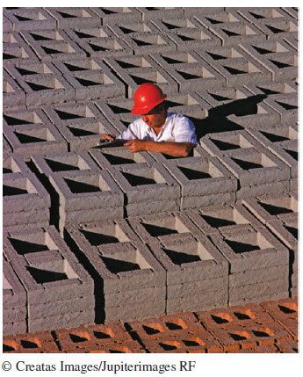
Example: Sample of Convenience
A construction engineer has just received a shipment of 1000 concrete blocks. The blocks have been delivered in a large pile. The engineer wishes to investigate the crushing strength of the blocks by measuring the strengths in a sample of 10 blocks. Explain why it might be difficult to draw a simple random sample of blocks.
Solution: To draw a simple random sample would require removing blocks from the center and bottom of the pile. One way to draw a sample of convenience would be to simply take 10 blocks off the top of the pile.

Slide 12
Problems with Samples of Convenience
The problem with samples of convenience is that they may differ systematically in some way from the population.
If it is reasonable to believe that no important systematic difference exists, then it is acceptable to treat the sample of convenience as if it were a simple random sample.

Slide 13
Objective 3
Describe stratified sampling, cluster sampling, systematic sampling, and voluntary response sampling

Slide 14
Stratified Random Sampling
In stratified random sampling, the population is divided up into groups, called strata, then a simple random sample is drawn from each stratum.
Stratified sampling is useful when the strata differ from one another, but the individuals within a stratum tend to be alike.

Slide 15
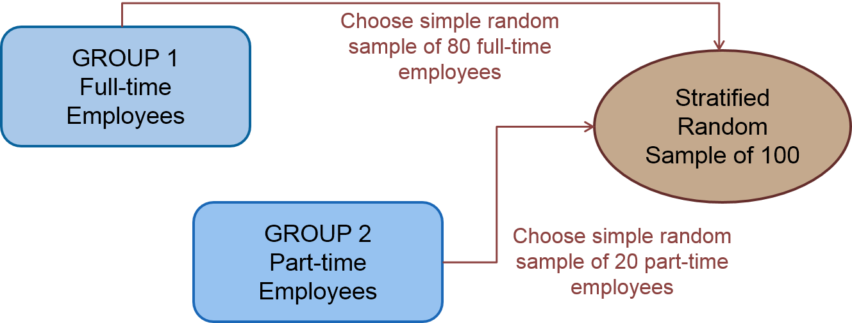
Example: Stratified Random Sampling
A company has 800 full-time and 200 part-time employees. To draw a sample of 100 employees, a simple random sample of 80 full-time employees is selected and a simple random sample of 20 part-time employees is selected.

Slide 16
Cluster Sampling
In cluster sampling, items are drawn from the population in groups, or clusters.
Cluster sampling is useful when the population is too large and spread out for simple random sampling to be feasible.

Slide 17
Example: Cluster Sampling
To estimate the unemployment rate, a government agency draws a simple random sample of households in a county. Someone visits each household and asks how many adults live in the household, and how many of them are unemployed.
What are the clusters? Why is this a cluster sample?

Slide 18
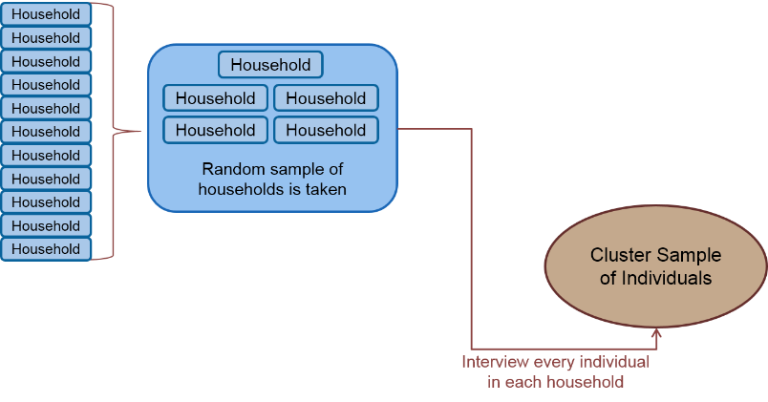
Example: Cluster Sampling (Continued)
The clusters are the groups of adults in each of the households in the county.
This is a cluster sample because a simple random sample of clusters is selected, and every individual in each selected cluster is part of the sample.

Slide 19
Systematic Sampling
In systematic sampling, items are ordered and every 𝑘th item is chosen to be included in the sample.
Systematic sampling is sometimes used to sample products as they come off an assembly line, in order to check that they meet quality standards.

Slide 20
Example: Systematic Sampling
Automobiles are coming off an assembly line. It is decided to draw a systematic sample for a detailed check of the steering system. The starting point will be the third car, then every fifth car after that will be sampled. Which cars will be sampled?

Slide 21
Example: Systematic Sampling (Continued)
Automobiles are coming off an assembly line. It is decided to draw a systematic sample for a detailed check of the steering system. The starting point will be the third car, then every fifth car after that will be sampled. Which cars will be sampled?
The sample will consist of cars numbered 3, 8, 13, 18, 23, 28, and so on.

Slide 22
Voluntary Response Sample
Voluntary response samples are often used by the media to try to engage the audience. For example, a radio announcer will invite people to call the station to say what they think.
Voluntary response samples are never reliable for the following reasons:
People who volunteer an opinion tend to have stronger opinions than is typical of the population.
People with negative opinions are often more likely to volunteer their response.

Slide 23
Objective 4
Distinguish between statistics and parameters

Slide 24
Terminology: Statistic and Parameter
A statistic is a number that describes a sample.
A parameter is a number that describes a population.
Example:
Which of the following is a statistic and which is a parameter?
57% of the teachers at Central High School are female.
The quantity 57% is a parameter, because it describes the entire population of teachers in the school.
In a sample of 100 surgery patients who were given a new pain reliever, 78% of them reported significant pain relief.
The quantity 78% is a statistic, because it describes a sample.

Slide 25
You Should Know . . .
What is Statistics
The difference between a population and a sample
What is a simple random sample
When samples of convenience are acceptable
The differences among:
Stratified sampling
Cluster sampling
Systematic sampling
Voluntary response sampling
The difference between a statistic and a parameter

Slide 26
Types of Data
Section 1.2

Slide 27
Objectives
Understand the structure of a typical data set
Distinguish between qualitative and quantitative variables
Distinguish between ordinal and nominal variables
Distinguish between discrete and continuous variables

Slide 28
Objective 1
Understand the structure of a typical data set

Slide 29
Structure of a Data Set
The values of the variables that we obtain are the data.
The characteristics of the individuals about which we collect information are called variables.
Information is collected on individuals.
The information collected is called a data set.
Data Set
Individuals
Variables
Data

Slide 30
Objective 2
Distinguish between qualitative and quantitative variables

Slide 31
Qualitative and Quantitative Variables
Variables can be divided into two types.
Qualitative Variables Classify individuals into categories
Quantitative Variables Tell how much or how many of something there is

Slide 32
Example: Qualitative and Quantitative
Which of the following variables are qualitative and which are quantitative?
A person’s age
This variable is quantitative because it tells how much time has elapsed since the person was born.
A person’s gender
This variable is qualitative because it consists of the categories “male” and “female”.
The mileage of a car
This variable is quantitative because it tells how many miles a car will go on a certain amount of gasoline.
The color of a car
This variable is qualitative because it consists of the categories of different colors.

Slide 33
Objective 3
Distinguish between ordinal and nominal variables

Slide 34
Ordinal and Nominal
Qualitative variables can be further divided into ordinal and nominal variables.
Ordinal Variables Have a natural ordering
Nominal Variables Do not have a natural ordering

Slide 35
Example: Ordinal and Nominal
Which of the following variables are ordinal and which are nominal?
State of residence
This variable is nominal because there is no natural ordering.
Gender
This variable is nominal because there is no natural ordering.
Letter grade in a class (A, B, C, D, or F)
This variable is ordinal because there is a natural ordering. For example, grades from best to worst are A, B, C, D, F.
Size of a soft drink ordered at a fast-food restaurant
This variable is ordinal because there is a natural ordering. For example, sizes may be small, medium, large, extra-large.

Slide 36
Objective 4
Distinguish between discrete and continuous variables

Slide 37
Discrete and Continuous
Quantitative variables can be further divided into discrete and continuous variables.
Discrete Variables Possible values can be listed
Continuous Variables Can take on any value in some interval

Slide 38
Example: Discrete and Continuous
Which of the following variables are discrete and which are continuous?
Age of a person at his or her last birthday
This variable is discrete because a person’s age at his or her birthday can be listed.
Height of a person
This variable is continuous because height can take on any value in an interval.
Number of siblings a person has
This variable is discrete because the number of siblings can be listed.
Distance a person commutes to work
This variable is continuous because distance can take on any value in an interval.

Slide 39
You Should Know . . .
The structure of a data set
How to distinguish between
Qualitative and quantitative variables
Ordinal and nominal variables
Discrete and continuous variables

