Slide 1
Elementary Statistics 3E
William Navidi and Barry Monk

Slide 2
Graphical Summaries for Qualitative Data
Section 2.1

Slide 3
Objectives
Construct frequency distributions for qualitative data
Construct bar graphs
Construct pie charts

Slide 4
Objective 1
Construct frequency distributions for qualitative data

Slide 5
Frequency Distribution
The frequency of a category is the number of times it occurs in the data set.
A frequency distribution is a table that presents the frequency for each category.

Slide 6
Example: Frequency Distribution
A retailer accepts four types of credit cards and lists the types used by the last 50 customers as follows.
Discover
Visa
Am. Express
Visa
MasterCard
Visa
Visa
MasterCard
MasterCard
MasterCard
Visa
Visa
MasterCard
Am. Express
Visa
Am. Express
Visa
Am. Express
Discover
Discover
Visa
Am. Express
Visa
Am. Express
Discover
Discover
Visa
Visa
MasterCard
Am. Express
Am. Express
MasterCard
Visa
MasterCard
Am. Express
Visa
Visa
MasterCard
Visa
Discover
Visa
Visa
Visa
Visa
Discover
MasterCard
MasterCard
Visa
Visa
Visa

Slide 7
Example: Frequency Distribution (Continued)
The frequency distribution presents the frequencies for each type of credit card.
Type of Credit Card | Frequency
MasterCard | 11
Visa | 23
American Express | 9
Discover | 7

Slide 8
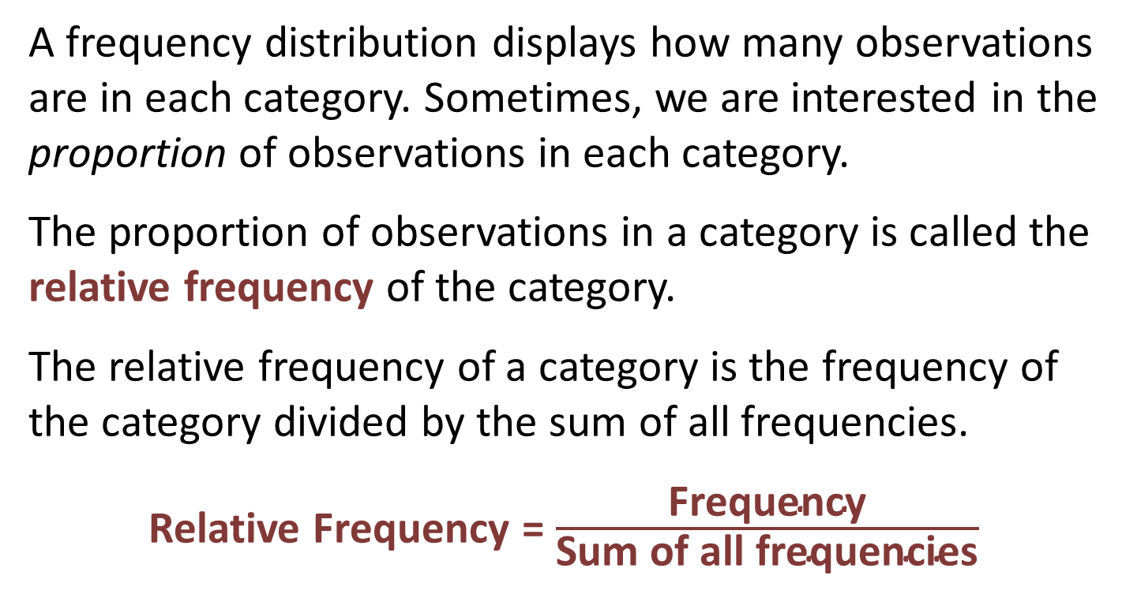
Relative Frequency
A frequency distribution displays how many observations are in each category. Sometimes, we are interested in the proportion of observations in each category.
The proportion of observations in a category is called the relative frequency of the category.
The relative frequency of a category is the frequency of the category divided by the sum of all frequencies.
Relative Frequency = $\frac{\text{Frequency}}{\text{Sum} \text{of} \text{all} \text{frequencies}}$

Slide 9
Example: Relative Frequency Distribution
To construct the relative frequency distribution for the credit card data, we begin by summing the frequencies:
11 + 23 + 9 + 7 = 50
Next, compute the relative frequency for each type of credit card.
Type of Credit Card | Frequency | Relative Frequency
MasterCard | 11 | 11/50 = 0.22
Visa | 23 | 23/50 = 0.46
American Express | 9 | 9/50 = 0.18
Discover | 7 | 7/50 = 0.14

Slide 10
Objective 2
Construct bar graphs

Slide 11
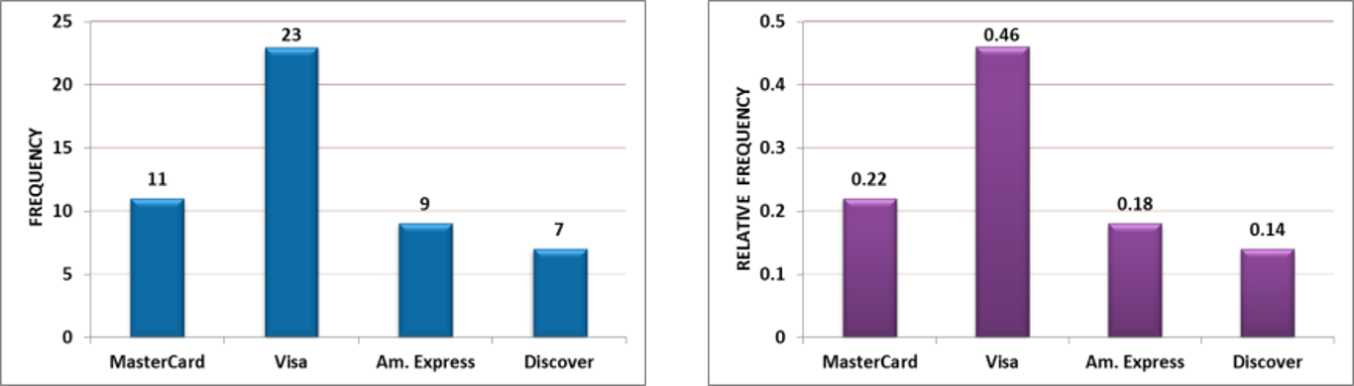
Bar Graphs
A bar graph is a graphical representation of a frequency distribution. A bar graph consists of rectangles of equal width, with one rectangle for each category. The heights of the rectangles represent the frequencies or relative frequencies of the categories.
Following are the frequency and relative frequency bar graphs for the credit card data.

Slide 12
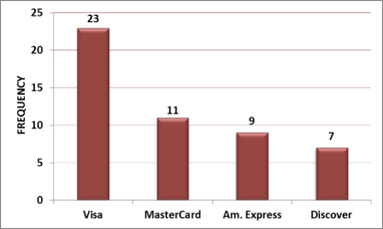
Pareto Chart
Sometimes it is desirable to construct a bar graph in which the categories are presented in order of frequency or relative frequency. Such a graph is called a Pareto chart. These charts are useful when it is important to see clearly which are the most frequently occurring categories.

Slide 13
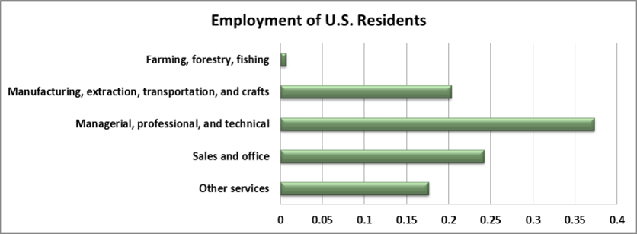
Horizontal Bars
The bars in a bar graph may be either horizontal or vertical. Horizontal bars are sometimes more convenient when the categories have long names.

Slide 14
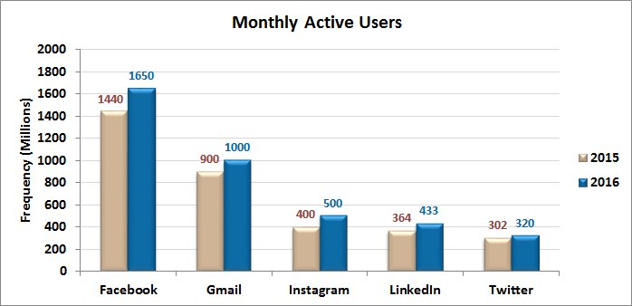
Side-by-side Bar Graphs
Sometimes we want to compare two bar graphs that have the same categories. The best way to do this is to construct both bar graphs on the same axes, putting bars that correspond to the same category next to each other. This is called a side-by-side bar graph.

Slide 15
Objective 3
Construct pie charts

Slide 16
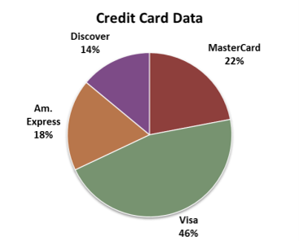
Pie Charts
A pie chart is an alternative to the bar graph for displaying relative frequency information. A pie chart is a circle which is divided into sectors, one for each category. The relative sizes of the sectors match the relative frequencies of the categories. For example, if a category has a relative frequency of 0.25, then its sector takes up 25% of the circle. Following is the pie chart for the credit card example at the beginning of this section.
Type of Credit Card | Relative Frequency
MasterCard | 11/50 = 0.22
Visa | 23/50 = 0.46
American Express | 9/50 = 0.18
Discover | 7/50 = 0.14

Slide 17
You Should Know . . .
How to construct a frequency and relative frequency distribution
How to construct and interpret bar graphs including:
  Pareto charts
  Bar graphs with horizontal bars
  Side-by-side bar graphs
How to construct and interpret pie charts

Slide 18
Frequency Distributions and Their Graphs
Section 2.2

Slide 19
Objectives
Construct frequency distributions for quantitative data
Construct histograms
Determine the shape of a distribution from a histogram
Construct frequency polygons and ogives

Slide 20
Objective 1
Construct frequency distributions for quantitative data

Slide 21
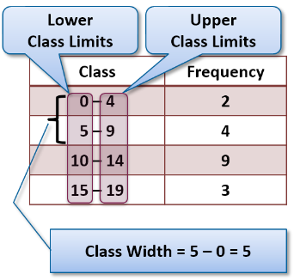
Frequency Distribution for Quantitative Data
To summarize quantitative data, we use a frequency distribution just like those for qualitative data. However, since these data have no natural categories, we divide the data into classes. Classes are intervals of equal width that cover all values that are observed in the data set.
The lower class limit of a class is the smallest value that can appear in that class.
The upper class limit of a class is the largest value that can appear in that class.
The class width is the difference between consecutive lower class limits.

Slide 22
Guidelines for Choosing Classes
There are many ways to construct a frequency distribution, and they will differ depending on the classes chosen. Following are guidelines for choosing the classes.
Every observation must fall into one of the classes.
The classes must not overlap.
The classes must be of equal width.
There must be no gaps between classes. Even if there are no observations in a class, it must be included in the frequency distribution.

Slide 23
Constructing a Frequency Distribution
Following are the general steps for constructing a frequency distribution.
Step 1: Choose a class width.
Step 2: Choose a lower class limit for the first class. This should be a convenient number that is slightly less than the minimum data value.
Step 3: Compute the lower limit for the second class, by adding the class width to the lower limit for the first class:
Lower limit for second class = Lower limit for first class + Class width
Step 4: Compute the lower limits for each of the remaining classes, by adding the class width to the lower limit of the preceding class. Stop when the largest data value is included in a class.
Step 5: Count the number of observations in each class, and construct the frequency distribution.

Slide 24
Example: Frequency Distribution
The emissions for 65 vehicles, in units of grams of particles per gallon of fuel, are given. Construct a frequency distribution using a class width of 1.
1.50
1.48
1.40
3.12
0.25
0.87
1.06
1.37
2.37
0.53
1.12
1.11
1.81
2.12
3.36
1.25
2.15
1.14
2.68
3.47
3.46
0.86
1.63
1.17
2.74
1.11
1.81
3.67
3.34
1.88
1.12
1.47
0.55
3.79
5.94
0.88
1.24
2.67
1.28
4.24
1.29
1.63
2.63
2.10
3.52
0.94
2.14
3.03
6.55
3.59
0.64
6.64
1.23
1.18
3.10
1.31
4.04
1.04
3.06
3.33
2.49
2.48
1.63
0.48
4.58

Slide 25
Example: Frequency Distribution (Continued 1)
Since the smallest value in the data set is 0.25, we choose 0.00 as the lower limit for the first class. The class width is 1 and the first lower class limit is 0.00, so the lower limit for the second class is 0.00 + 1 = 1.00.
The remaining lower class limits are as follows.
1.00 + 1 = 2.00
2.00 + 1 = 3.00
3.00 + 1 = 4.00
4.00 + 1 = 5.00
5.00 + 1 = 6.00
6.00 + 1 = 7.00
Since the largest data value is 6.64, every data value is now contained in a class.

Slide 26
Example: Frequency Distribution (Continued 2)
Lastly, we count the number of observations in each class to obtain the frequency distribution.
Class | Frequency
0.00 – 0.99 | 9
1.00 – 1.99 | 26
2.00 – 2.99 | 11
3.00 – 3.99 | 13
4.00 – 4.99 | 3
5.00 – 5.99 | 1
6.00 – 6.99 | 2

Slide 27
Relative Frequency Distribution
Given a frequency distribution, a relative frequency distribution can be constructed by computing the relative frequency for each class.
Relative Frequency = $\frac{\text{Frequency}}{\text{Sum} \text{of} \text{all} \text{frequencies}}$
Class | Frequency | Relative Frequency
0.00 – 0.99 | 9 | 0.138
1.00 – 1.99 | 26 | 0.400
2.00 – 2.99 | 11 | 0.169
3.00 – 3.99 | 13 | 0.200
4.00 – 4.99 | 3 | 0.046
5.00 – 5.99 | 1 | 0.015
6.00 – 6.99 | 2 | 0.031

Slide 28
Objective 2
Construct histograms

Slide 29
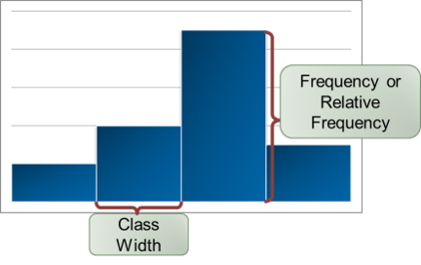
Histogram
Once we have a frequency distribution or a relative frequency distribution, we can put the information in graphical form by constructing a histogram.
A histogram is constructed by drawing a rectangle for each class. The heights of the rectangles are equal to the frequencies or the relative frequencies, and the widths are equal to the class width.

Slide 30
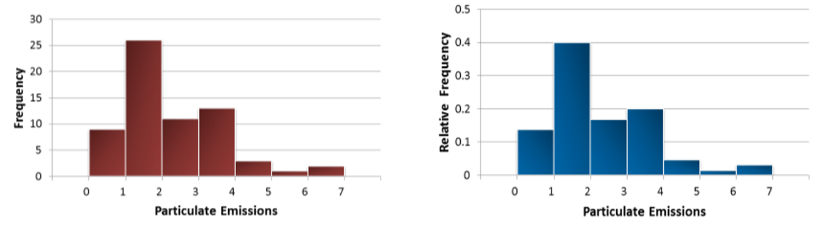
Example: Histogram
The frequency histogram and relative frequency histogram are given for the particulate emissions data.
Note that the two histograms have the same shape. The only difference is the scale on the vertical axis.

Slide 31
Choosing the Number of Classes
There are no hard and fast rules for choosing the number of classes. In general, it is good to have more classes rather than fewer, but it is also good to have reasonably large frequencies in some of the classes. There are two principles that can guide the choice.
Too few classes produce a histogram lacking in detail.
Too many classes produce a histogram with too much detail, so that the main features of the data are obscured.

Slide 32
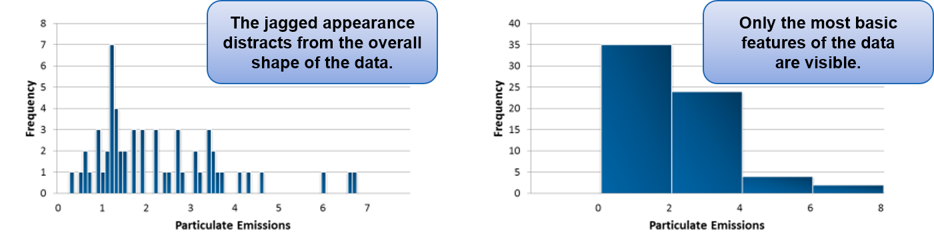
Choosing the Number of Classes (Continued)
The following histograms illustrate too many classes and too few.

Slide 33
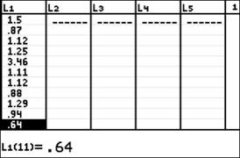
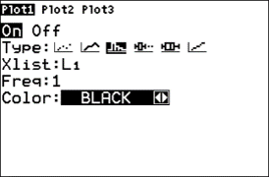
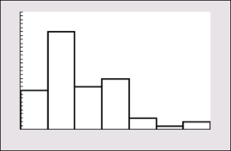
Histograms on the TI-84 PLUS
The following steps will create a histogram for the particulate emissions data on the TI-84 PLUS.
Step 1: Enter the data in list L1.
Step 2: Press 2nd, Y=, then 1 to access the Plot1 menu. Select On and the histogram plot type.
Step 3: Press Zoom, 9 to view the plot.

Slide 34
Open-Ended Classes
It is sometimes necessary for the first class to have no lower limit or for the last class to have no upper limit. Such a class is called open-ended. When a frequency distribution contains an open-ended class, a histogram cannot be drawn.
The following frequency
distribution presents the
number of deaths in the U.S.
due to pneumonia in a recent
year for various age groups.
Note that the last age group is
“85 and older”, which is an
open-ended class.
Age | Number of Deaths
5 – 14 | 69
15 – 24 | 178
25 – 34 | 299
35 – 44 | 875
45 – 54 | 1872
55 – 64 | 3099
65 – 74 | 6283
75 – 84 | 17,775
85 and older | 27,758

Slide 35
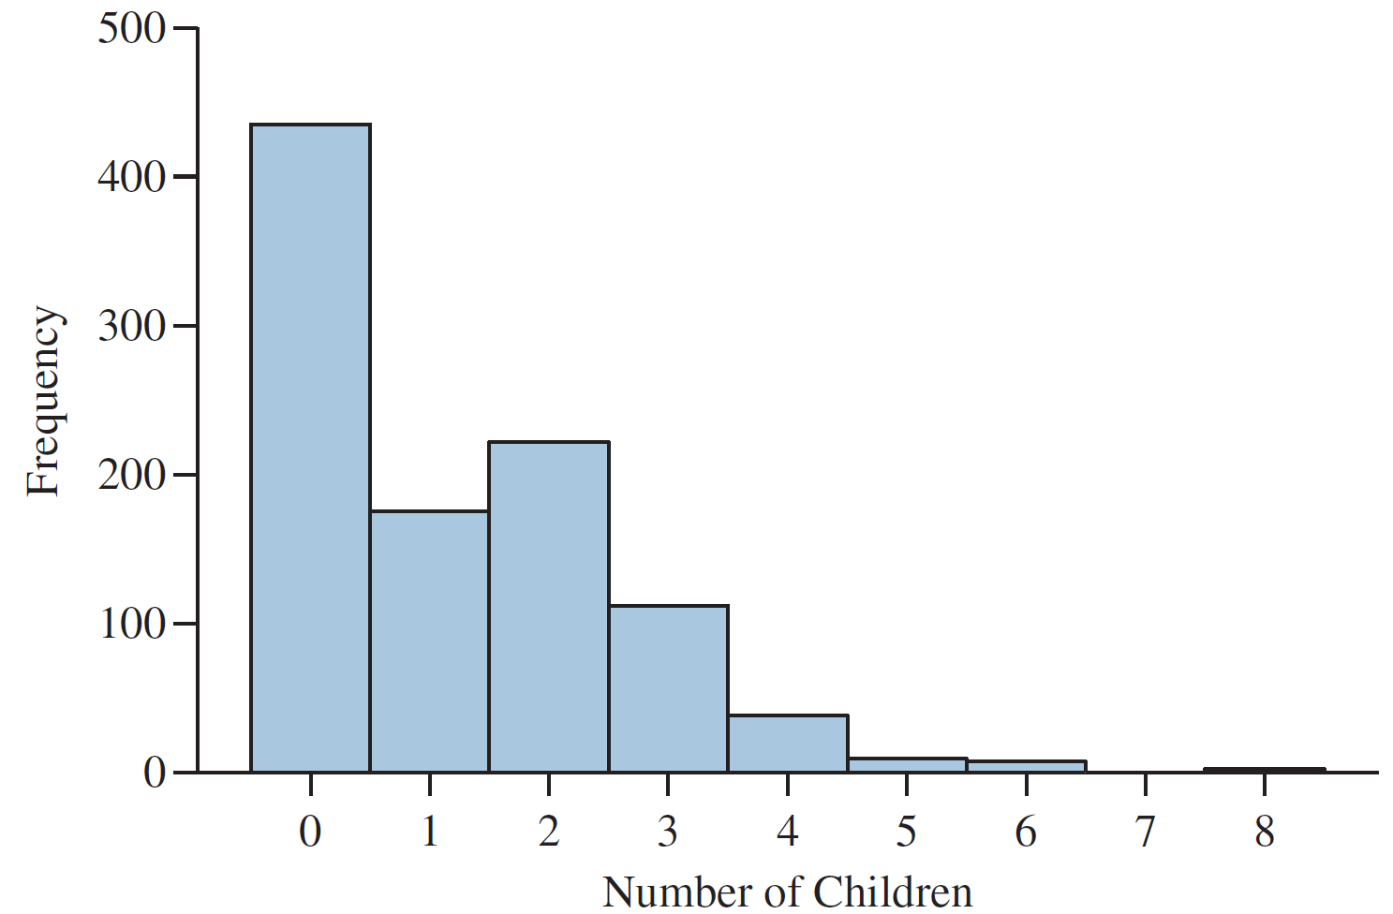
Histograms for Discrete Data
When data are discrete, we can construct a frequency distribution in which each possible value of the variable forms a class. The following table and histogram presents the results of a hypothetical survey in which 1000 adult women were asked how many children they had.
Number of Children | Frequency
0 | 435
1 | 175
2 | 222
3 | 112
4 | 38
5 | 9
6 | 7
7 | 0
8 | 2

Slide 36
Objective 3
Determine the shape of a distribution from a histogram

Slide 37
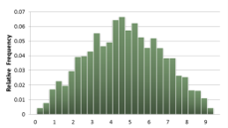
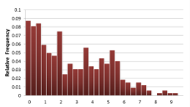
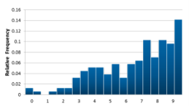
Shape of a Data Set
A histogram gives a visual impression of the “shape” of a data set. Statisticians have developed terminology to describe some of the commonly observed shapes.
A histogram is symmetric if its right half is a mirror image of its left half. There are very few histograms that are perfectly symmetric, but many are approximately symmetric.
A histogram with a long right-hand tail is said to be skewed to the right, or positively skewed.
A histogram with a long left-hand tail is said to be skewed to the left, or negatively skewed.

Slide 38
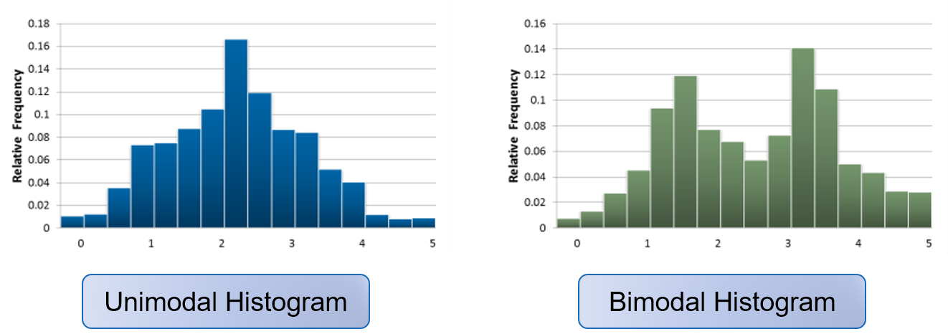
Unimodal and Bimodal Histograms
A peak, or high point, of a histogram is referred to as a mode. A histogram is unimodal if it has only one mode, and bimodal if it has two clearly distinct modes.

Slide 39
Objective 4
Construct frequency polygons and ogives

Slide 40
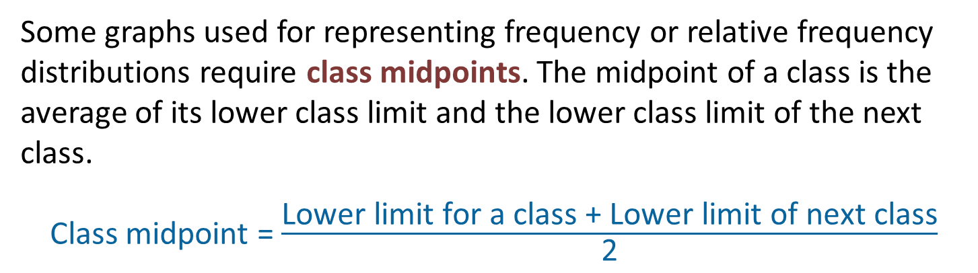
Class Midpoints
Some graphs used for representing frequency or relative frequency distributions require class midpoints. The midpoint of a class is the average of its lower class limit and the lower class limit of the next class.
Class midpoint = $\frac{\text{Lower} \text{limit} \text{for} \text{a} \text{class}\text{ + }\text{Lower} \text{limit} \text{of} \text{next} \text{class}}{\text{2}}$

Slide 41
Example: Class Midpoints
Consider the classes in the particulate emissions data from earlier in this section. The class midpoints are computed in the table.
Class | Class Midpoint
0.00 – 0.99 | (0 + 1)/2 = 0.5
1.00 – 1.99 | (1 + 2)/2 = 1.5
2.00 – 2.99 | (2 + 3)/2 = 2.5
3.00 – 3.99 | (3 + 4)/2 = 3.5
4.00 – 4.99 | (4 + 5)/2 = 4.5
5.00 – 5.99 | (5 + 6)/2 = 5.5
6.00 – 6.99 | (6 + 7)/2 = 6.5

Slide 42
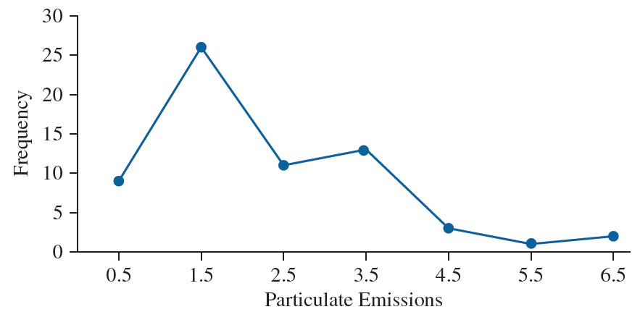
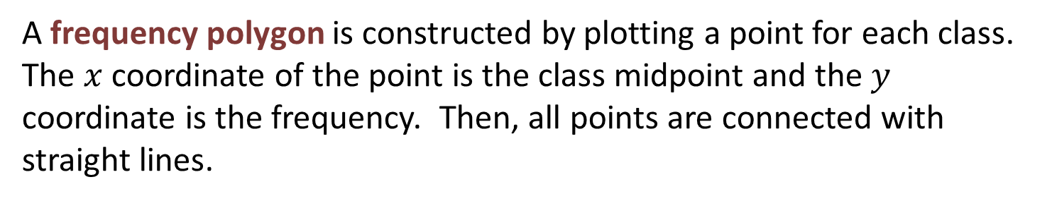
Frequency Polygon
A frequency polygon is constructed by plotting a point for each class. The $x$ coordinate of the point is the class midpoint and the $y$ coordinate is the frequency. Then, all points are connected with straight lines.
Class Midpoint | Frequency
0.5 | 9
1.5 | 26
2.5 | 11
3.5 | 13
4.5 | 3
5.5 | 1
6.5 | 2

Slide 43
Cumulative Frequency
The cumulative frequency of a class is the sum of the frequencies of that class and all previous classes.
Class | Frequency | Cumulative Frequency
0.00 – 0.99 | 9 | 9
1.00 – 1.99 | 26 | 35
2.00 – 2.99 | 11 | 46
3.00 – 3.99 | 13 | 59
4.00 – 4.99 | 3 | 62
5.00 – 5.99 | 1 | 63
6.00 – 6.99 | 2 | 65

Slide 44
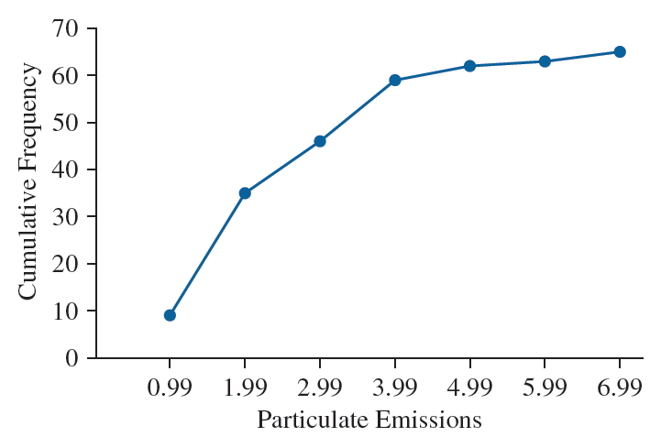
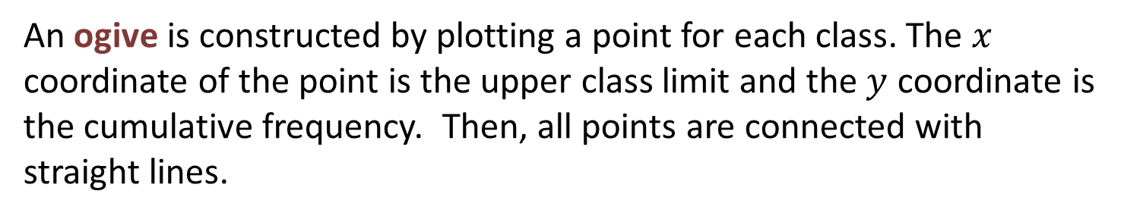
Ogives
An ogive is constructed by plotting a point for each class. The $x$ coordinate of the point is the upper class limit and the $y$ coordinate is the cumulative frequency. Then, all points are connected with straight lines.
Upper Class Limit | Cumulative Frequency
0.99 | 9
1.99 | 35
2.99 | 46
3.99 | 59
4.99 | 62
5.99 | 63
6.99 | 65

Slide 45
You Should Know . . .
How to construct a frequency and relative frequency distribution for quantitative data
How to construct and interpret histograms
The guiding principles for choosing the number of classes in a histogram
How to construct a histogram on the TI-84 PLUS calculator
Some possible shapes of a data set including:
  Symmetric
  Skewed to the right (positively skewed)
  Skewed to the left (negatively skewed)
  Unimodal
  Bimodal
How to construct frequency polygons and ogives

Slide 46
More Graphs for Quantitative Data
Section 2.3

Slide 47
Objectives
Construct stem-and-leaf plots
Construct dotplots
Construct time-series plots

Slide 48
Objective 1
Construct stem-and-leaf plots

Slide 49
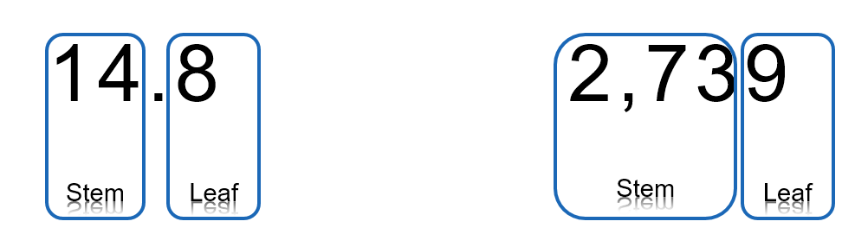
Stem-and-Leaf Plots
Stem-and-leaf plots are a simple way to display small data sets.
In a stem-and-leaf plot, the rightmost digit is the leaf, and the remaining digits form the stem.
Consider the values 14.8 and 2,739.

Slide 50
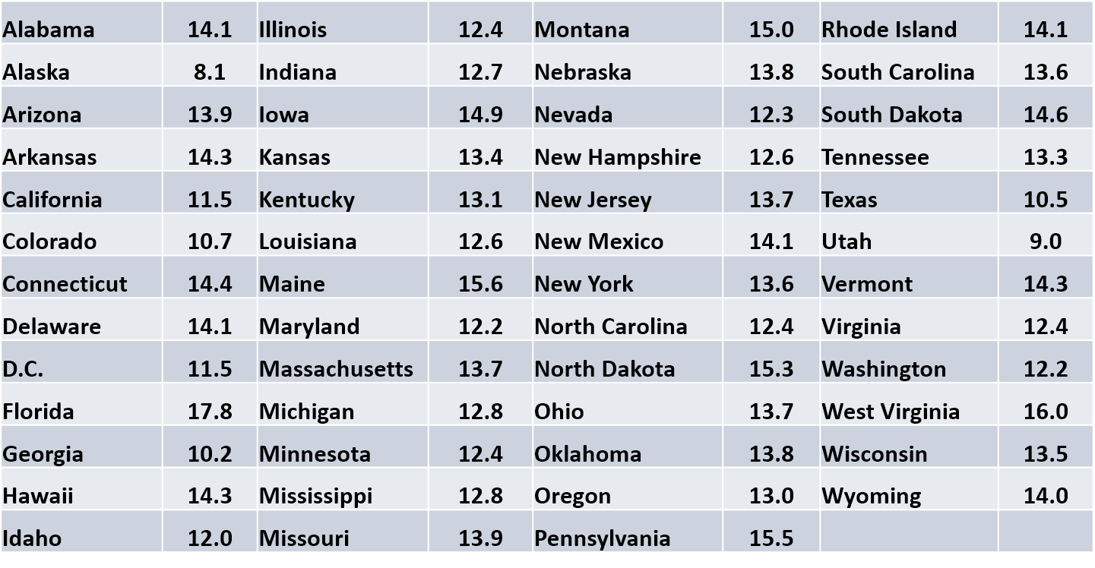
Example: Stem-and-Leaf Plots
The following table presents the U.S. Census Bureau projection for the percentage of the population aged 65 and over for each state and the District of Columbia. Construct a stem-and-leaf plot.

Slide 51
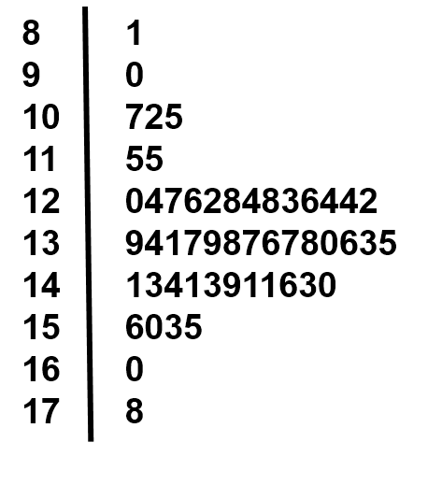
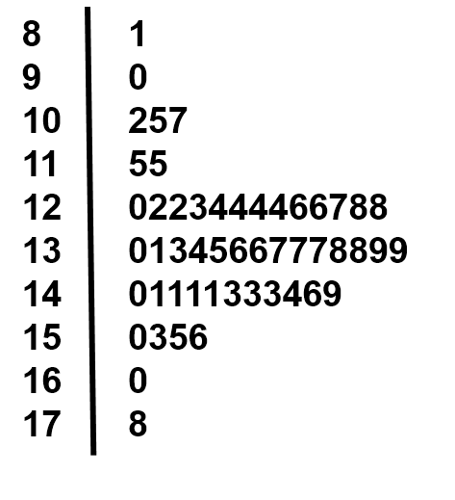
Example: Stem-and-Leaf Plots (Continued)
Step 1: Make a vertical list of all the stems, in increasing order, and draw a vertical line to the right of this list.
Step 2: For each value in the data set, write the leaf next to its stem.
Step 3: For each stem, arrange its leaves in increasing order.

Slide 52
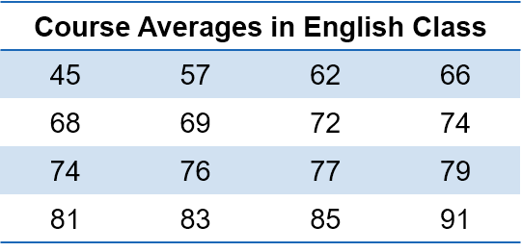
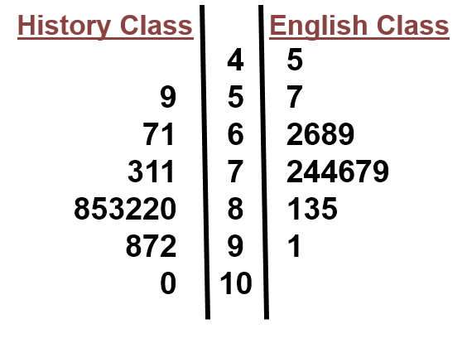
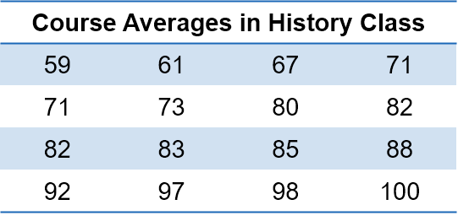
Back-to-Back Stem-and-Leaf Plots
When two data sets have values similar enough so that the same stems can be used, their shapes can be compared with a back-to-back stem-and-leaf plot. Consider the following course averages from an English class and a History class. The classes can be compared with a back-to-back stem-and-leaf plot.

Slide 53
Objective 2
Construct dotplots

Slide 54
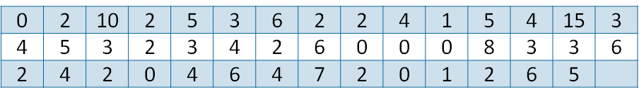
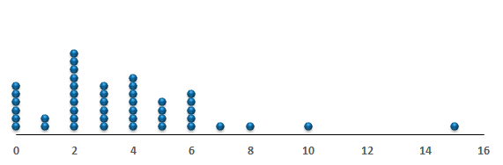
Dotplots
A dotplot is a graph that can be used to give a rough impression of the shape of a data set. It is useful when the data set is not too large, and when there are some repeated values.
Consider the number of children had by each of the presidents of the U.S. and their wives.

Slide 55
Interpreting Dotplots
A dotplot gives a good indication of where the values are concentrated, and where the gaps are. For example, it is immediately apparent that the most frequent number of children is 2, and only four presidents had more than 6.

Slide 56
Objective 3
Construct time-series plots

Slide 57
Time-Series Plot
A time-series plot may be used when the data consist of values of a variable measured at different points in time. In a time-series plot, the horizontal axis represents time, and the vertical axis represents the value of the variable we are measuring.

Slide 58
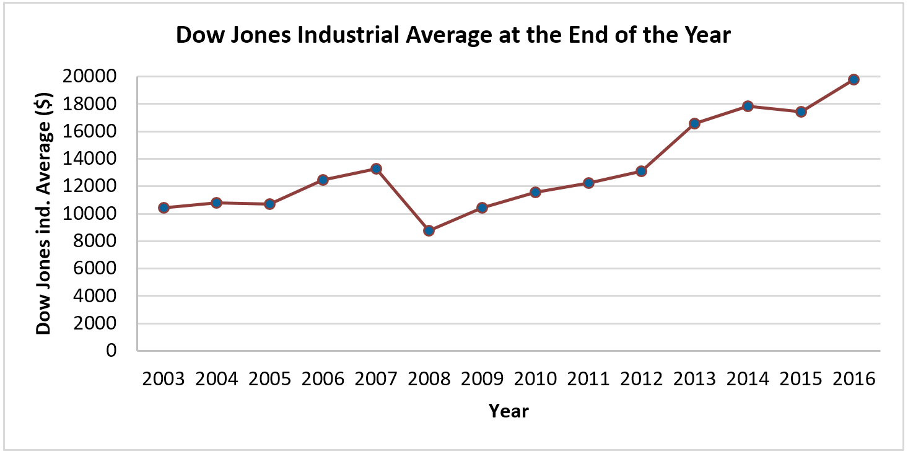
Example: Time-Series Plot
The following table and time-series plot display
the closing value of the Dow Jones Industrial
Average at the end of each year from 2003 to 2016.
Year | Average
2003 | 10,453.92
2004 | 10,783.01
2005 | 10,717.50
2006 | 12,463.15
2007 | 13,264.82
2008 | 8,776.39
2009 | 10,428.05
2010 | 11,557.51
2011 | 12,217.56
2012 | 13,104.14
2013 | 16,576.66
2014 | 17,823.07
2015 | 17,425.03
2016 | 19,762.60

Slide 59
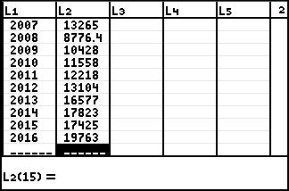
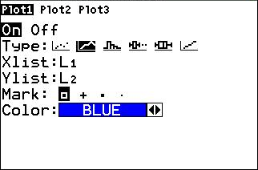
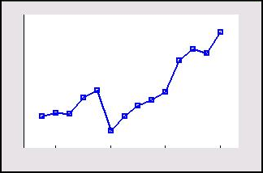
Time-Series Plots on the TI-84 PLUS
The following steps will create a time-series plot for the Dow Jones Industrial Average data on the TI-84 PLUS.
Step 1: Enter the x-values data in list L1 and the y-values in list L2.
Step 2: Press 2nd, Y=, then 1 to access the Plot1 menu. Select On and the Line Graph plot type. Make sure that L1 is entered in the Xlist field and L2 is entered in the Ylist field.
Step 3: Press Zoom, 9 to view the plot.

Slide 60
You Should Know . . .
How to construct and interpret:
  Stem-and-leaf plots
  Dotplots
  Time-series plots

Slide 61
Graphs Can Be Misleading
Section 2.4

Slide 62
Objectives
Understand how improper positioning of the vertical scale can be misleading
Understand the area principle for constructing statistical graphs
Understand how three-dimensional graphs can be misleading

Slide 63
Graphical Misrepresentation
Statistical graphs, when properly used, are powerful forms of communication. Unfortunately, when graphs are improperly used, they can misrepresent the data and lead people to draw incorrect conclusions.
We discuss here three of the most common forms of misrepresentation.
Incorrect position of the vertical scale
Incorrect sizing of graphical images
Misleading perspective for three-dimensional diagrams.

Slide 64
Objective 1
Understand how improper positioning of the vertical scale can be misleading

Slide 65
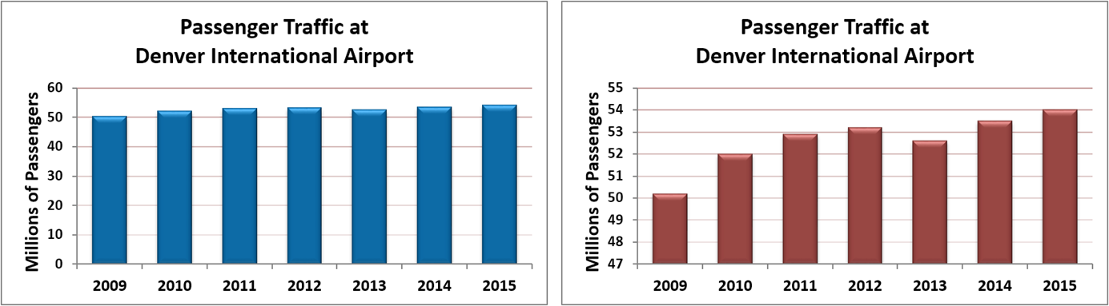
Positioning the Vertical Axis
The baseline of a graph or plot is the value at which the horizontal axis intersects with the vertical axis. With graphs or plots that represent how much or how many of something, it may be misleading if the baseline is not at zero.
These graphs are based on the same data, but give different impressions. The graph on the right has a baseline at 47 which exaggerates the differences between the bars.

Slide 66
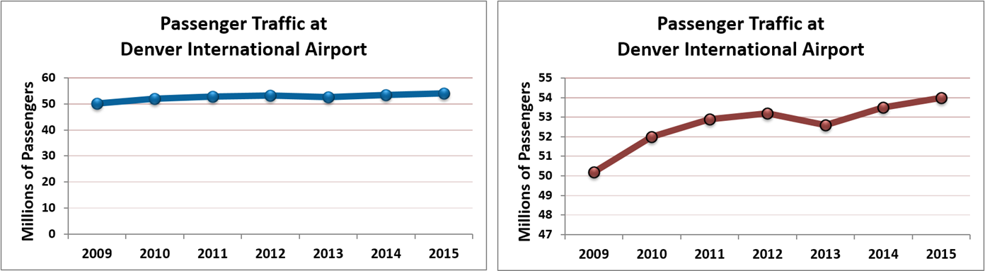
Misrepresentation with Time-Series
The same misleading information can be created with time-series plots as well.

Slide 67
Objective 2
Understand the area principle for constructing statistical graphs

Slide 68
The Area Principle
We often use images to compare amounts. Larger images correspond to greater amounts. To use images properly in this way, we must follow a rule known as The Area Principle.
The Area Principle
When amounts are compared by constructing an image for each amount, the areas of the images must be proportional to the amounts. For example, if one amount is twice as much as another, its image should have twice as much area as the other image.

Slide 69
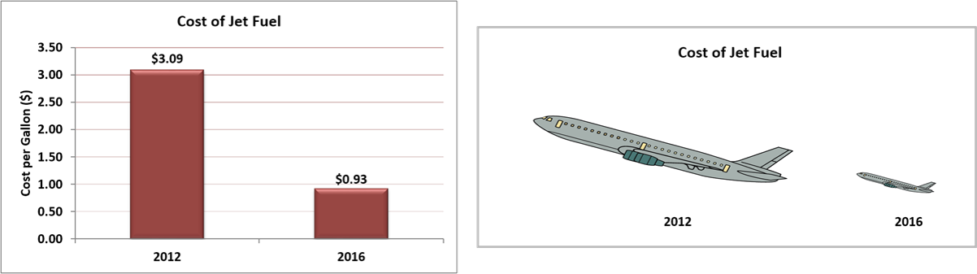
Example: The Area Principle
The cost of jet fuel in 2012 was $3.09 per gallon and in 2016 it had fallen to $0.93. Note that the price in 2016 is about one-third of the price in 2012.
In the bar graph, the area for the 2016 bar is about one-third that of the 2012 bar. In the planes image, the difference appears much larger. The reason is that both the height and width of the airplane have been decreased by a factor of approximately one-third. Thus, the area of the smaller is about one-ninth the area of the larger. The airplane graph violates the Area Principle and gives a misleading impression.

Slide 70
Objective 3
Understand how three-dimensional graphs can be misleading

Slide 71
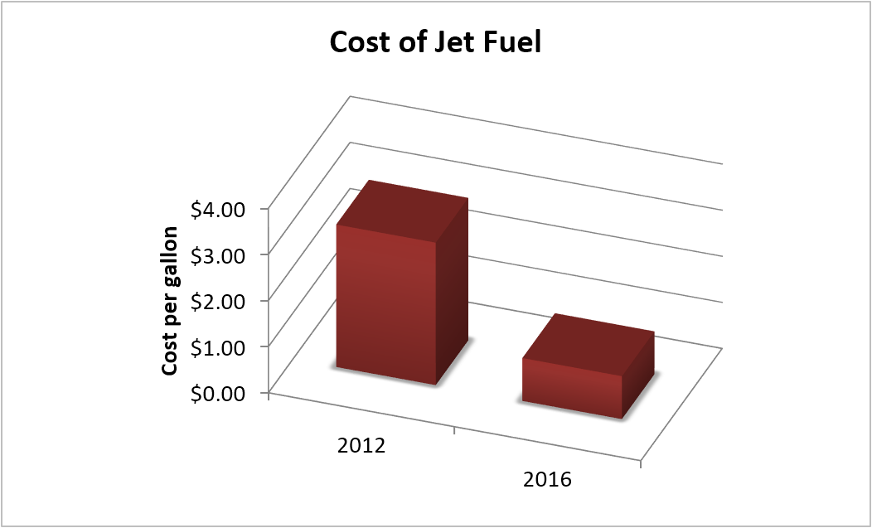
Three-Dimensional Graphs
Newspapers and magazines often present three-dimensional bar graphs because they are visually impressive.
Unfortunately, in order to make the tops of the bars visible, these graphs are often drawn as though the reader is looking down on them. This makes the bars look shorter than they really are.

Slide 72
You Should Know . . .
The common ways that graphs can be misleading including:
  Incorrect positioning of the vertical axis
  Incorrect sizing of graphical images by not following the Area Principle
  How three-dimensional graphs can distort the perspective

