Slide 1
Elementary Statistics 3E
William Navidi and Barry Monk

Slide 2
The Standard Normal Curve
Section 7.1

Slide 3

Objectives
Use a probability density curve to describe a population
Use a normal curve to describe a normal population
Find areas under the standard normal curve
Find $z$-scores corresponding to areas under the normal curve

Slide 4
Objective 1
Use a probability density curve to describe a population

Slide 5
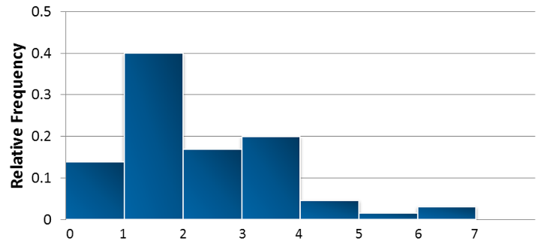
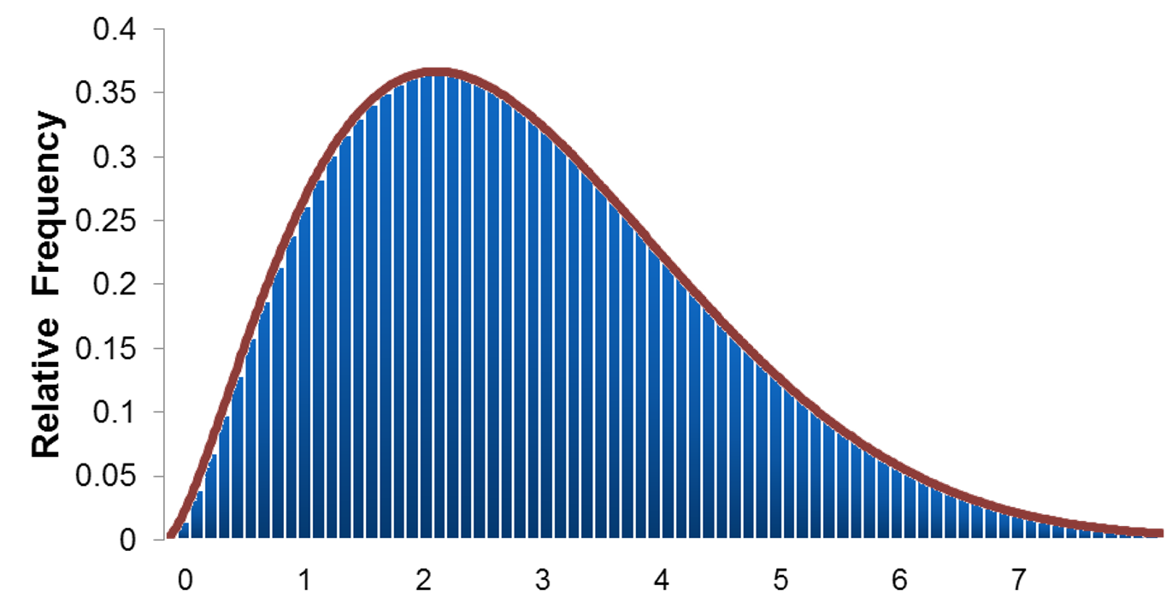
Probability Density Curves
The following figure presents a relative frequency histogram for the particulate emissions of a sample of 65 vehicles.
If we had information on the entire population, containing millions of vehicles, we could make the rectangles extremely narrow.
The histogram would then look smooth and could be approximated by a curve. The curve used to describe the distribution of this variable is called the probability density curve of the random variable. The probability density curve tells what proportion of the population falls within a given interval.

Slide 6
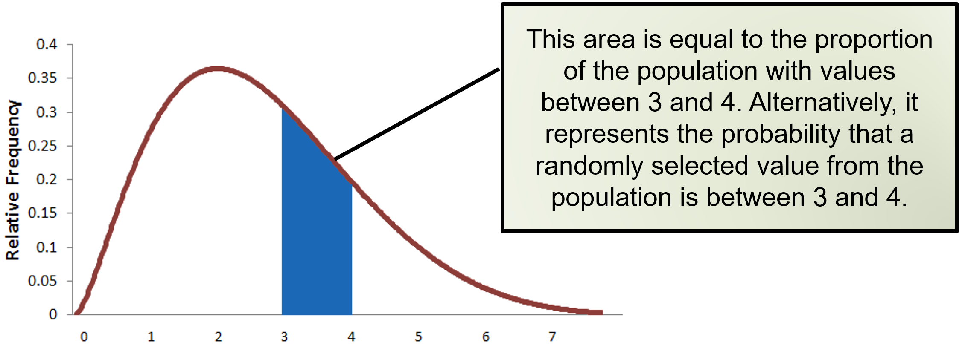
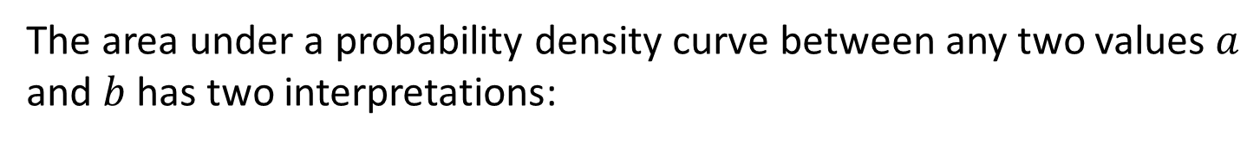
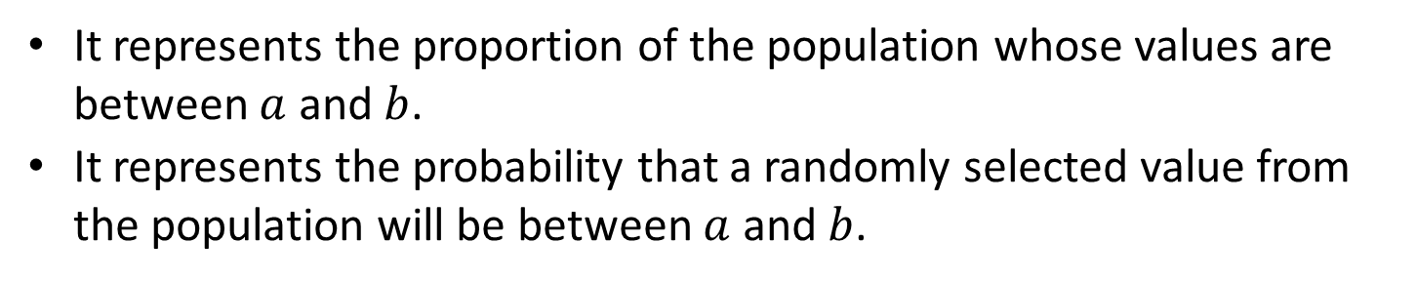
Area and Probability Density Curves
The area under a probability density curve between any two values $a$ and $b$has two interpretations:
It represents the proportion of the population whose values are between $a$ and $b$.
It represents the probability that a randomly selected value from the population will be between $a$ and $b$.

Slide 7
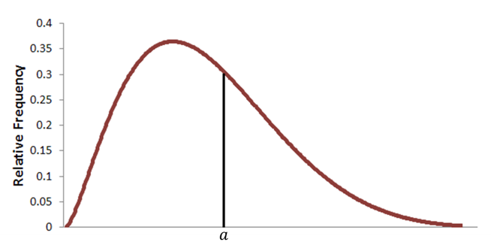
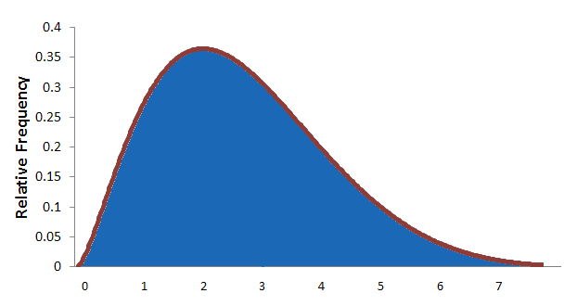
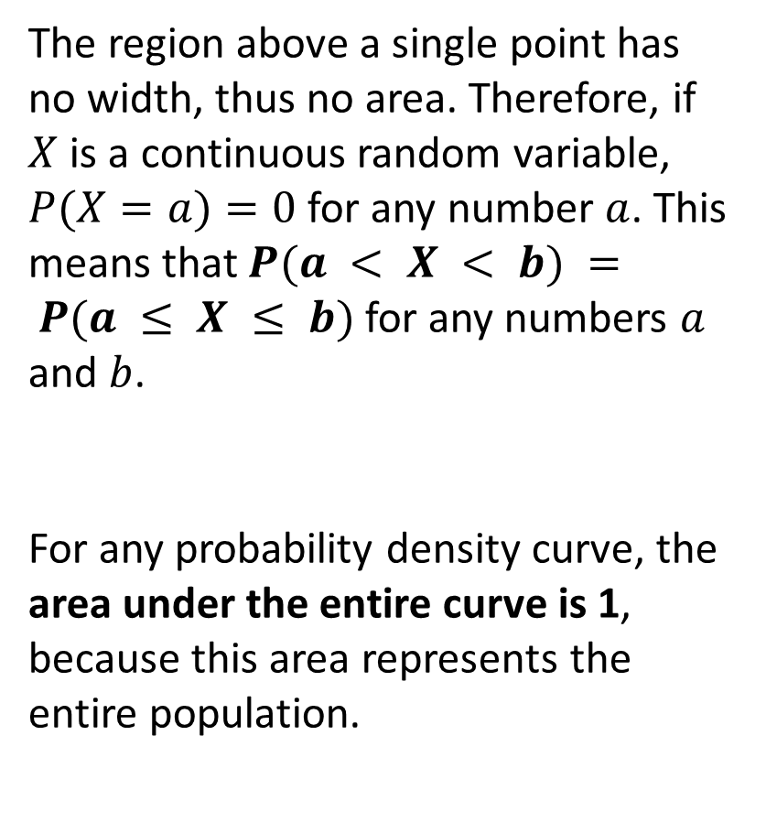
Properties of Probability Density Curves
The region above a single point has no width, thus no area. Therefore, if $X$ is a continuous random variable, $P(X=a)=0$ for any number $a$. This means that $P(a < X < b) = P(a ≤ X ≤ b)$for any numbers $a$ and $b$.
For any probability density curve, the area under the entire curve is 1, because this area represents the entire population.

Slide 8
Objective 2
Use a normal curve to describe a normal population

Slide 9
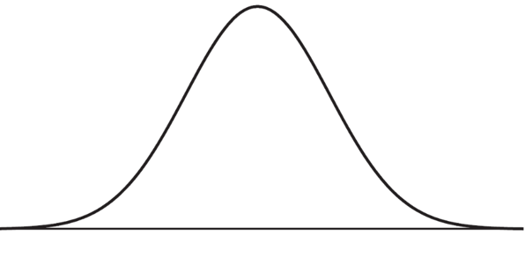
Normal Curves
Probability density curves comes in many varieties, depending on the characteristics of the populations they represent. Many important statistical procedures can be carried out using only one type of probability density curve, called a normal curve.
A population that is represented by a normal curve is said to be normally distributed, or to have a normal distribution.

Slide 10
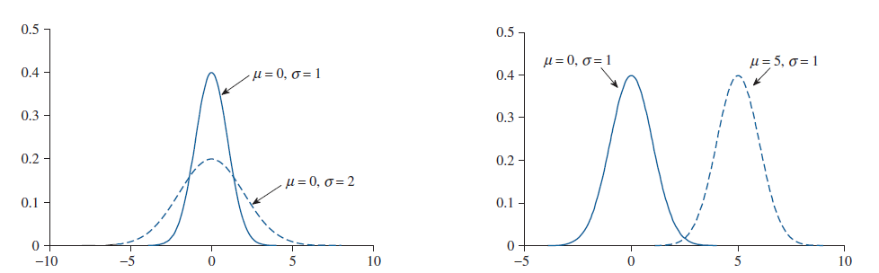
Properties of Normal Curves
The population mean determines the location of the peak. The population standard deviation measures the spread of the population. Therefore, the normal curve is wide and flat when the population standard deviation is large, and tall and narrow when the population standard deviation is small. The mean and median of a normal distribution are both equal to the mode.

Slide 11
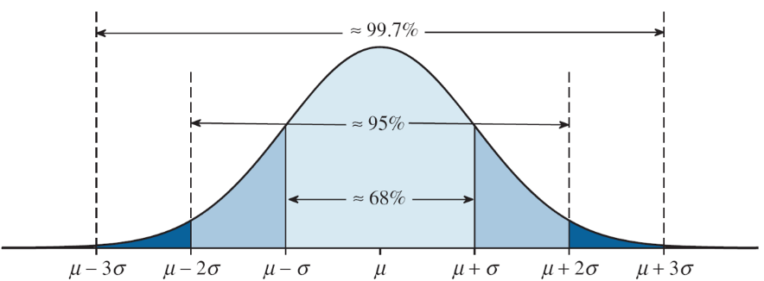
Empirical Rule
The normal distribution follows the Empirical Rule.

Slide 12
Objective 3*
Find areas under the standard normal curve
*(Tables)

Slide 13
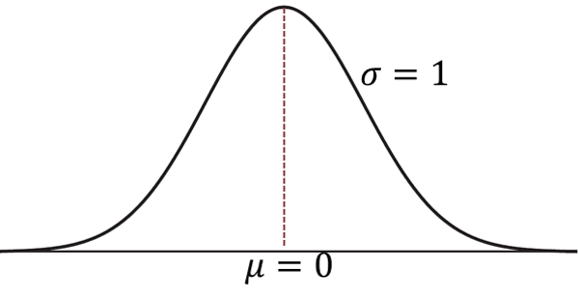
Standard Normal Curve
A normal distribution can have any mean and any positive standard deviation. However, the normal distribution with a mean of 0 and standard deviation of 1 is known as the standard normal distribution.

Slide 14
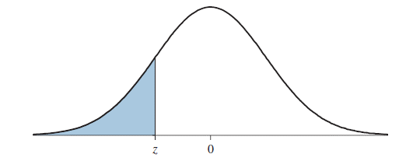

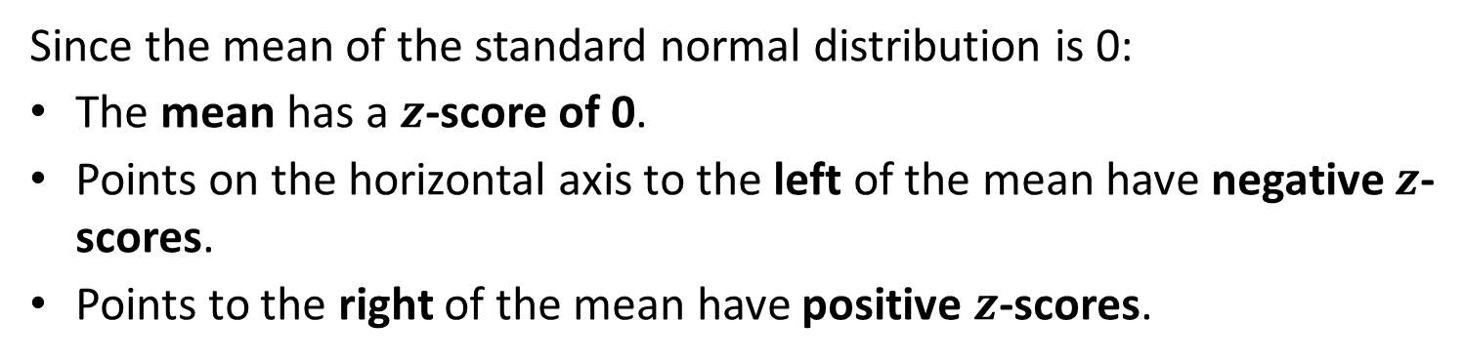
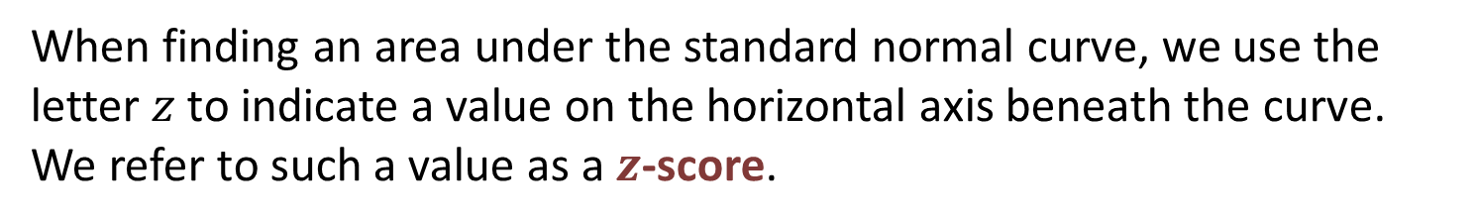
$Z$-Scores
When finding an area under the standard normal curve, we use the letter $z$ to indicate a value on the horizontal axis beneath the curve. We refer to such a value as a $z$-score.
Since the mean of the standard normal distribution is 0:
The mean has a $z$-score of 0.
Points on the horizontal axis to the left of the mean have negative $z$-scores.
Points to the right of the mean have positive $z$-scores.

Slide 15
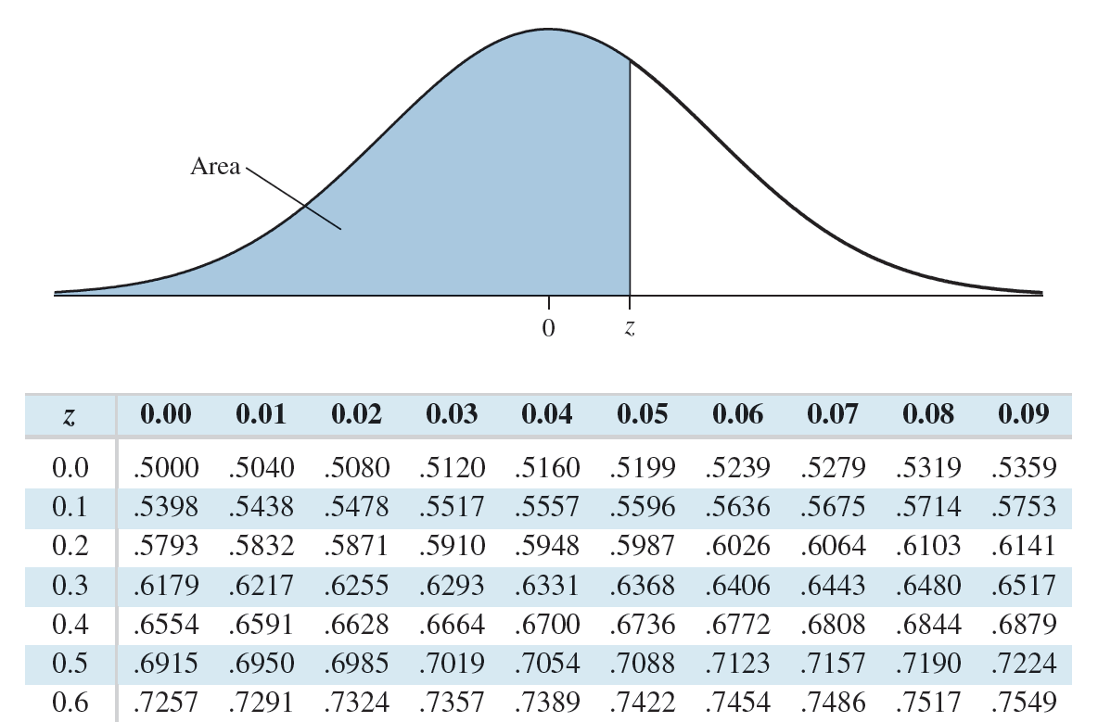
Using Table A.2 to Find Areas
Table A.2 may be used to find the area to the left of a given $z$-score.

Slide 16
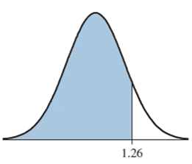
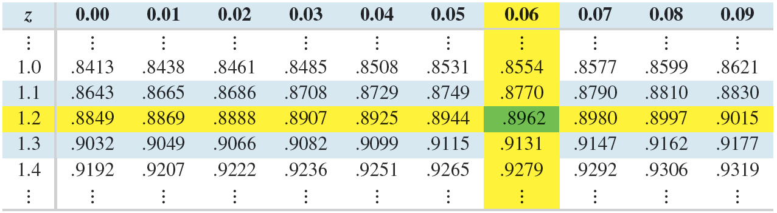
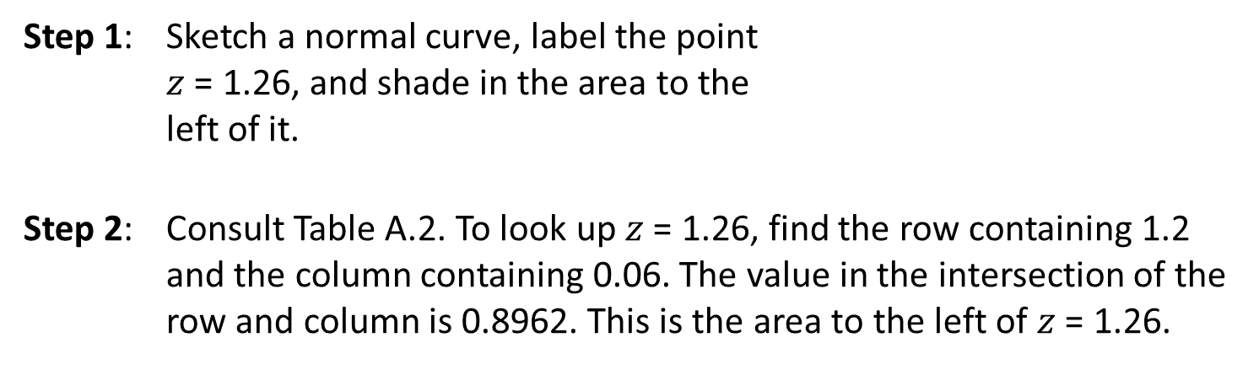
Example 1: Area Under Standard Normal (Tables)
Find the area to the left of $z$ = 1.26.
Step 1: Sketch a normal curve, label the point
$z$ = 1.26, and shade in the area to the
left of it.
Step 2: Consult Table A.2. To look up $z$ = 1.26, find the row containing 1.2 and the column containing 0.06. The value in the intersection of the row and column is 0.8962. This is the area to the left of $z$ = 1.26.

Slide 17
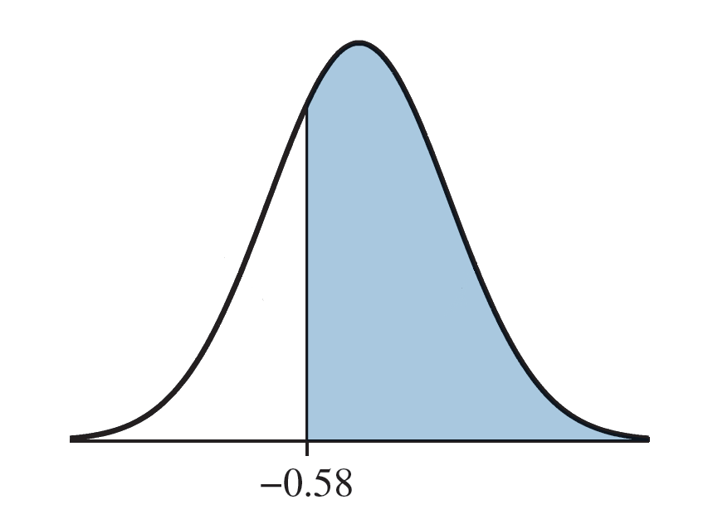
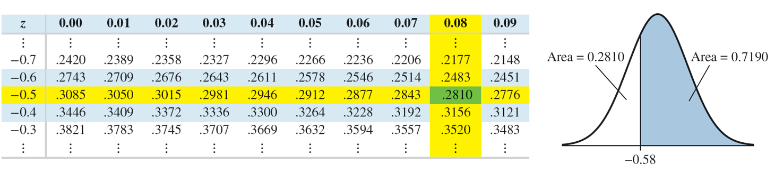
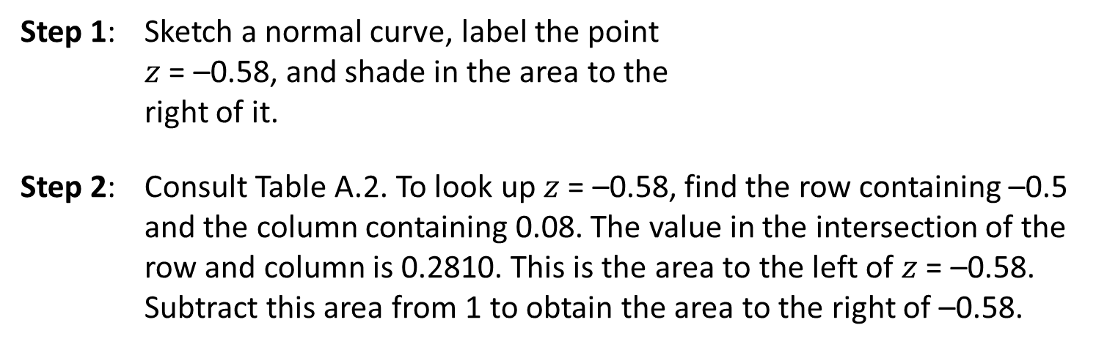
Example 2: Area Under Standard Normal (Tables)
Find the area to the right of $z$ = –0.58.
Step 1: Sketch a normal curve, label the point
$z$ = –0.58, and shade in the area to the
right of it.
Step 2: Consult Table A.2. To look up $z$ = –0.58, find the row containing –0.5 and the column containing 0.08. The value in the intersection of the row and column is 0.2810. This is the area to the left of $z$ = –0.58. Subtract this area from 1 to obtain the area to the right of –0.58.

Slide 18
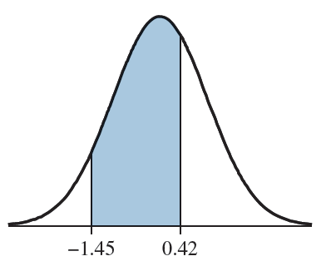
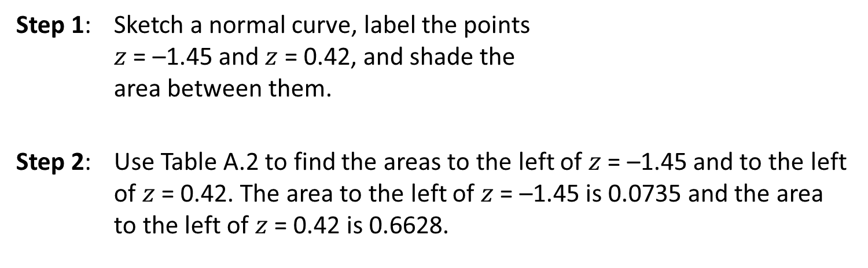
Example 3: Area Under Standard Normal (Tables)
Find the area between $z$ = –1.45 and $z$ = 0.42.
Step 1: Sketch a normal curve, label the points
$z$ = –1.45 and $z$ = 0.42, and shade the
area between them.
Step 2: Use Table A.2 to find the areas to the left of $z$ = –1.45 and to the left of $z$ = 0.42. The area to the left of $z$ = –1.45 is 0.0735 and the area to the left of $z$ = 0.42 is 0.6628.

Slide 19
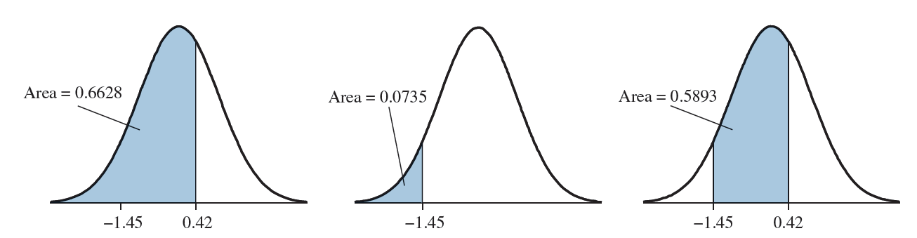
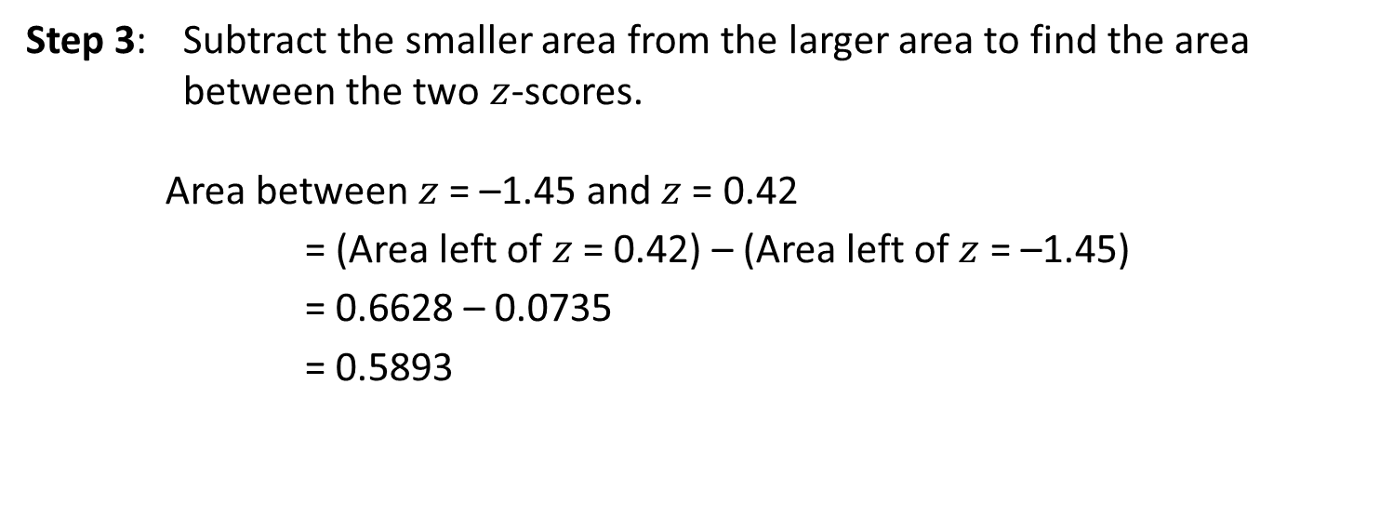
Example 3: Area Under Standard Normal Continued (Tables)
Step 3: Subtract the smaller area from the larger area to find the area between the two $z$-scores.
Area between $z$ = –1.45 and $z$ = 0.42
= (Area left of $z$ = 0.42) – (Area left of $z$ = –1.45)
= 0.6628 – 0.0735
= 0.5893

Slide 20
Objective 3**
Find areas under the standard normal curve
*(TI-84 PLUS)

Slide 21
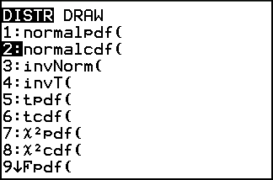
Finding Areas with the TI-84 PLUS
On the TI-84 PLUS calculator, the normalcdf command is used to find areas under a normal curve. Four numbers must be used as the input. The first entry is the lower bound of the area. The second entry is the upper bound of the area. The last two entries are the mean and standard deviation. This command is accessed by pressing 2nd, Vars.

Slide 22
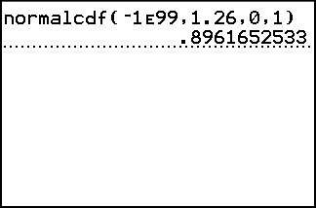
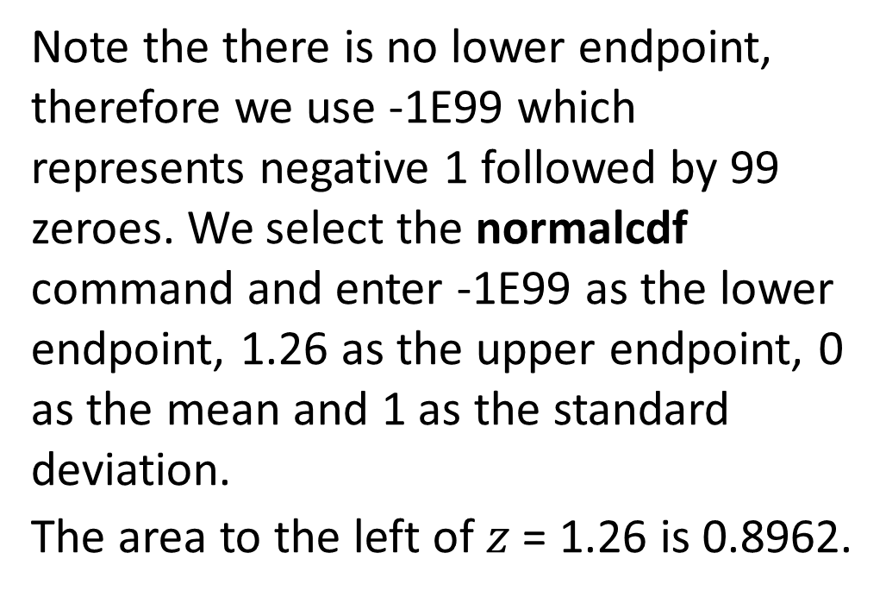
Example 1: Area Under Standard Normal (TI-84)
Find the area to the left of $z$ = 1.26.
Note the there is no lower endpoint, therefore we use -1E99 which represents negative 1 followed by 99 zeroes. We select the normalcdf command and enter -1E99 as the lower endpoint, 1.26 as the upper endpoint, 0 as the mean and 1 as the standard deviation.
The area to the left of $z$ = 1.26 is 0.8962.

Slide 23
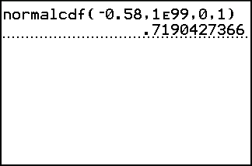
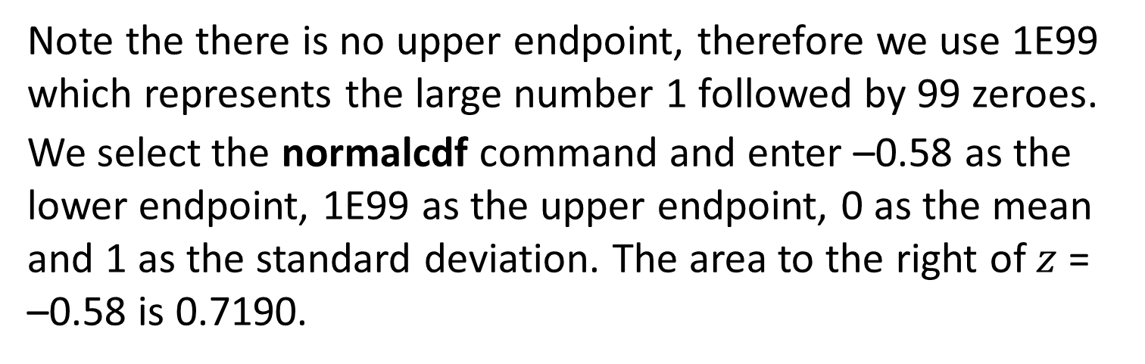
Example 2: Area Under Standard Normal (TI-84)
Find the area to the right of $z$ = –0.58.
Note the there is no upper endpoint, therefore we use 1E99 which represents the large number 1 followed by 99 zeroes.
We select the normalcdf command and enter –0.58 as the lower endpoint, 1E99 as the upper endpoint, 0 as the mean and 1 as the standard deviation. The area to the right of $z$ = –0.58 is 0.7190.

Slide 24
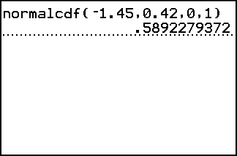
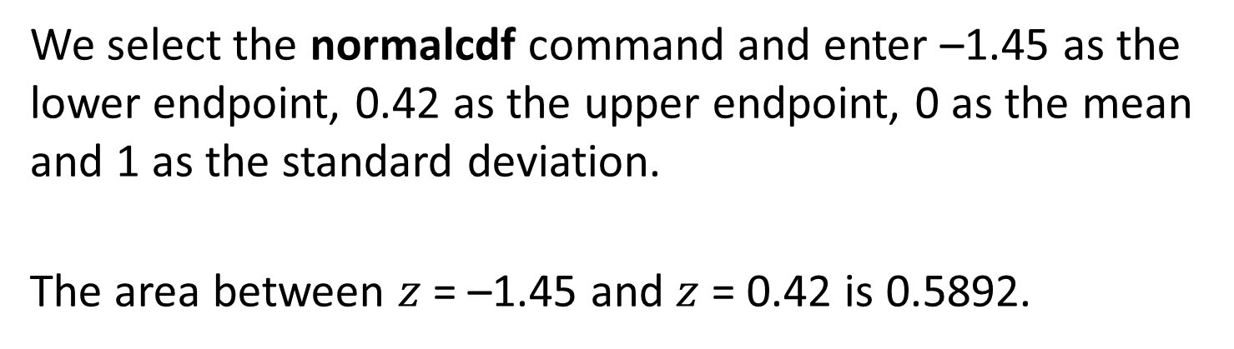
Example 3: Area Under Standard Normal (TI-84)
Find the area between $z$ = –1.45 and $z$ = 0.42.
We select the normalcdf command and enter –1.45 as the lower endpoint, 0.42 as the upper endpoint, 0 as the mean and 1 as the standard deviation.
The area between $z$ = –1.45 and $z$ = 0.42 is 0.5892.

Slide 25
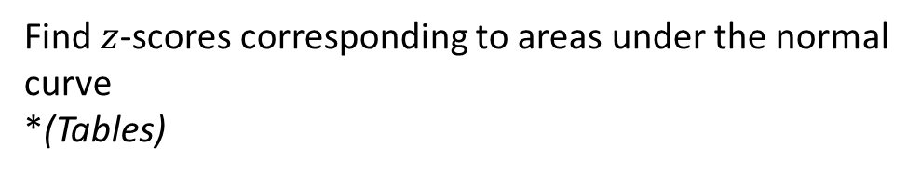
Objective 4*
Find $z$-scores corresponding to areas under the normal curve
*(Tables)

Slide 26
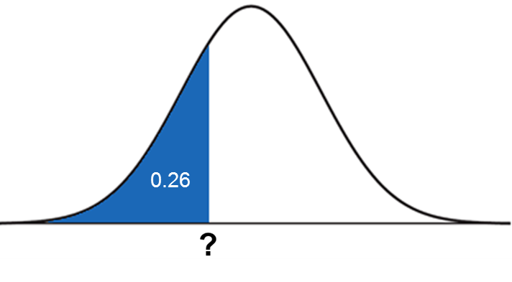

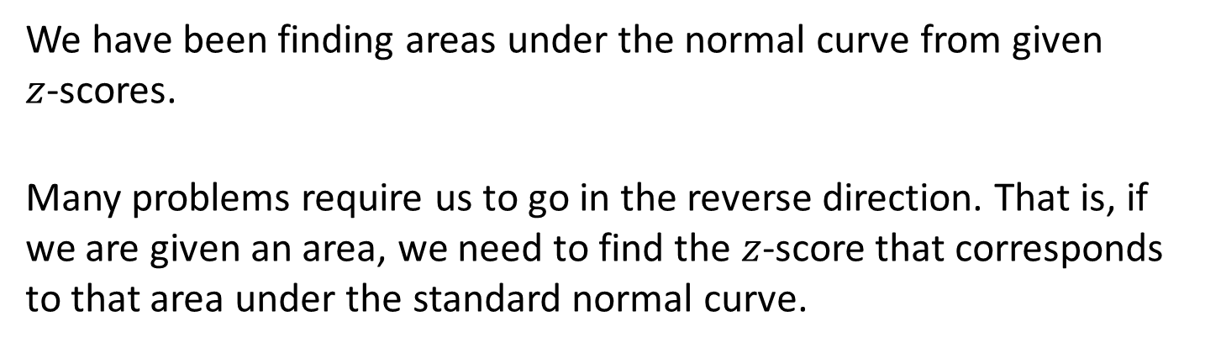
$Z$-scores From Areas
We have been finding areas under the normal curve from given
$z$-scores.
Many problems require us to go in the reverse direction. That is, if we are given an area, we need to find the $z$-score that corresponds to that area under the standard normal curve.

Slide 27
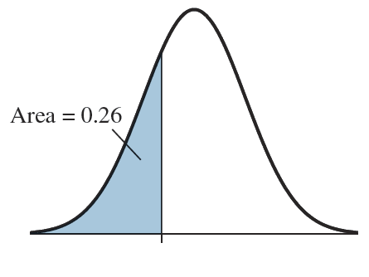
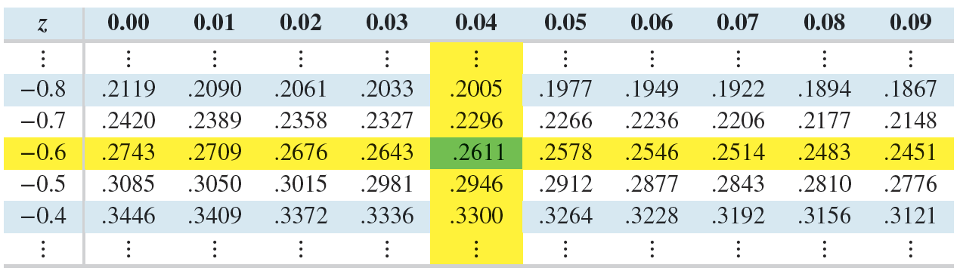
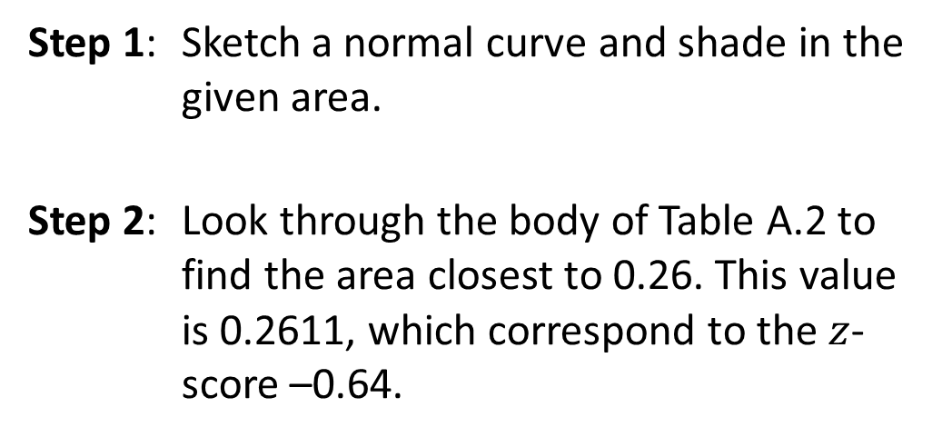
Example 1: Finding $z$-Scores (Tables)
Find the $z$-score that has an area of 0.26 to its left.
Step 1: Sketch a normal curve and shade in the given area.
Step 2: Look through the body of Table A.2 to find the area closest to 0.26. This value is 0.2611, which correspond to the $z$-score –0.64.

Slide 28
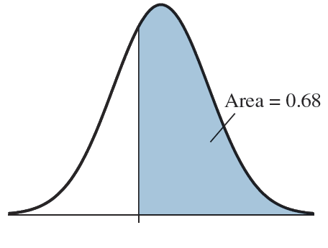
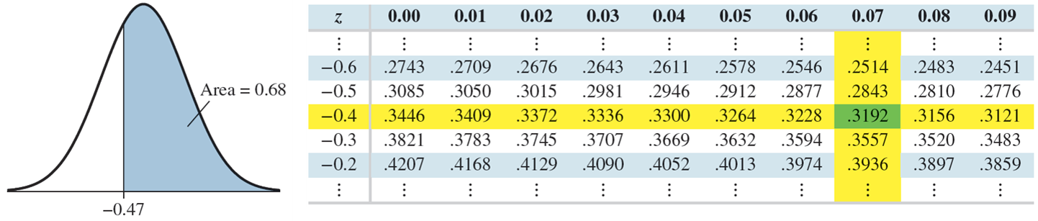
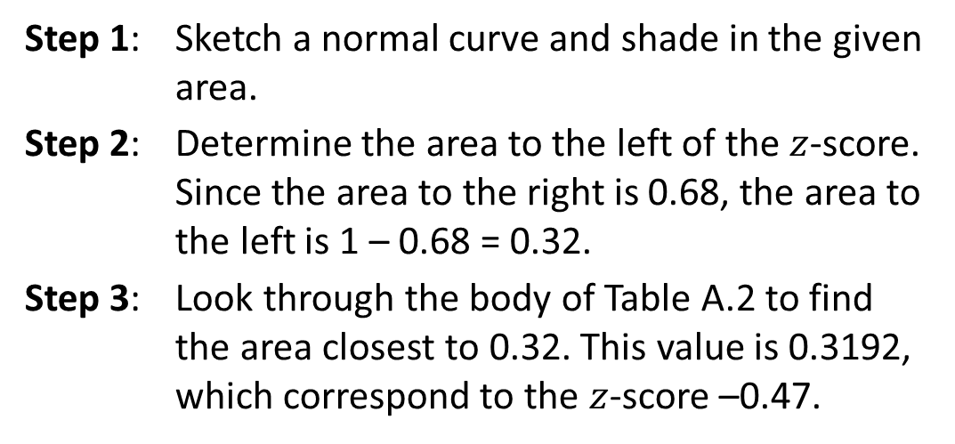
Example 2: Finding $z$-Scores (Tables)
Find the $z$-score that has an area of 0.68 to its right.
Step 1: Sketch a normal curve and shade in the given area.
Step 2: Determine the area to the left of the $z$-score. Since the area to the right is 0.68, the area to the left is 1 – 0.68 = 0.32.
Step 3: Look through the body of Table A.2 to find the area closest to 0.32. This value is 0.3192, which correspond to the $z$-score –0.47.

Slide 29
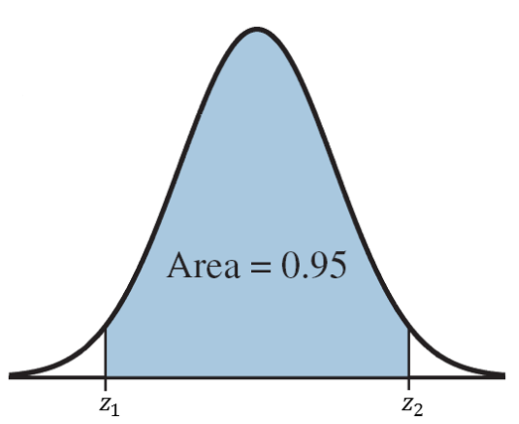
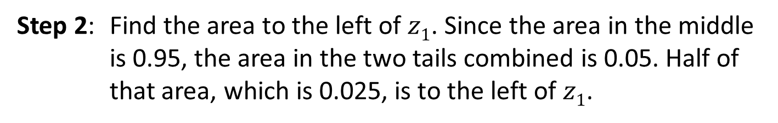

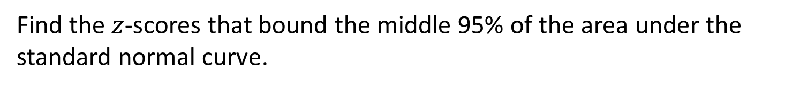
Example 3: Finding $z$-Scores (Tables)
Find the $z$-scores that bound the middle 95% of the area under the standard normal curve.
Step 1: Sketch a normal curve and shade in the given area. Label the $z$-score on the left $z_{1}$ and the $z$-score on the right $z_{2}$.
Step 2: Find the area to the left of $z1$. Since the area in the middle is 0.95, the area in the two tails combined is 0.05. Half of that area, which is 0.025, is to the left of $z1$.

Slide 30
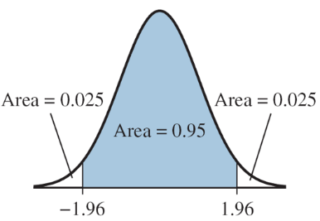
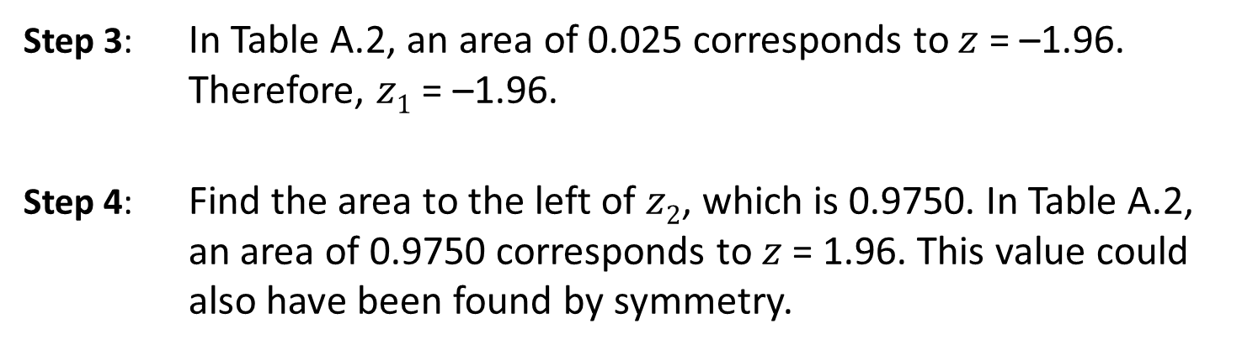
Example 3: Finding $z$-Scores Continued (Tables)
Step 3: In Table A.2, an area of 0.025 corresponds to $z$ = –1.96. Therefore, $z1$ = –1.96.
Step 4: Find the area to the left of $z2$, which is 0.9750. In Table A.2, an area of 0.9750 corresponds to $z$ = 1.96. This value could also have been found by symmetry.

Slide 31
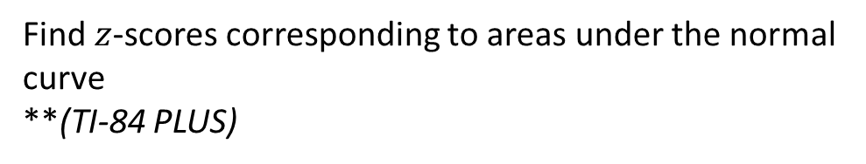
Objective 4**
Find $z$-scores corresponding to areas under the normal curve
**(TI-84 PLUS)

Slide 32
Normal Values From Areas
We have been finding areas under the normal curve.
Many problems require us to go in the reverse direction. That is, if we are given an area, we need to find the value from the population that corresponds to that area under the normal curve.

Slide 33

Normal Values From Areas on the TI-84 PLUS
The invNorm command on the TI-84 PLUS calculator returns the value from the normal population with a given area to its left. This command takes three values as its input. The first value is the area to the left, the second and third values are the mean and standard deviation, respectively. This command is accessed by pressing
2nd, Vars.

Slide 34

Example 1: Finding $z$-Scores (TI-84 PLUS)
Find the $z$-score that has an area of 0.26 to its left.
We select the invNorm command and enter 0.26 as the area to the left, 0 as the mean, and 1 as the standard deviation.
The z-score with an area of 0.26 to its left is approximately –0.64.

Slide 35

Example 2: Finding $z$-Scores (TI-84 PLUS)
Find the $z$-score that has an area of 0.68 to its right.
Since the area to the right is 0.68, the area to the left is 1 – 0.68 = 0.32.
We use the invNorm command with 0.32 as the area to the left, 0 as the mean, and 1 as the standard deviation. The z-score with an area of 0.68 to its right is approximately –0.47.

Slide 36


Example 3: Finding $z$-Scores (TI-84 PLUS)
Find the $z$-scores that bound the middle 95% of the area under the standard normal curve.
We first sketch a normal curve and shade in the given area. Label the $z$-score on the left $z1$ and the $z$-score on the right $z2$.
Now, since the area in the middle is 0.95, the area in the two tails combined is 0.05. Half of that area, which is 0.025, is to the left of $z1$. We use the invNorm command with 0.025 as the area to the left, 0 as the mean, and 1 as the standard deviation. We find that $z1$ = –1.96. By symmetry, $z2$ = 1.96.

Slide 37

You Should Know . . .
How to use a probability density curve to describe a population
How the shape of a normal curve is affected by the mean and standard deviation
How to find areas under a normal curve
How to find $z$-scores corresponding to areas under a normal curve

Slide 38
Applications of the Normal Distribution
Section 7.2

Slide 39
Objectives
Convert values from a normal distribution to $z$-scores
Find areas under a normal curve
Find the value from a normal distribution corresponding to a given proportion

Slide 40

Objective 1
Convert values from a normal distribution to
$z$-scores

Slide 41

Standardization
Recall that the $z$-score of a data value represents the number of standard deviations that data value is above or below the mean.
If $x$ is a value from a normal distribution with mean $μ$ and standard deviation $σ$, we can convert $x$ to a $z$-score by using a method known as standardization. The $z$-score of $x$ is $z=\frac{x−μ}{σ}$.
For example, consider a woman whose height is $x$ = 67 inches from a normal population with mean $μ$ = 64 inches and $σ$ = 3 inches. The $z$-score is:
$$z=\frac{x−μ}{σ}=\frac{67−64}{3}=1$$

Slide 42
Objective 2*
Find areas under a normal curve
*(Tables)

Slide 43

Using Table A.2 to Find Areas
Table A.2 may be used to find the area to the left of a given $z$-score. When computing areas for a general normal curve, we first standardize to $z$-scores.

Slide 44


Example 1: Area Under a Normal Curve (Tables)
A study reported that the length of pregnancy from conception to birth is approximately normally distributed with mean $μ$= 272 days and standard deviation $σ$ = 9 days. What proportion of pregnancies last longer than 280 days?
Solution:
The $z$-score for 280 is $z=\frac{x−μ}{σ}=\frac{280−272}{9}=0.89$. Using Table A.2, we find the area to the left of $z=0.89$to be 0.8133. The area to the right is therefore 1 – 0.8133 = 0.1867. We conclude that the proportion of pregnancies that last longer than 280 days is 0.1867.

Slide 45



Example 2: Area Under a Normal Curve (Tables)
The length of a pregnancy from conception to birth is approximately normally distributed with mean $μ$ = 272 days and standard deviation $σ$ = 9 days. A pregnancy is considered full-term if it lasts between 252 days and 298 days. What proportion of pregnancies are full-term?
Solution:
The $z$-score for 252 is $z=\frac{x−μ}{σ}=\frac{252−272}{9}=−2.22$.
The $z$-score for 298 is $z=\frac{x−μ}{σ}=\frac{298−272}{9}=2.89$.
Using Table A.2, we find that the area to the left of $z$ = 2.89 is 0.9981 and the area to the left of $z$= –2.22 is 0.0132. The area between $z$ = − 2.22 and $z$ = 2.89 is therefore 0.9981 – 0.0132 = 0.9849.
The proportion of pregnancies that are full-term, between 252 days and 298 days, is 0.9849.

Slide 46
Objective 2**
Find areas under a normal curve
*(TI-84 PLUS)

Slide 47

Example 1: Area Under a Normal Curve (TI-84)
A study reported that the length of pregnancy from conception to birth is approximately normally distributed with mean $μ$= 272 days and standard deviation $σ$ = 9 days. What proportion of pregnancies last longer than 280 days?
Solution:
We use the normalcdf command with 280 as the lower endpoint, 1E99 as the upper endpoint, 272 as the mean, and 9 as the standard deviation. We conclude that the proportion of pregnancies that last longer than 280 days is 0.1870.

Slide 48

Example 2: Area Under a Normal Curve (TI-84)
The length of a pregnancy from conception to birth is approximately normally distributed with mean $μ$ = 272 days and standard deviation
$σ$ = 9 days. A pregnancy is considered full-term if it lasts between 252 days and 298 days. What proportion of pregnancies are full-term?
Solution:
We use the normalcdf command with 252 as the lower endpoint, 298 as the upper endpoint, 272 as the mean, and 9 as the standard deviation. The proportion of pregnancies that are full-term, between 252 days and 298 days, is 0.9849.

Slide 49
Objective 3*
Find the value from a normal distribution corresponding to a given proportion
*(Tables)

Slide 50
Finding Normal Values from a Given $Z$-score
Suppose we want to find the value from a normal distribution that has a given $z$-score. To do this, we solve the standardization formula $z=\frac{x−μ}{σ}$ for $x$.
The value of $x$ that corresponds to a given $z$-score is $x=μ+z∙σ$
Example:
Heights in a group of men are normally distributed with mean $μ$= 69 inches and standard deviation $σ$ = 3 inches. Find the height whose
$z$-score is 0.6. Interpret the result.
Solution:
We want the height with a $z$-score of 0.6. Therefore,
$x=μ+z∙σ$ = 69 + (0.6)(3) = 70.8
We interpret this by saying that a man 70.8 inches tall has a height 0.6 standard deviation above the mean.

Slide 51

Steps for Finding Normal Values
The following procedure can be use to find the value from a normal distribution that has a given proportion above or below it using Table A.2.
Step 1: Sketch a normal curve, label the mean, label the value $x$ to be found, and shade in and label the given area.
Step 2: If the given area is on the right, subtract it from 1 to get the area on the left.
Step 3: Look in the body of Table A.2 to find the area closest to the given area. Find the $z$-score corresponding to that area.
Step 4: Obtain the value from the normal distribution by computing
$x=μ+z∙σ$.

Slide 52


Example: Finding Normal Values (Tables)
Mensa is an organization whose membership is limited to people whose IQ is in the top 2% of the population. Assume that scores on an IQ test are normally distributed with mean $μ$ = 100 and standard deviation $σ$ = 15. What is the minimum score needed to qualify for membership in Mensa?
Step 1: The figure shows the value $x$ separating the
upper 2% from the lower 98%.
Step 2: The area 0.02 is on the right, so we subtract
from 1 and work with the area 0.98 on the left.
Step 3: The area closest to 0.98 in Table A.2 is 0.9798, which corresponds to a $z$-score of 2.05.
Step 4: The IQ score that separates the upper 2% from the lower 98% is
$x=μ+z∙σ$ = 100 + (2.05)(15) = 130.75
Since IQ scores are generally whole numbers, we will round this to $x$ = 131.

Slide 53
Objective 3**
Find the value from a normal distribution corresponding to a given proportion
**(TI-84 PLUS)

Slide 54


Example: Finding Normal Values (TI-84)
Mensa is an organization whose membership is limited to people whose IQ is in the top 2% of the population. Assume that scores on an IQ test are normally distributed with mean $μ$ = 100 and standard deviation $σ$ = 15. What is the minimum score needed to qualify for membership in Mensa?
Solution:
The figure shows the value $x$ separating the upper 2% from the lower 98%. The area 0.02 is on the right, so we subtract from 1 and work with the area 0.98 on the left.
Using the invNorm command with 0.98 as the area on the left, 100 as the mean, and 15 as the standard deviation, we find the minimum score to be 130.81. Since IQ scores are generally whole numbers, we round this to $x$ = 131.

Slide 55

You Should Know . . .
How to convert values from a normal distribution to $z$-scores
How to find areas under a normal curve
How to find the value from a normal population corresponding to a given proportion

Slide 56
Sampling Distributions and The Central Limit Theorem
Section 7.3

Slide 57
Objectives
Construct the sampling distribution of a sample mean
Use the Central Limit Theorem to compute probabilities involving sample means

Slide 58
Objective 1
Construct the sampling distribution of a sample mean

Slide 59

Sampling Distribution of the Sample Mean
In real situations, statistical studies involve sampling several individuals then computing numerical summaries of the samples. Most often the sample mean, $\overline{x},$is computed.
If several samples are drawn from a population, they are likely to have different values for $\overline{x}$. Because the value of $\overline{x}$ varies each time a sample is drawn, $\overline{x}$ is a random variable. For each value of the random variable, $\overline{x}$, we can compute a probability. The probability distribution of $\overline{x}$ is called the sampling distribution of $\overline{x}.$

Slide 60

An Example of a Sampling Distribution
Tetrahedral dice are shaped like a pyramid with four faces. Each face corresponds to a number between 1 and 4. Tossing a tetrahedral die is like sampling a value from the population $\left\{1, 2, 3, 4\right\}$. We can easily find the population mean, $μ=2.5$, and the population standard deviation $σ=1.118$.
Suppose that a tetrahedral die is tossed three times. The sequence of three numbers observed may be thought of as a sample of size 3. We may get samples such as [1, 1, 1], [1, 1, 2], [1, 1, 3], and so on.

Slide 61

An Example of a Sampling Distribution (Continued)
The table displays all possible samples of size 3 and the sample mean $\overline{x}$ of each. The mean of all of values of $\overline{x}$ is $μ_{\overline{x}}=2.5$ and the standard deviation of all values of $\overline{x}$ is $σ_{\overline{x}}=0.6455$.
Next, we compare these values to the population mean (2.5) and population standard deviation (1.118).

Slide 62
Mean and Standard Deviation of a Sampling Distribution
The mean of the sampling distribution is $μ_{\overline{x}}=2.5$, which is the same as the mean of the population, $μ=2.5$. This relation always holds.
The mean of the sampling distribution is denoted by $μ_{\overline{x}}$and equals the mean of the population:
$$μ_{\overline{x}}=μ$$
The standard deviation of the sampling distribution is $σ_{\overline{x}}=0.6455$, which is less than the population standard deviation $σ=1.118$. It is not obvious how these two quantities are related. Note, that $σ_{\overline{x}}=0.6455=\frac{1.118}{\sqrt{3}}=\frac{σ}{\sqrt{3}}$. Recall that the sample size is $n=3$, which suggests that $σ_{\overline{x}}=\frac{σ}{\sqrt{n}}$.
The standard deviation of the sampling distribution, sometimes called the standard error, is denoted by $σ_{\overline{x}}$and equals the standard deviation of the population divided by the square root of the sample size:
$σ_{\overline{x}}=\frac{σ}{\sqrt{n}}$

Slide 63

Example: Sampling Distribution
Among students at a certain college, the mean number of hours of television watched per week is $μ$ = 10.5, and the standard deviation is $σ$ = 3.6. A simple random sample of 16 students is chosen for a study of viewing habits. Let $\overline{x}$be the mean number of hours of TV watched by the sampled students. Find the mean $μ_{\overline{x}}$ and the standard deviation $σ_{\overline{x}}$of $\overline{x}$ .
Solution:
The mean of $\overline{x}$ is:
$μ_{\overline{x}}$ = $μ$ = 10.5
The sample size is $n$ = 16. Therefore, the standard deviation of $\overline{x}$ is:
$σ_{\overline{x}}$ = $\frac{σ}{\sqrt{n}}$ = $\frac{3.6}{\sqrt{16}}$ = 0.9

Slide 64

Sampling Distribution for Sample of Size 3
Consider again the tetrahedral die example. The sampling distribution for $\overline{x}$ can be determined from the table of all possible values of $\overline{x}$.
The probability that the sample mean is 1.00 is $\frac{1}{64}$, or 0.016, because out of the 64 possible samples, only 1 has a sample mean equal to 1.00. Similarly, the probability that $\overline{x}$ =1.33 is $\frac{3}{64}$, or 0.047, because there are 3 samples whose sample mean is 1.33.
The remaining probabilities are as follows.
$$\overline{x}$$ | 1.00 | 1.33 | 1.67 | 2.00 | 2.33 | 2.67 | 3.00 | 3.33 | 3.67 | 4.00
$$P(\overline{x})$$ | 0.016 | 0.047 | 0.094 | 0.156 | 0.188 | 0.188 | 0.156 | 0.094 | 0.047 | 0.016

Slide 65


Probability Histogram for a Sampling Distribution
In the tetrahedral die example, the population is $\left\{1, 2, 3, 4\right\}$. When a die is rolled, each number has the same chance of appearing, $\frac{1}{4}$ or 0.25.
The probability histogram for the sampling distribution of $\overline{x}$ with sample size 3 is obtained from the sampling distribution on the previous slide.
The probability histogram for the sampling distribution looks a lot like the normal curve, whereas the probability histogram for the population does not.
Remarkably, it is true that, for any population, if the sample size is large enough, the sample mean $\overline{x}$ will be approximately normally distributed. For a symmetric population like the tetrahedral die population, the sample mean is approximately normally distributed even for a small sample size like $n$ = 3.

Slide 66


Sampling Distribution from a Skewed Population
If a population is skewed, a larger sample size is necessary for the sampling distribution of $\overline{x}$ to be approximately normal. Consider the following probability distribution.
Below are the probability histograms for the sampling distribution of $\overline{x}$ for samples of size 3, 10, and 30. Note that the shapes of the distributions begin to approximate a normal curve as the sample size increases.
The size of the sample needed to obtain approximate normality depends mostly on the skewness of the population. In practice, a sample of size
$n$ > 30 is large enough.

Slide 67
The Central Limit Theorem
The remarkable fact that the sampling distribution of $\overline{x}$ is approximately normal for a large sample from any distribution is part of one of the most used theorems in Statistics, the Central Limit Theorem.
Let $\overline{x}$ be the mean of a large ($n$ > 30) simple random sample from a population with mean $μ$ and standard deviation $σ$. Then $\overline{x}$ has an approximately normal distribution, with mean $μ_{\overline{x}}$ = $μ$ and standard deviation $σ_{\overline{x}}$= $\frac{σ}{\sqrt{n}}$ .
The Central Limit Theorem applies for all populations. However, for symmetric populations, a smaller sample size may suffice. If the population itself is normal, the sample mean $\overline{x}$ will be normal for any sample size.

Slide 68
Example 1: The Central Limit Theorem
A sample of size 45 will be drawn from a population with mean $μ$ = 15 and standard deviation $σ$ = 3.5. Is it appropriate to use the normal distribution to find probabilities for $\overline{x}$?
Solution:
Yes, by The Central Limit Theorem, since $n$ > 30, $\overline{x}$ has an approximately normal distribution.

Slide 69
Example 2: The Central Limit Theorem
A sample of size 8 will be drawn from a normal population with mean $μ$ = –60 and standard deviation $σ$ = 5. Is it appropriate to use the normal distribution to find probabilities for $\overline{x}$?
Solution:
Yes, since the population itself is approximately normal, $\overline{x}$ has an approximately normal distribution.

Slide 70
Example 3: The Central Limit Theorem
A sample of size 24 will be drawn from a population with mean $μ$ = 35 and standard deviation $σ$ = 1.2. Is it appropriate to use the normal distribution to find probabilities for $\overline{x}$?
Solution:
No, since the population is not known to be normal and $n$ is not greater than 30, we cannot be certain that $\overline{x}$ has an approximately normal distribution.

Slide 71
Objective 2
Use the Central Limit Theorem to compute probabilities involving sample means

Slide 72


Example 1: Using the Central Limit Theorem
Recent data from the U.S. Census indicates that the mean age of college students is $μ$ = 25 years, with a standard deviation of $σ$ = 9.5 years. A simple random sample of 125 students is drawn. What is the probability that the sample mean age of the students is greater than 26 years?
Solution:
The sample size is 125, which is greater than 30.
Therefore, we may use the normal curve.
We compute $μ_{\overline{x}}$ and $σ_{\overline{x}}$
$μ_{\overline{x}}$ = $μ$ = 25 and $σ_{\overline{x}}$= $\frac{σ}{\sqrt{n}}$ = $\frac{9.5}{\sqrt{125}}$ = 0.85
Find the area under the normal curve.
The probability that the sample mean age of the students is greater than 26 years is approximately 0.1197.

Slide 73



Example 2: Using the Central Limit Theorem
Hereford cattle are one of the most popular breeds of cattle. Based on data from the Hereford Cattle Society, the mean weight of a one-year-old Hereford bull is 1135 pounds, with a standard deviation of 97 pounds. Would it be unusual for the mean weight of 100 head of cattle to be less than 1100 pounds?
Solution:
The sample size is 100, which is greater than 30.
Therefore, we may use the normal curve.
We compute $μ_{\overline{x}}$ and $σ_{\overline{x}}$
$μ_{\overline{x}}$ = $μ$ = 1135 and $σ_{\overline{x}}$= $\frac{σ}{\sqrt{n}}$ = $\frac{97}{\sqrt{100}}$ = 9.7
Find the area under the normal curve.
This probability is less than 0.05, so it would be unusual for the sample mean to be less than 1100.

Slide 74
You Should Know . . .
How to construct the sampling distribution of a sample mean
How to find the mean and standard deviation of a sampling distribution of $\overline{x}$
The Central Limit Theorem
How to use the Central Limit Theorem to compute probabilities involving sample means

Slide 75
The Central Limit Theorem for Proportions
Section 7.4

Slide 76
Objectives
Construct the sampling distribution for a sample proportion
Use the Central Limit Theorem to compute probabilities for sample proportions

Slide 77
Objective 1
Construct the sampling distribution for a sample proportion

Slide 78

Sample and Population Proportion
In a population, the proportion who have a certain characteristic is called the population proportion. The population proportion is denoted by $p$.
In a simple random sample of $n$ individuals, let $x$ be the number in the sample who have the characteristic. The sample proportion is $\hat{p}=\frac{x}{n}$.
Example:
A computer retailer wants to estimate the proportion of people in her city who own laptop computers. She cannot survey everyone in the city, so she draws a sample of 100 people and surveys them. It turns out that 35 out of the 100 people in the sample own laptops.
The sample proportion is $\hat{p}=\frac{35}{100}$.
The proportion of people in the entire city who own laptops is the population proportion, $p$.

Slide 79

Sampling Distribution of $\hat{p}$
If several samples are drawn from a population, they are likely to have different values for $\hat{p}$. Because the value of $\hat{p}$ varies each time a sample is drawn, $\hat{p}$ is a random variable, and it has a probability distribution.
The probability distribution of $\hat{p}$ is called the sampling distribution of $\hat{p}$.

Slide 80
An Example of a Sampling Distribution
Consider tossing a fair coin five times. This produces a sample of size $n$ = 5, where each item in the sample is either a head or a tail. The proportion of times the coin lands on heads is the sample proportion $\hat{p}$. The probability that it lands heads each time is 0.5. Therefore, the population proportion of heads is $p$ = 0.5. Next, we look at all 32 possible samples that can be constructed.

Slide 81

An Example of a Sampling Distribution (Continued)
The table displays all possible samples of size 5 and their sample
proportion $\hat{p}$. The mean of all values of $\hat{p}$ is $μ_{\hat{p}}=0.5$ and the standard deviation of all values of $\hat{p}$ is $σ_{\hat{p}}=$ 0.2236.
Next, we compare these values to the population proportion (0.5) and the sample size (5).

Slide 82

Mean and Standard Deviation of a Sampling Distribution
In the previous table, the mean of the sampling distribution is $μ_{\hat{p}}=0.5$, which is the same as the population proportion, $p=0.5$. This relation always holds.
The mean of the sampling distribution of $\hat{p}$ is denoted by $μ_{\hat{p}}$ and equals the population proportion:
$$μ_{\hat{p}}=p$$
The standard deviation of the sampling distribution is $σ_{\hat{p}}=0.2236$. It is not immediately obvious how this is related to the population proportion $p$ and the sample size $n$. Note, however, that $σ_{\hat{p}}=0.2236=\sqrt{\frac{0.5\left(1−0.5\right)}{5}}=\sqrt{\frac{p\left(1−p\right)}{n}}$
The standard deviation of the sampling distribution of $\hat{p}$ is denoted by $σ_{\hat{p}}$, is:
$$σ_{\hat{p}}=\sqrt{\frac{p\left(1−p\right)}{n}}$$

Slide 83
Example: Sampling Distribution
The soft-drink cups at a certain fast-food restaurant have tickets attached to them. Customers peel off the tickets to see whether they win a prize. The proportion of tickets that are winners is $p$ = 0.25. A total of $n$ = 70 people purchase soft drinks between noon and 1:00 PM on a certain day. Let $\hat{p}$be the proportion that win a prize. Find the mean and standard deviation of $\hat{p}$.
Solution:
The population proportion is $p$ = 0.25 and the sample size is $n$ = 70.
The mean of $\hat{p}$ is:
$$μ_{\hat{p}}=p=0.25$$
The standard deviation of $\hat{p}$ is:
$σ_{\hat{p}}=\sqrt{\frac{p\left(1−p\right)}{n}}$ $=\sqrt{\frac{0.25\left(1−0.25\right)}{70}}=0.0518$.

Slide 84

Probability Histogram for a Sampling Distribution
The probability histogram for the sampling distribution of $\hat{p}$ for the proportion of heads in five tosses of a fair coin is presented. We can see that the distribution is reasonably well approximated by a normal curve.
The experiment is conducted again but with 50 tosses of a fair coin. As we increased the number of tosses, the sampling distribution of $\hat{p}$is more closely approximated by a normal curve.
When $p$ = 0.5, the sampling distribution of $\hat{p}$is somewhat close to normal even for a small sample size like $n$ = 5. When $p$ is close to 0 or close to 1, a larger sample size is needed before the distribution of $\hat{p}$is close to normal.
A common rule of thumb is that the distribution may be approximated with a normal curve whenever $np$ and $n(1− p)$are both at least 10.

Slide 85
Central Limit Theorem for Proportions
Let $\hat{p}$ be the sample proportion for a sample of size $n$ from a population with population proportion $p$.
If $np≥10$ and $n\left(1−p\right)≥10$, then the distribution of $\hat{p}$ is approximately normal, with mean $μ_{\hat{p}}=p$ and standard deviation $σ_{\hat{p}}=\sqrt{\frac{p\left(1−p\right)}{n}}$.

Slide 86

Example 1: The Central Limit Theorem
A sample of size 20 is drawn from a population with population proportion $p$ = 0.7. Is it appropriate to use the normal distribution to find probabilities for $\hat{p}$?
Solution:
No. $np=20\left(0.7\right)=14$ and $n\left(1−p\right)=20\left(0.3\right)=6$. Since $n(1−p)$ is not at least 10, we cannot be certain that the distribution of $\hat{p}$ is approximately normal.

Slide 87

Example 2: The Central Limit Theorem
A sample of size 55 is drawn from a population with population proportion $p$ = 0.8. Is it appropriate to use the normal distribution to find probabilities for $\hat{p}$?
Solution:
Yes, since $np=55\left(0.8\right)=44$ and $n\left(1−p\right)=55\left(0.2\right)$
$=11$ are both at least 10, the distribution of $\hat{p}$ is approximately normal.

Slide 88
Objective 2
Use the Central Limit Theorem to compute probabilities for sample proportions

Slide 89



Example 1: Using the Central Limit Theorem
According to a Harris poll, chocolate is the favorite ice cream flavor for 27% of Americans. If a sample of 100 Americans is taken, what is the probability that the sample proportion of those who prefer chocolate is greater than 0.30?
Solution:
We first check the assumptions.
$np=100(0.27)=27≥10$
$n\left(1−p\right)=100\left(1−0.27\right)=73≥10$
We may use the normal curve.
We compute $μ_{\hat{p}}$ and $σ_{\hat{p}}$
$μ_{\hat{p}}=p=0.27$ and $σ_{\hat{p}}=\sqrt{\frac{p\left(1−p\right)}{n}}=\sqrt{\frac{\left(0.27\right)\left(1−0.27\right)}{100}}=0.044396$
Find the area under the normal curve using tables or technology.
The probability that the sample proportion of those who prefer chocolate is greater than 0.30 is 0.2496.

Slide 90


Example 2: Using the Central Limit Theorem
Approximately 60% of eligible voters voted in the 2016 U.S. presidential election. If a sample of 88 eligible voters were polled, would it be unusual if less than half of them had voted?
Solution:
We first check the assumptions.
$np=88(0.6)=52.8≥10$
$n\left(1−p\right)=88\left(1−0.6\right)=35.2≥10$
We may use the normal curve.
We compute $μ_{\hat{p}}$ and $σ_{\hat{p}}$
$μ_{\hat{p}}=p=0.6$ and $σ_{\hat{p}}=\sqrt{\frac{p\left(1−p\right)}{n}}=\sqrt{\frac{\left(0.6\right)\left(1−0.6\right)}{88}}=0.052223$
Find the area under the normal curve using tables or technology.
The probability that the sample proportion of those who voted is 0.0283. It would be unusual for the sample proportion to be less than 0.40.

Slide 91

You Should Know . . .
The notation for sample and population proportions
How to construct the sampling distribution for a sample proportion
How to find the mean and standard deviation of the sampling distribution of $\hat{p}$
How to use the Central Limit Theorem for Proportions to compute probabilities for sample proportions

