Slide 1
Elementary Statistics 3E
William Navidi and Barry Monk

Slide 2

Confidence Intervals for a Population Mean, $σ$ Known
Section 8.1

Slide 3
Objectives
Construct and interpret confidence intervals for a population mean when the population standard deviation is known
Find critical values for confidence intervals
Describe the relationship between the confidence level and the margin of error
Find the sample size necessary to obtain a confidence interval of a given width
Distinguish between confidence and probability

Slide 4
Objective 1
Construct and interpret confidence intervals for a population mean when the population standard deviation is known

Slide 5

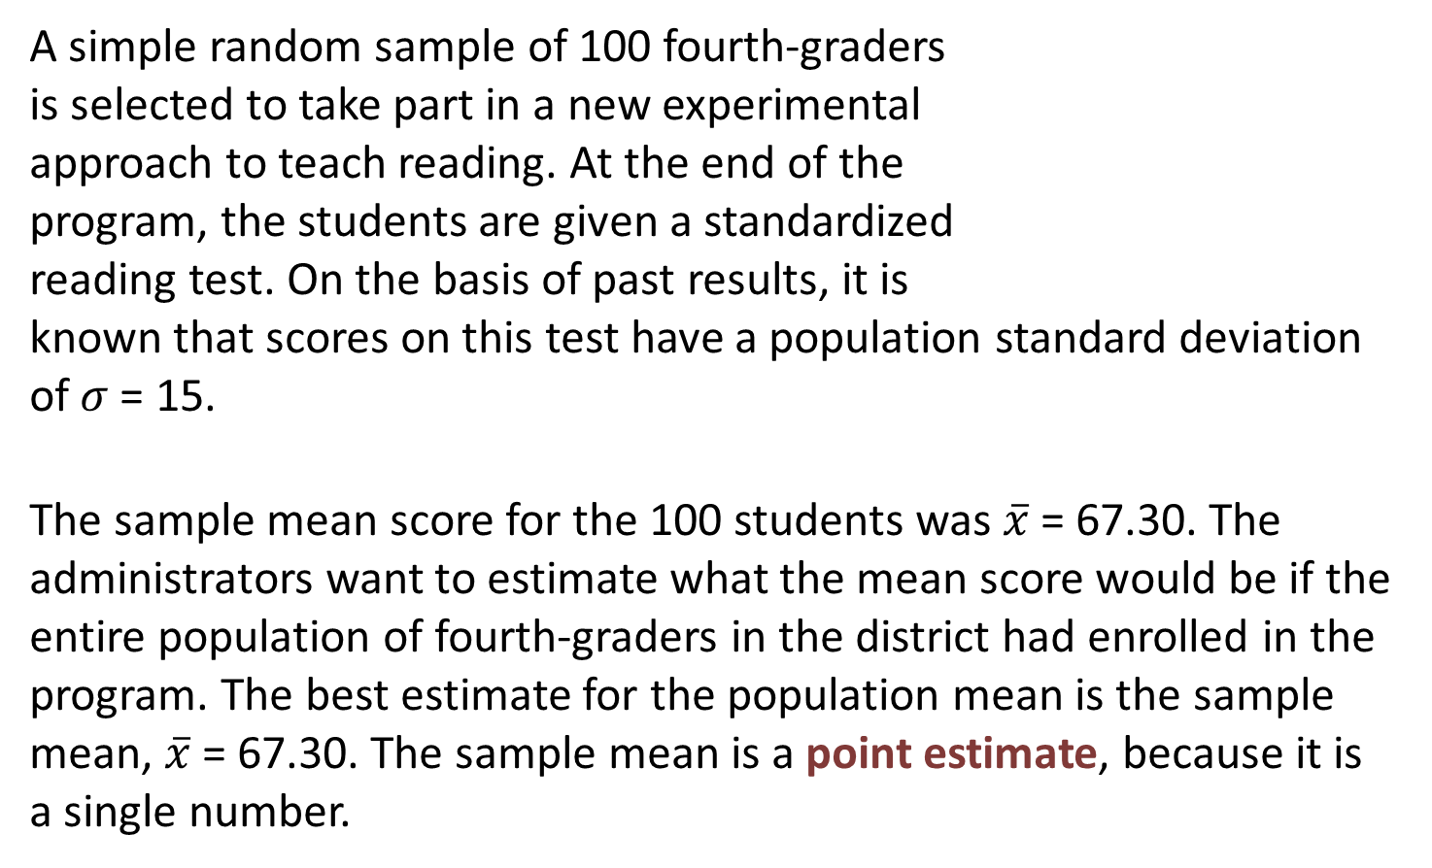
Point Estimate
A simple random sample of 100 fourth-graders
is selected to take part in a new experimental
approach to teach reading. At the end of the
program, the students are given a standardized
reading test. On the basis of past results, it is
known that scores on this test have a population standard deviation of$σ$= 15.
The sample mean score for the 100 students was $\overline{x}$ = 67.30. The administrators want to estimate what the mean score would be if the entire population of fourth-graders in the district had enrolled in the program. The best estimate for the population mean is the sample mean, $\overline{x}$= 67.30. The sample mean is a point estimate, because it is a single number.

Slide 6
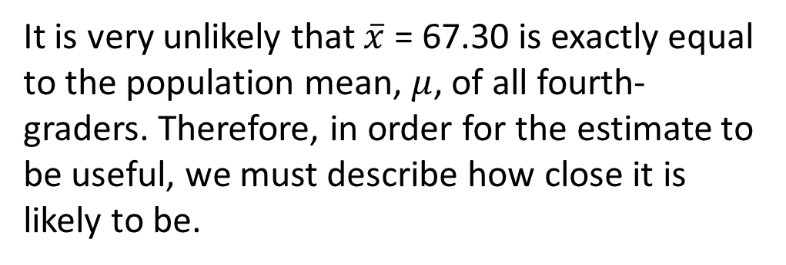
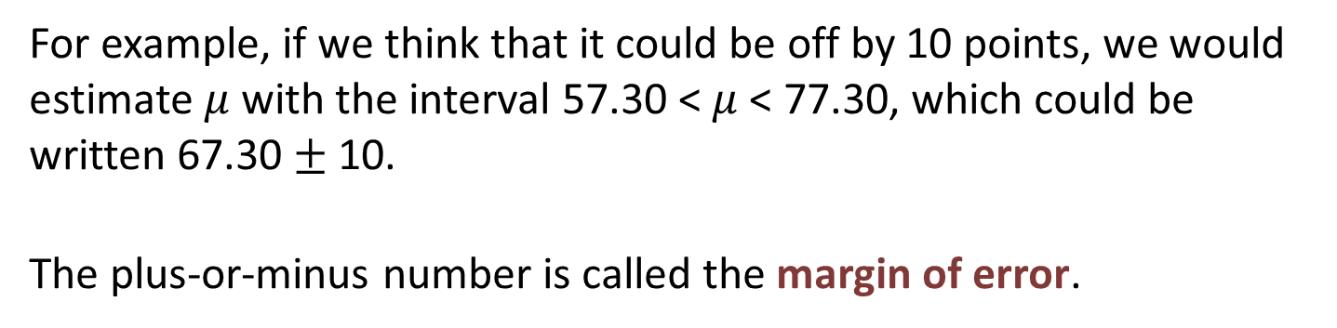
Margin of Error
It is very unlikely that $\overline{x}$ = 67.30 is exactly equal to the population mean, $μ$, of all fourth-graders. Therefore, in order for the estimate to be useful, we must describe how close it is likely to be.
For example, if we think that it could be off by 10 points, we would estimate $μ$ with the interval 57.30 < $μ$ < 77.30, which could be written 67.30 $±$ 10.
The plus-or-minus number is called the margin of error.

Slide 7
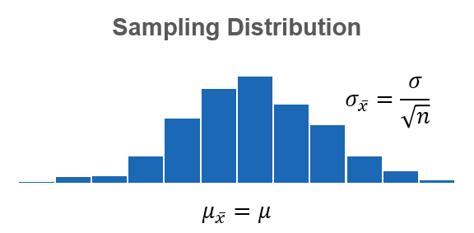
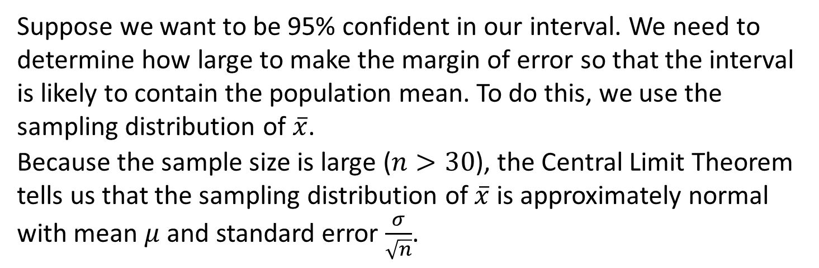
95% Confidence Interval
Suppose we want to be 95% confident in our interval. We need to determine how large to make the margin of error so that the interval is likely to contain the population mean. To do this, we use the sampling distribution of $\overline{x}$.
Because the sample size is large ($n>30$), the Central Limit Theorem tells us that the sampling distribution of $\overline{x}$ is approximately normal with mean $μ$ and standard error $\frac{σ}{\sqrt{n}}$.

Slide 8
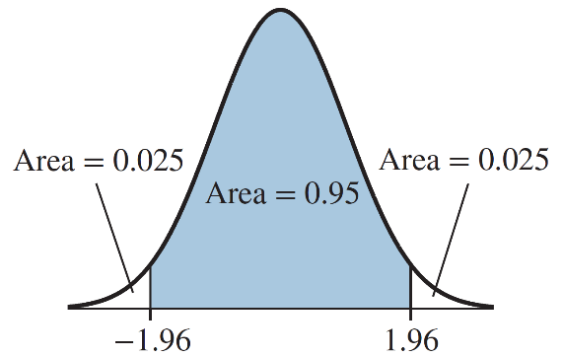

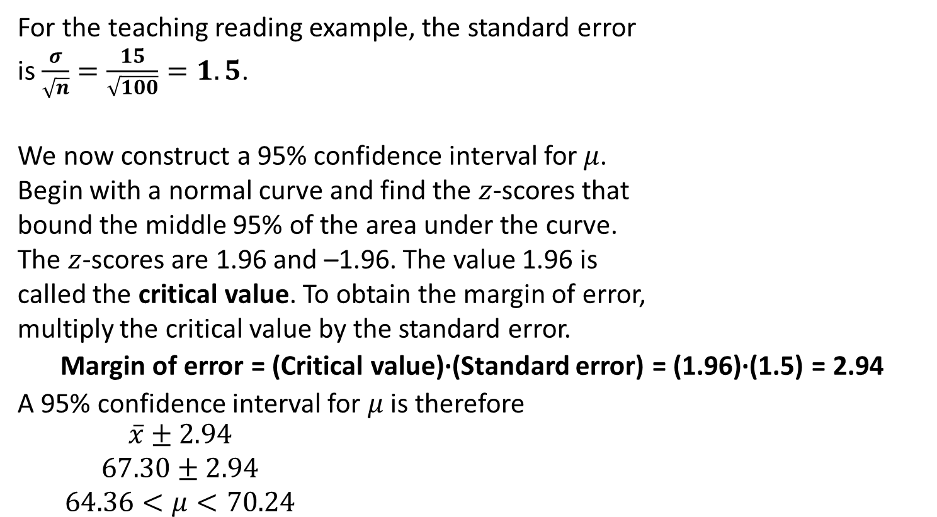
95% Confidence Interval (Continued)
For the teaching reading example, the standard error
is $\frac{σ}{\sqrt{n}}=\frac{15}{\sqrt{100}}=1.5$.
We now construct a 95% confidence interval for $μ$.
Begin with a normal curve and find the $z$-scores that
bound the middle 95% of the area under the curve.
The $z$-scores are 1.96 and –1.96. The value 1.96 is
called the critical value. To obtain the margin of error,
multiply the critical value by the standard error.
Margin of error = (Critical value)∙(Standard error) = (1.96)∙(1.5) = 2.94
A 95% confidence interval for $μ$ is therefore
$\begin{aligned}\overline{x}±2.94 \\ 67.30±2.94 \\ 64.36&<μ<70.24\end{aligned}$
Remember:
$\overline{x}=67.30$
$σ=15$
$n=100$
We are 95% confident that the population mean is between 64.36 and 70.24.

Slide 9
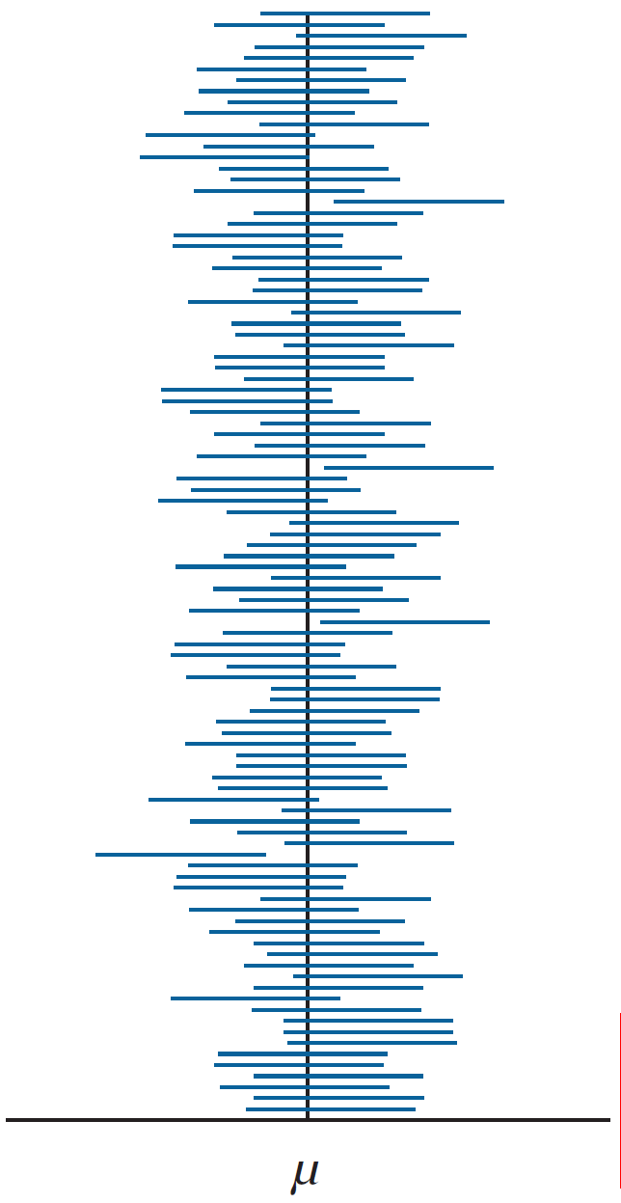
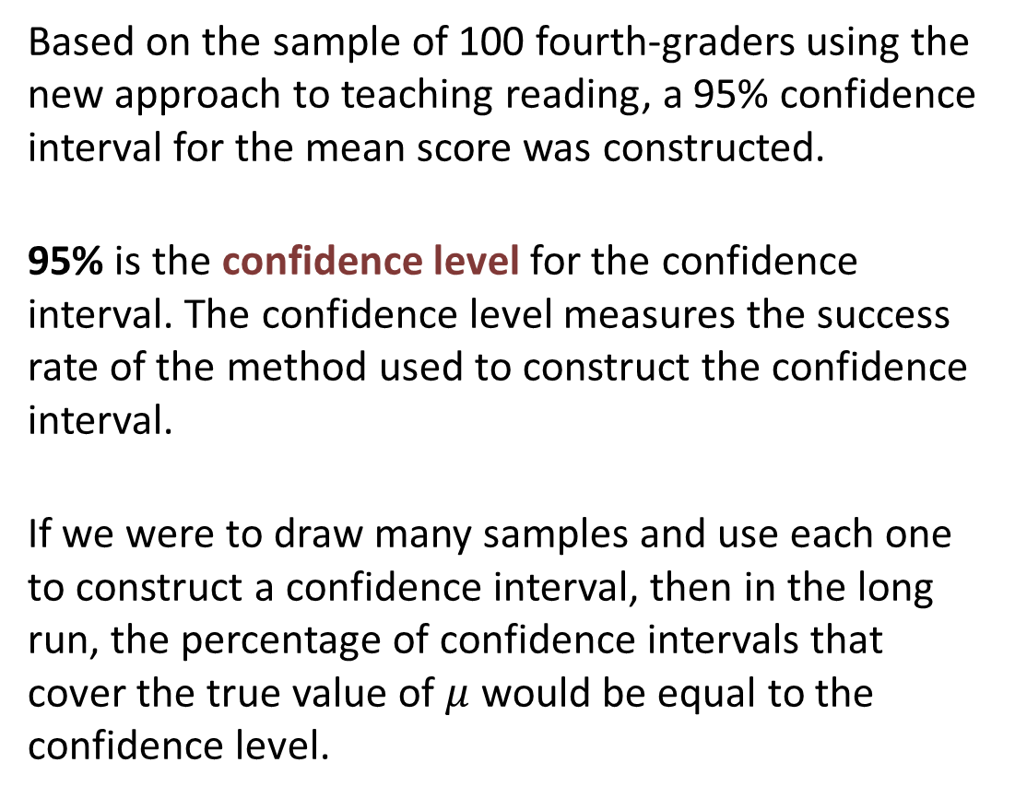
Confidence Level
Based on the sample of 100 fourth-graders using the new approach to teaching reading, a 95% confidence interval for the mean score was constructed.
95% is the confidence level for the confidence interval. The confidence level measures the success rate of the method used to construct the confidence interval.
If we were to draw many samples and use each one to construct a confidence interval, then in the long run, the percentage of confidence intervals that cover the true value of $μ$ would be equal to the confidence level.

Slide 10
Terminology
A point estimate is a single number that is used to estimate the value of an unknown parameter.
A confidence interval is an interval that is used to estimate the value of a parameter.
The confidence level is a percentage between 0% and 100% that measures the success rate of the method used to construct the confidence interval.
The margin of error is computed by multiplying the critical value by the standard error.

Slide 11
Objective 2
Find critical values for confidence intervals

Slide 12
Finding the Critical Value
Although 95% is the most commonly used confidence level, sometimes we will want to construct a confidence interval with a different level. We can construct a confidence interval with any confidence level between 0% and 100% by finding the appropriate critical value for that level. The critical values for several common confidence levels are given in the bottom row of Table A.3.

Slide 13
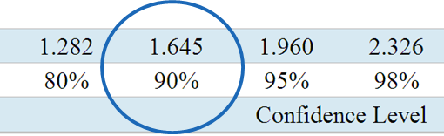

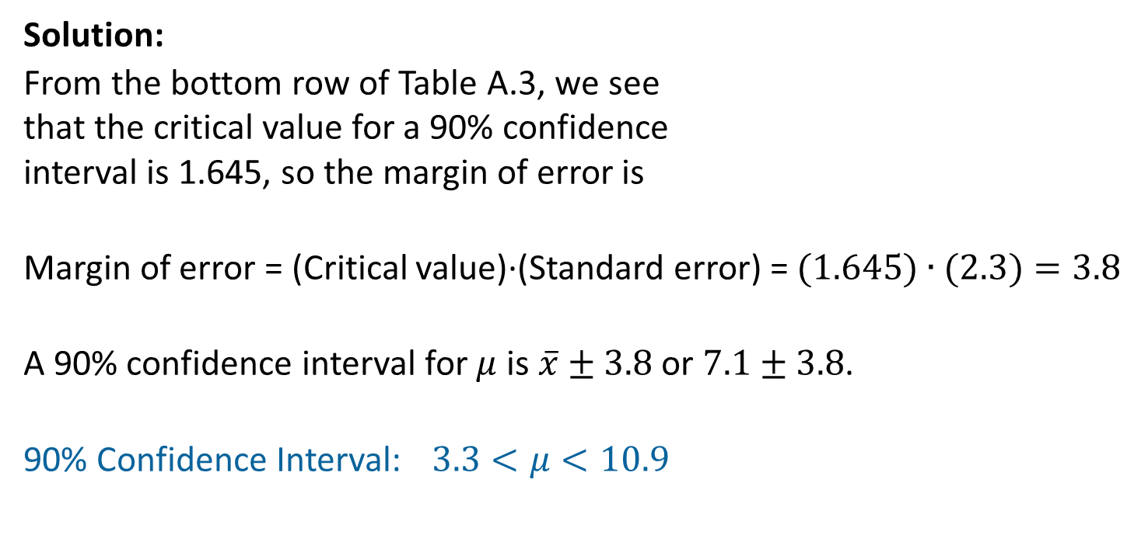
Example 1: Confidence Interval
A large sample has mean $\overline{x}=7.1$ and standard error $\frac{σ}{\sqrt{n}}=2.3$. Construct a 90% confidence interval for the population mean $μ$.
Solution:
From the bottom row of Table A.3, we see
that the critical value for a 90% confidence
interval is 1.645, so the margin of error is
Margin of error = (Critical value)∙(Standard error) = $(1.645)∙(2.3)=3.8$
A 90% confidence interval for $μ$ is $\overline{x}±3.8$ or $7.1±3.8$.
90% Confidence Interval: $3.3<μ<10.9$

Slide 14
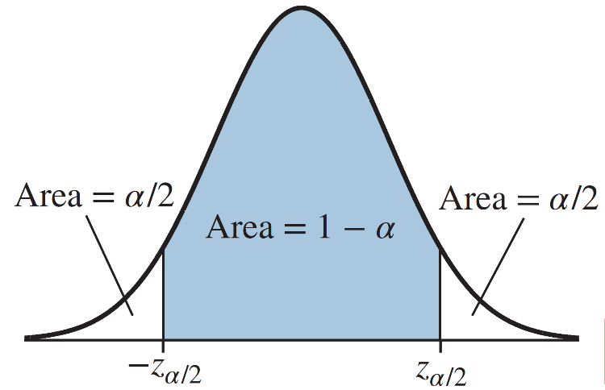

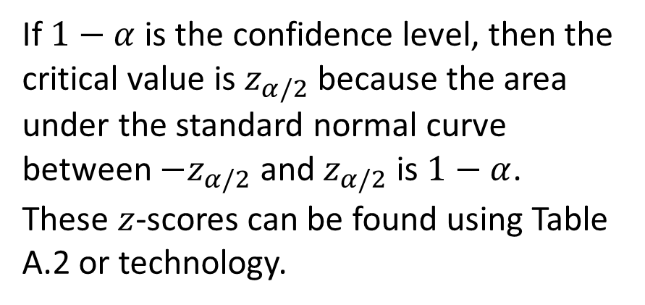
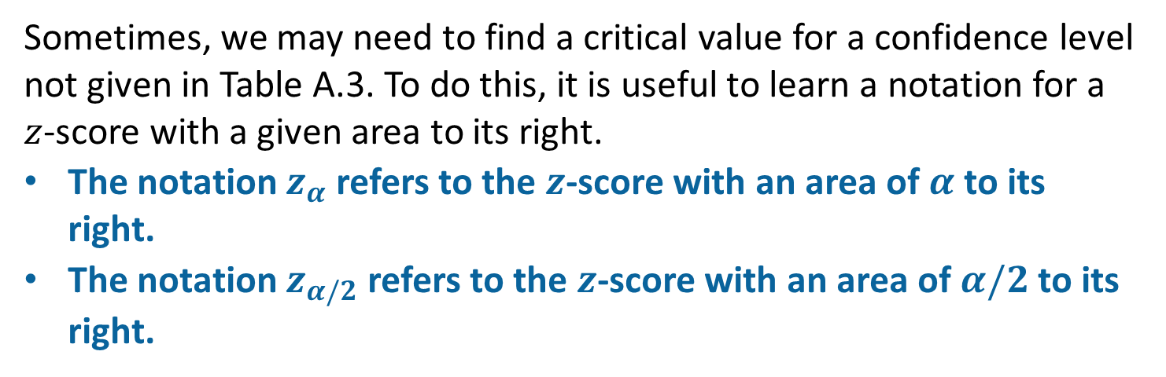
$z_{α}$ Notation
Sometimes, we may need to find a critical value for a confidence level not given in Table A.3. To do this, it is useful to learn a notation for a $z$-score with a given area to its right.
The notation $z_{α}$ refers to the $z$-score with an area of $α$ to its right.
The notation $z_{α/2}$ refers to the $z$-score with an area of $α/2$ to its right.
If $1−α$ is the confidence level, then the critical value is $z_{α/2}$ because the area under the standard normal curve between ${−z}_{α/2}$ and $z_{α/2}$ is $1−α$.
These $z$-scores can be found using Table A.2 or technology.

Slide 15
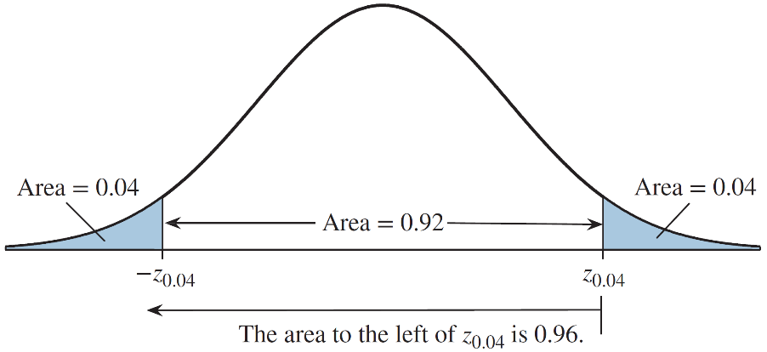
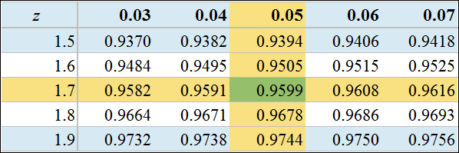
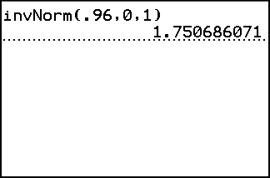
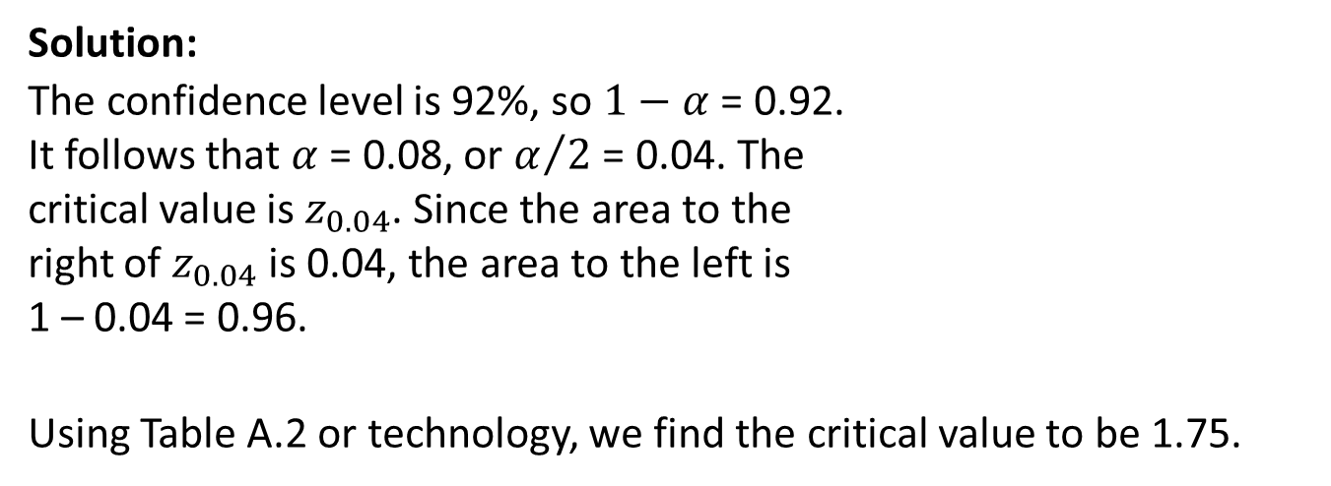
Example: Finding a Critical Value Not in the Table
Find the critical value $z_{α/2}$ for a 92% confidence interval.
Solution:
The confidence level is 92%, so $1−α$ = 0.92.
It follows that $α$ = 0.08, or $α/2$ = 0.04. The
critical value is $z_{0.04}$. Since the area to the
right of $z_{0.04}$ is 0.04, the area to the left is
1 – 0.04 = 0.96.
Using Table A.2 or technology, we find the critical value to be 1.75.

Slide 16
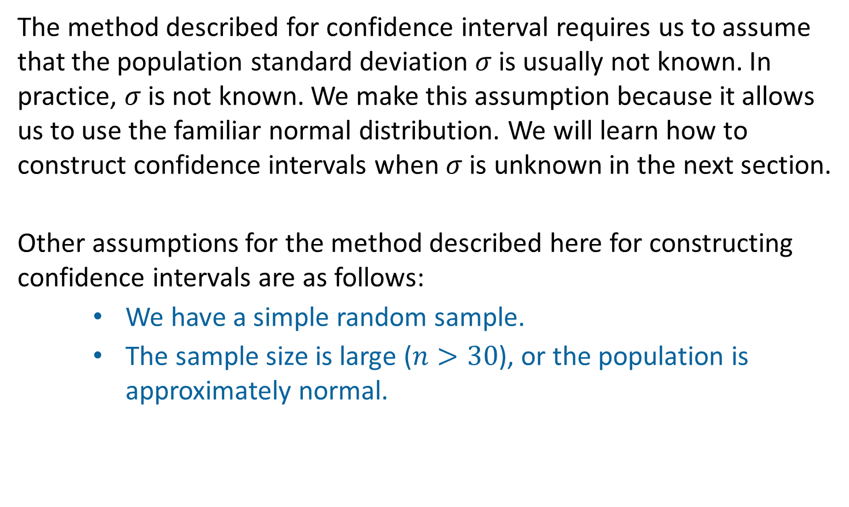
Assumptions
The method described for confidence interval requires us to assume that the population standard deviation $σ$ is usually not known. In practice, $σ$ is not known. We make this assumption because it allows us to use the familiar normal distribution. We will learn how to construct confidence intervals when $σ$ is unknown in the next section.
Other assumptions for the method described here for constructing confidence intervals are as follows:
We have a simple random sample.
The sample size is large ($n>30$), or the population is approximately normal.

Slide 17
Example 2: Confidence Interval
A machine that fills cereal boxes is supposed to put 20 ounces of cereal in each box. A simple random sample of 6 boxes is found to contain a sample mean of 20.25 ounces of cereal. It is known from past experience that the fill weights are normally distributed with a standard deviation of 0.2 ounce.
Construct a 90% confidence interval for the mean fill weight.

Slide 18
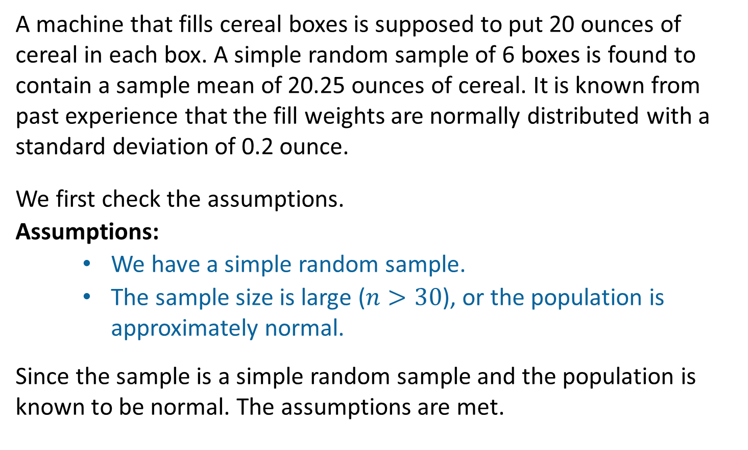
Example 2: Confidence Interval (Continued 1)
A machine that fills cereal boxes is supposed to put 20 ounces of cereal in each box. A simple random sample of 6 boxes is found to contain a sample mean of 20.25 ounces of cereal. It is known from past experience that the fill weights are normally distributed with a standard deviation of 0.2 ounce.
We first check the assumptions.
Assumptions:
We have a simple random sample.
The sample size is large ($n>30$), or the population is approximately normal.
Since the sample is a simple random sample and the population is known to be normal. The assumptions are met.

Slide 19
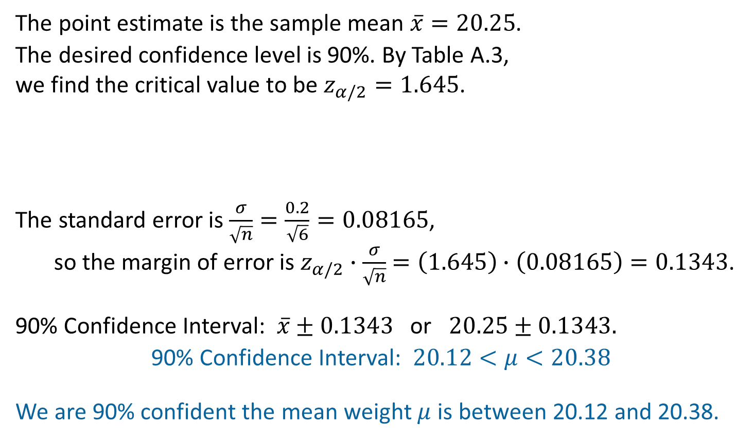

Example 2: Confidence Interval (Continued 2)
The point estimate is the sample mean $\overline{x}=20.25$.
The desired confidence level is 90%. By Table A.3,
we find the critical value to be $z_{α/2}=1.645$.
The standard error is $\frac{σ}{\sqrt{n}}=\frac{0.2}{\sqrt{6}}=0.08165$,
so the margin of error is $z_{α/2}∙\frac{σ}{\sqrt{n}}$ $=\left(1.645\right)∙\left(0.08165\right)=0.1343$.
90% Confidence Interval: $\overline{x}±0.1343$ or $20.25±0.1343.$
90% Confidence Interval:$20.12<μ<20.38$
We are 90% confident the mean weight $μ$ is between 20.12 and 20.38.
Remember:
$\overline{x}=20.25$
$σ=0.2$
$n=6$

Slide 20
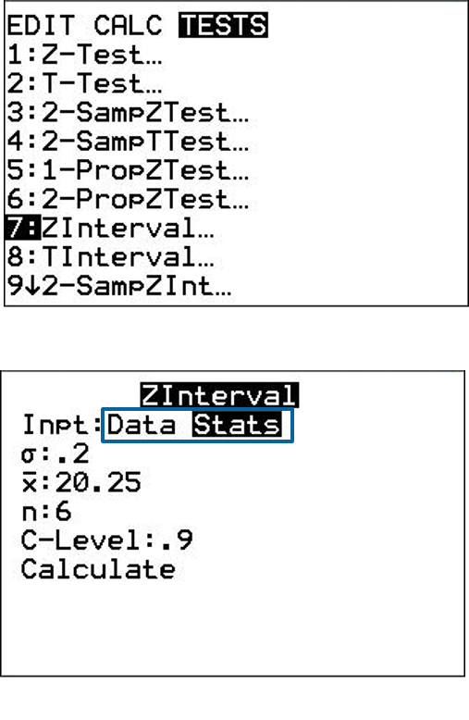
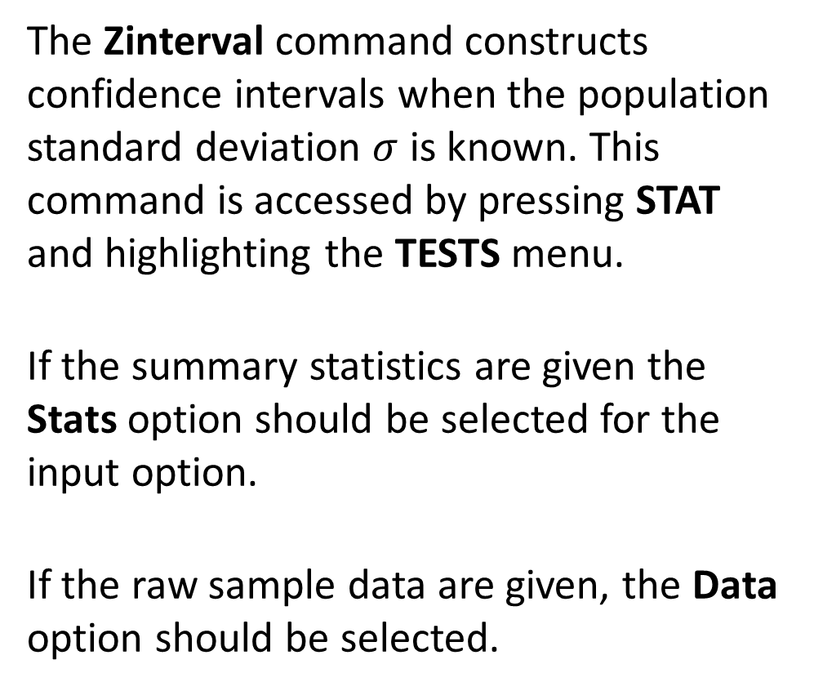
Confidence Intervals on the TI-84 PLUS
The Zinterval command constructs confidence intervals when the population standard deviation $σ$ is known. This command is accessed by pressing STAT and highlighting the TESTS menu.
If the summary statistics are given the Stats option should be selected for the input option.
If the raw sample data are given, the Data option should be selected.

Slide 21
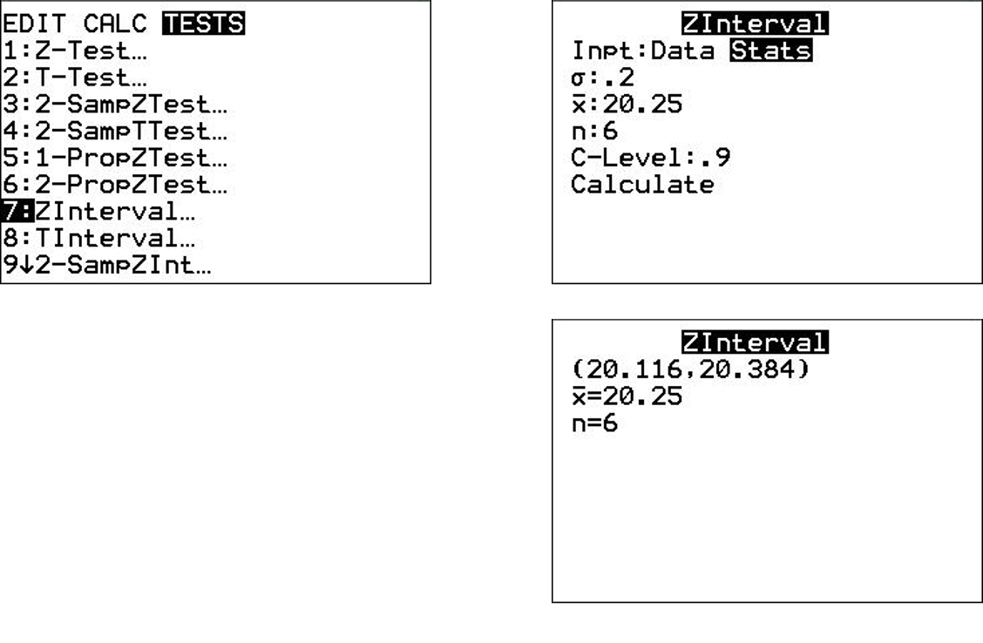
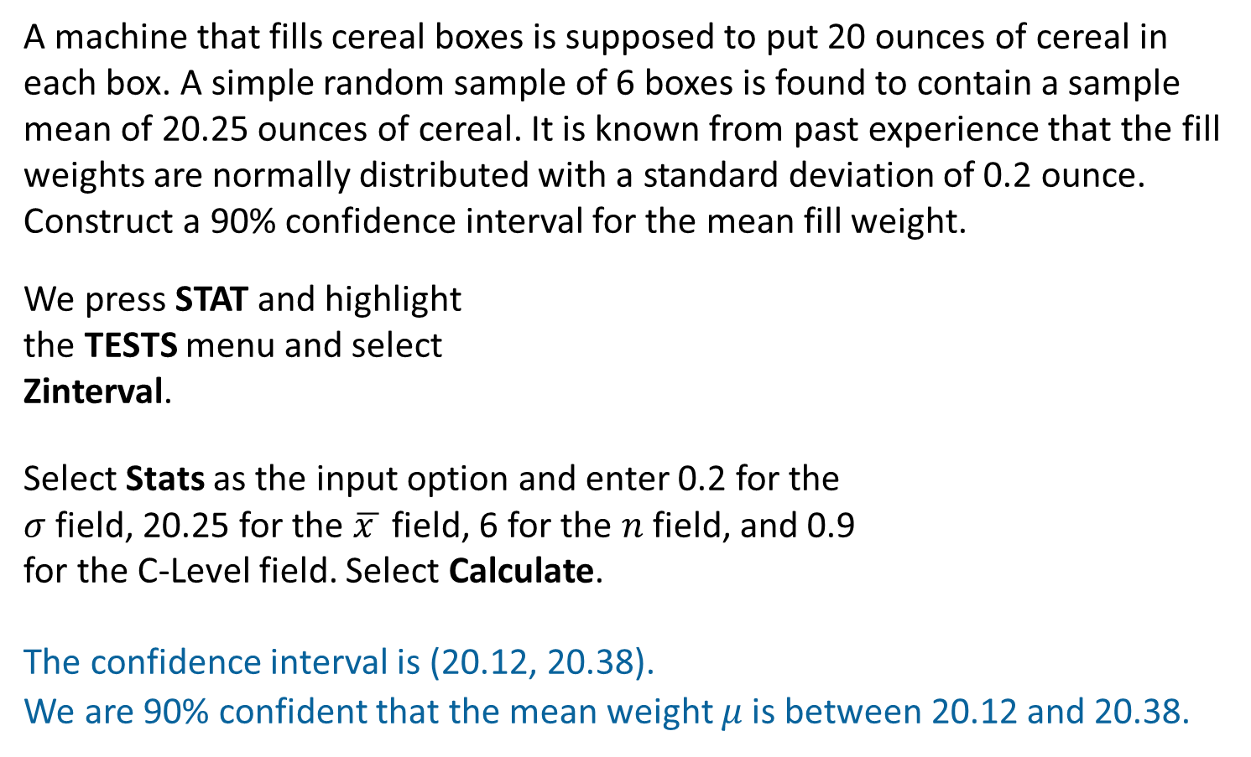
Example: Confidence Interval (TI-84 PLUS)
A machine that fills cereal boxes is supposed to put 20 ounces of cereal in each box. A simple random sample of 6 boxes is found to contain a sample mean of 20.25 ounces of cereal. It is known from past experience that the fill weights are normally distributed with a standard deviation of 0.2 ounce. Construct a 90% confidence interval for the mean fill weight.
We press STAT and highlight
the TESTS menu and select
Zinterval.
Select Stats as the input option and enter 0.2 for the
$σ$ field, 20.25 for the $\overline{x }$ field, 6 for the $n$ field, and 0.9
for the C-Level field. Select Calculate.
The confidence interval is (20.12, 20.38).
We are 90% confident that the mean weight $μ$ is between 20.12 and 20.38.

Slide 22
Objective 3
Describe the relationship between the confidence level and the margin of error

Slide 23
Confidence Versus Margin of Error
If we want to be more confident that our interval contains the true value, we must increase the critical value, which increases the margin of error. There is a trade-off. We would rather have a higher level of confidence than a lower level, but we would also rather have a smaller margin of error than a larger one.

Slide 24
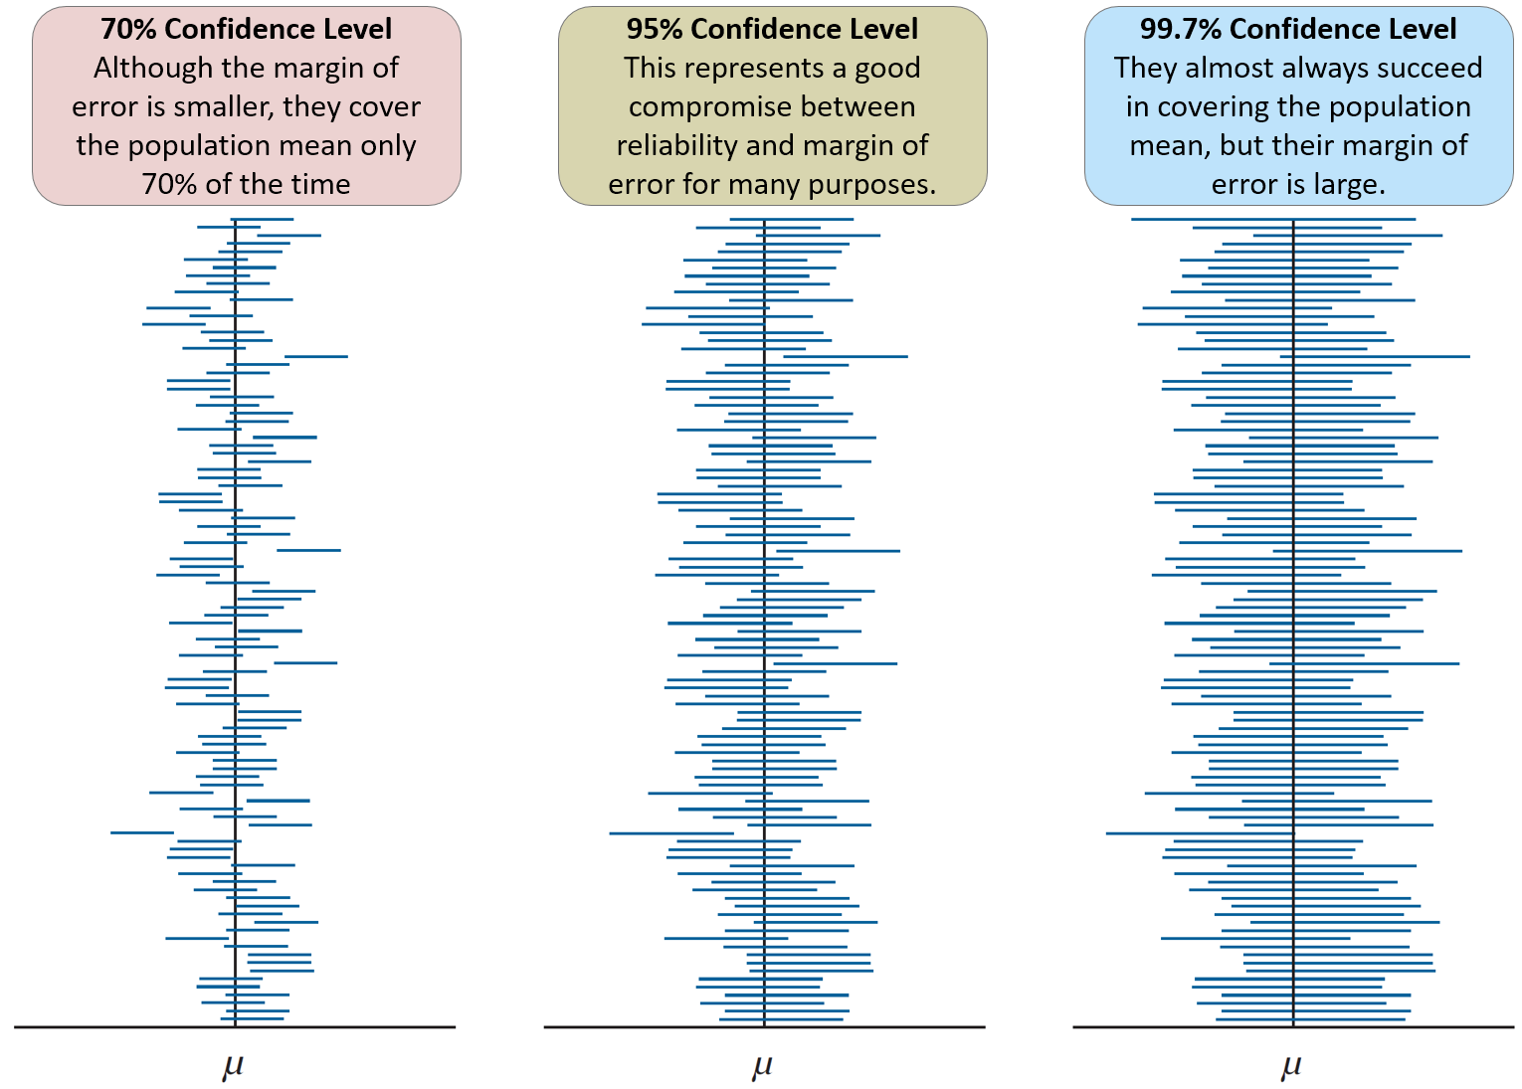
Comparing Confidence Levels

Slide 25
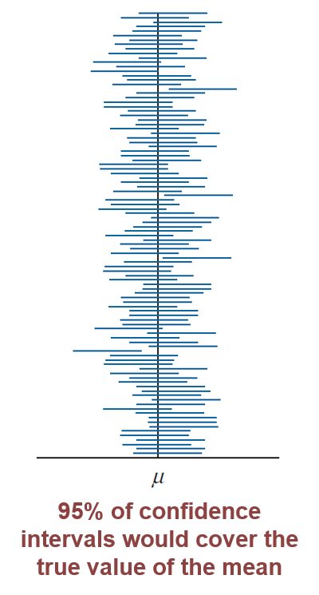
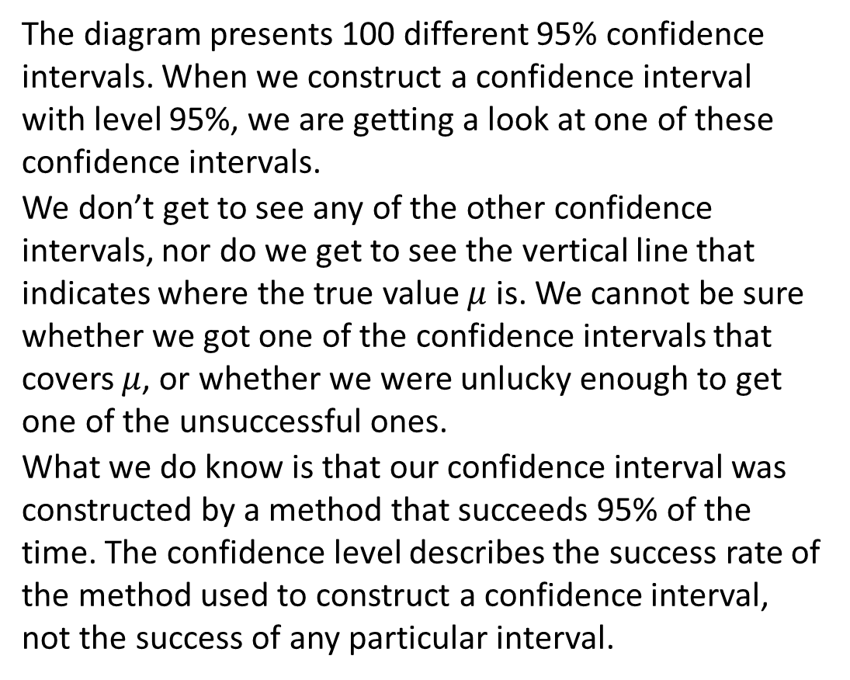
Measuring the Success Rate of the Method
The diagram presents 100 different 95% confidence intervals. When we construct a confidence interval with level 95%, we are getting a look at one of these confidence intervals.
We don’t get to see any of the other confidence intervals, nor do we get to see the vertical line that indicates where the true value $μ$ is. We cannot be sure whether we got one of the confidence intervals that covers $μ$, or whether we were unlucky enough to get one of the unsuccessful ones.
What we do know is that our confidence interval was constructed by a method that succeeds 95% of the time. The confidence level describes the success rate of the method used to construct a confidence interval, not the success of any particular interval.

Slide 26
Objective 4
Find the sample size necessary to obtain a confidence interval of a given width

Slide 27
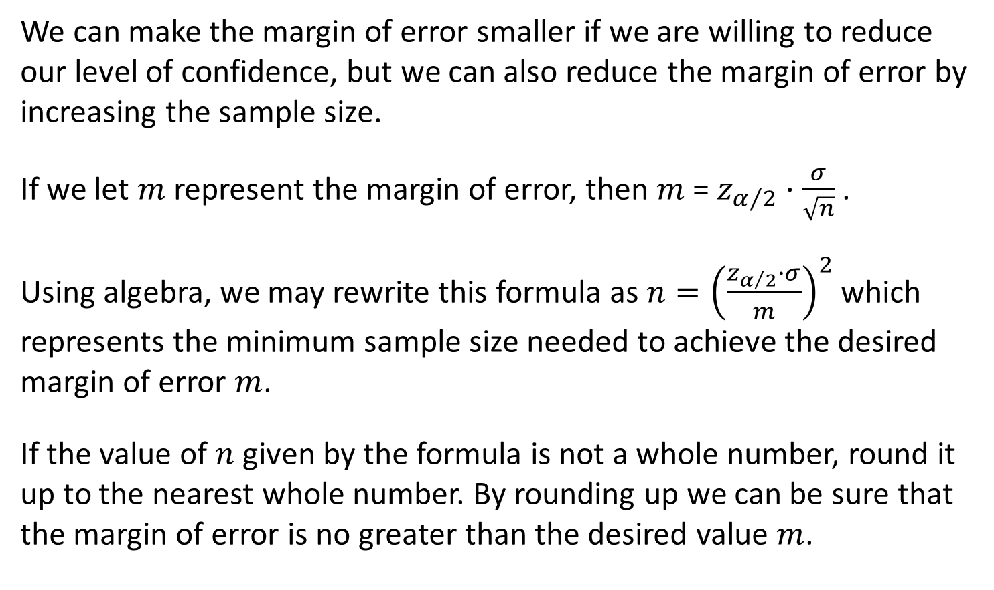
Sample Size
We can make the margin of error smaller if we are willing to reduce our level of confidence, but we can also reduce the margin of error by increasing the sample size.
If we let $m$ represent the margin of error, then $m$ = $z_{α/2}·\frac{σ}{\sqrt{n}}$ .
Using algebra, we may rewrite this formula as $n={\left(\frac{z_{α/2}∙σ}{m}\right)}^{2}$ which represents the minimum sample size needed to achieve the desired margin of error $m$.
If the value of $n$ given by the formula is not a whole number, round it up to the nearest whole number. By rounding up we can be sure that the margin of error is no greater than the desired value $m$.

Slide 28
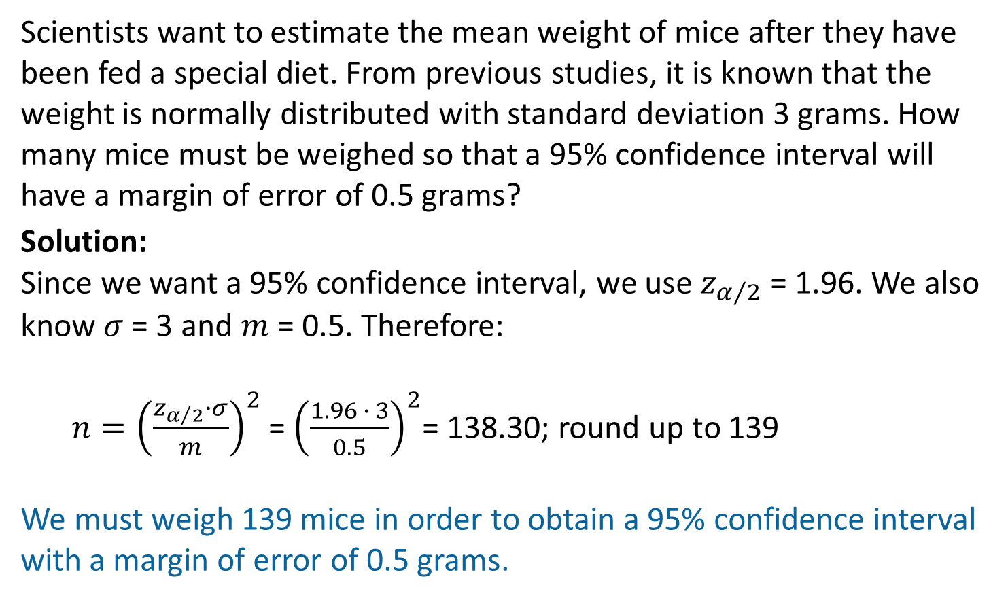
Example: Sample Size
Scientists want to estimate the mean weight of mice after they have been fed a special diet. From previous studies, it is known that the weight is normally distributed with standard deviation 3 grams. How many mice must be weighed so that a 95% confidence interval will have a margin of error of 0.5 grams?
Solution:
Since we want a 95% confidence interval, we use $z_{α/2}$= 1.96. We also know $σ$ = 3 and $m$ = 0.5. Therefore:
$n={\left(\frac{z_{α/2}∙σ}{m}\right)}^{2}$= ${\left(\frac{1.96 ∙ 3}{0.5}\right)}^{2}$= 138.30; round up to 139
We must weigh 139 mice in order to obtain a 95% confidence interval with a margin of error of 0.5 grams.

Slide 29
Objective 5
Distinguish between confidence and probability

Slide 30
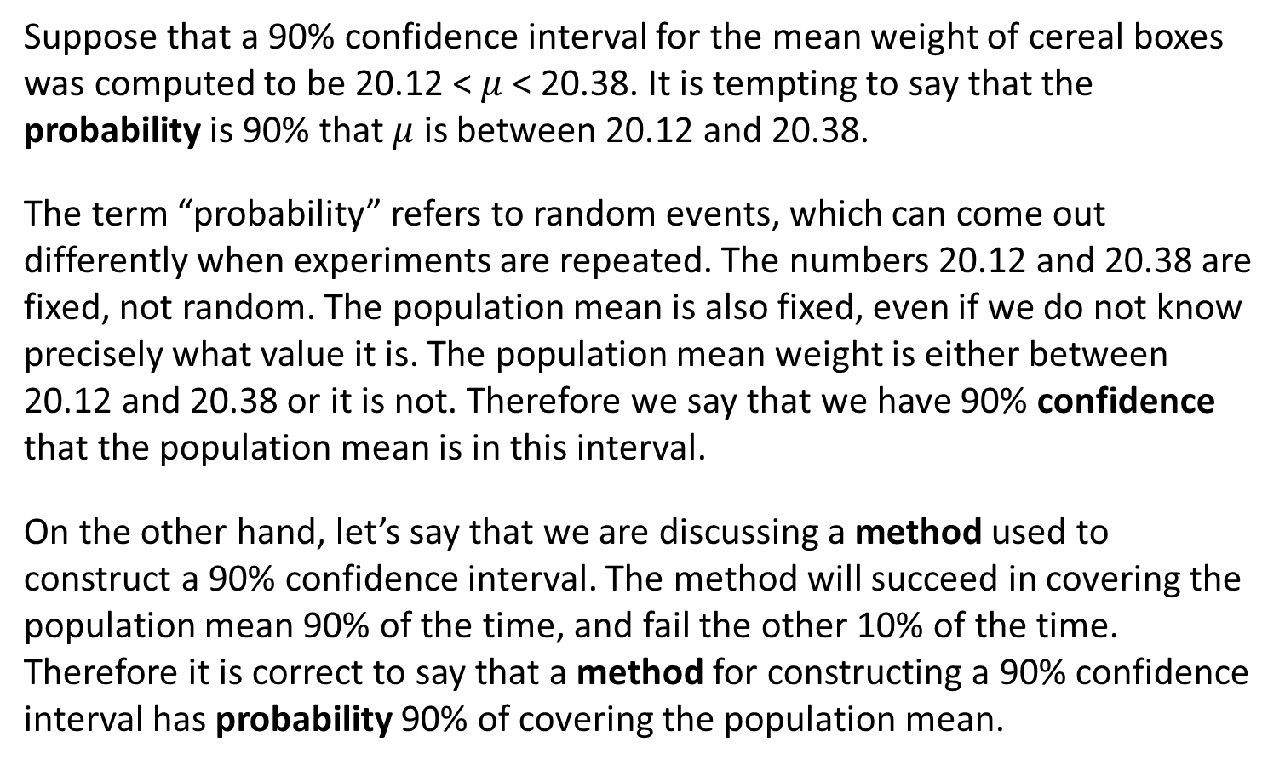
Interpreting a Confidence Level
Suppose that a 90% confidence interval for the mean weight of cereal boxes was computed to be 20.12 < $μ$ < 20.38. It is tempting to say that the probability is 90% that $μ$ is between 20.12 and 20.38.
The term “probability” refers to random events, which can come out differently when experiments are repeated. The numbers 20.12 and 20.38 are fixed, not random. The population mean is also fixed, even if we do not know precisely what value it is. The population mean weight is either between 20.12 and 20.38 or it is not. Therefore we say that we have 90% confidence that the population mean is in this interval.
On the other hand, let’s say that we are discussing a method used to construct a 90% confidence interval. The method will succeed in covering the population mean 90% of the time, and fail the other 10% of the time. Therefore it is correct to say that a method for constructing a 90% confidence interval has probability 90% of covering the population mean.

Slide 31
You Should Know . . .
How to construct and interpret confidence intervals for a population mean when the population standard deviation is known
How to find critical values for confidence intervals
How to describe the relationship between the confidence level and the margin of error
How to find the sample size necessary to obtain a confidence interval of a given width
The difference between confidence and probability

Slide 32
Elementary Statistics 3E
William Navidi and Barry Monk

Slide 33
Confidence Intervals for a Population Mean, $σ$ Unknown
Section 8.2

Slide 34

Objectives
Describe the properties of the Student’s $t$ distribution
Construct confidence intervals for a population mean when the population standard deviation is unknown

Slide 35

Objective 1
Describe the properties of the Student’s $t$ distribution

Slide 36
Student’s $t$ Distribution
When constructing a confidence interval where we know the population standard deviation $σ$, the confidence interval is $\overline{x}±z_{α/2}∙\frac{σ}{\sqrt{n}}$. The critical value is $z_{α/2}$ because the quantity $\frac{ \overline{x }−μ}{σ/{\sqrt{n}}}$ has a normal distribution.
It is rare that we would know the value of $σ$ while needing to estimate the value of $μ$. In practice, it is more common that $σ$ is unknown. When we don’t know the value of $σ$, we may replace it with the sample standard deviation $s$. However, we cannot then use ${ z}_{α/2 }$ as the critical value, because the quantity $\frac{\overline{x } −μ}{s/{\sqrt{n}}}$ does not have a normal distribution. The distribution of this quantity is called the Student’s $t$ distribution.
There are actually many different Student’s $t$ distributions and they are distinguished by a quantity called the degrees of freedom. When using the Student’s $t$ distribution to construct a confidence interval for a population mean, the number of degrees of freedom is 1 less than the sample size.

Slide 37
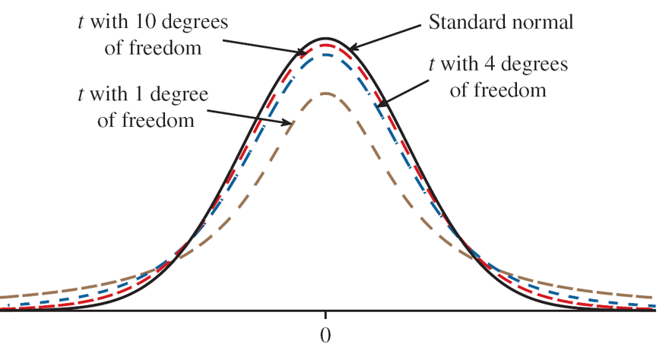
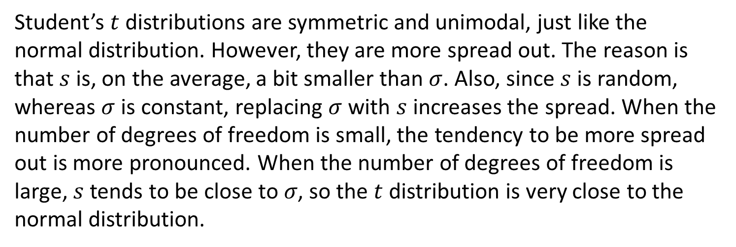
Student’s $t$ Distribution and the Standard Normal
Student’s $t$ distributions are symmetric and unimodal, just like the normal distribution. However, they are more spread out. The reason is that $s$ is, on the average, a bit smaller than $σ$. Also, since $s$ is random, whereas $σ$is constant, replacing $σ$with $s$ increases the spread. When the number of degrees of freedom is small, the tendency to be more spread out is more pronounced. When the number of degrees of freedom is large, $s$ tends to be close to 𝜎, so the $t$ distribution is very close to the normal distribution.

Slide 38
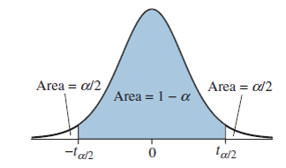
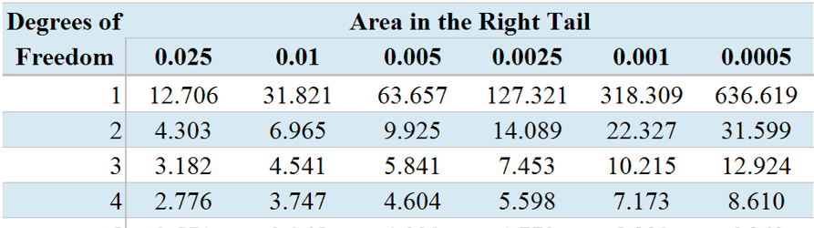
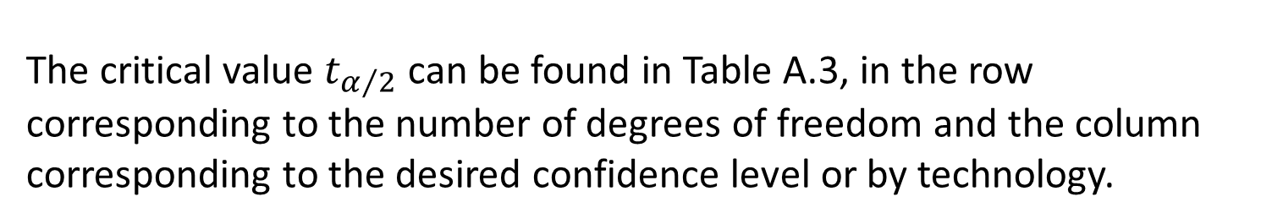
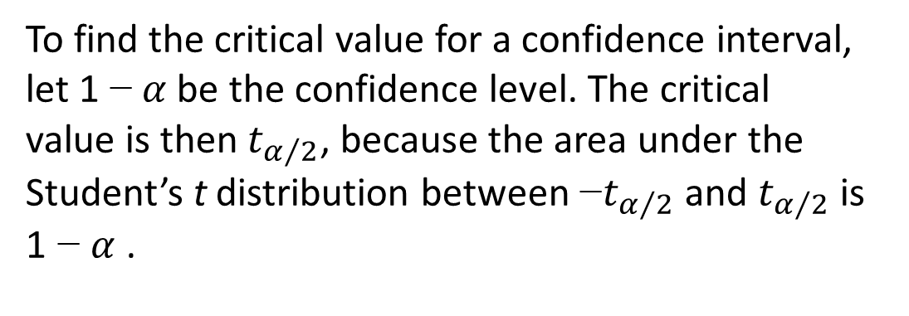
The Critical Value $t_{α/2}$
To find the critical value for a confidence interval, let 1 − $α$ be the confidence level. The critical value is then $t_{α/2}$, because the area under the Student’s t distribution between −$t_{α/2}$ and $t_{α/2}$ is 1 − $α$ .
The critical value $t_{α/2}$ can be found in Table A.3, in the row corresponding to the number of degrees of freedom and the column corresponding to the desired confidence level or by technology.

Slide 39
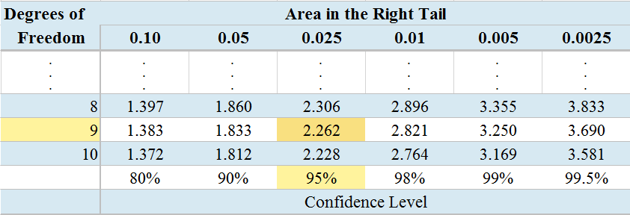
Example: Critical Value
A simple random sample of size 10 is drawn from a normal population. Find the critical value $t_{α/2}$for a 95% confidence interval.
Solution:
The sample size is $n$ = 10, so the number of degrees of freedom is
$n$ – 1 = 9. We consult Table A.3, looking in the row corresponding to 9 degrees of freedom, and in the column with confidence level 95%. The critical value is $t_{α/2}$ = 2.262.

Slide 40
Degrees of Freedom Not in the Table
If the desired number of degrees of freedom isn’t listed in Table A.3, then
If the desired number is less than 200, use the next smaller number that is in the table.
If the desired number is greater than 200, use the $z$-value found in the last row of Table A.3, or use Table A.2.

Slide 41
Assumptions
The assumptions for constructing a confidence interval for $μ$ when $σ$ is unknown are as follows.
We have a simple random sample.
The sample size is large ($n>30$), or the population is approximately normal.
When the sample size is small ($n≤30$), we must check to determine whether the sample comes from a population that is approximately normal. A simple method is to draw a dotplot or boxplot of the sample. If there are no outliers, and if the sample is not strongly skewed, then it is reasonable to assume the population is approximately normal and it is appropriate to construct a confidence interval using the Student’s $t$ distribution.

Slide 42
Objective 2*
Construct confidence intervals for a population mean when the population standard deviation is unknown *(Tables)

Slide 43

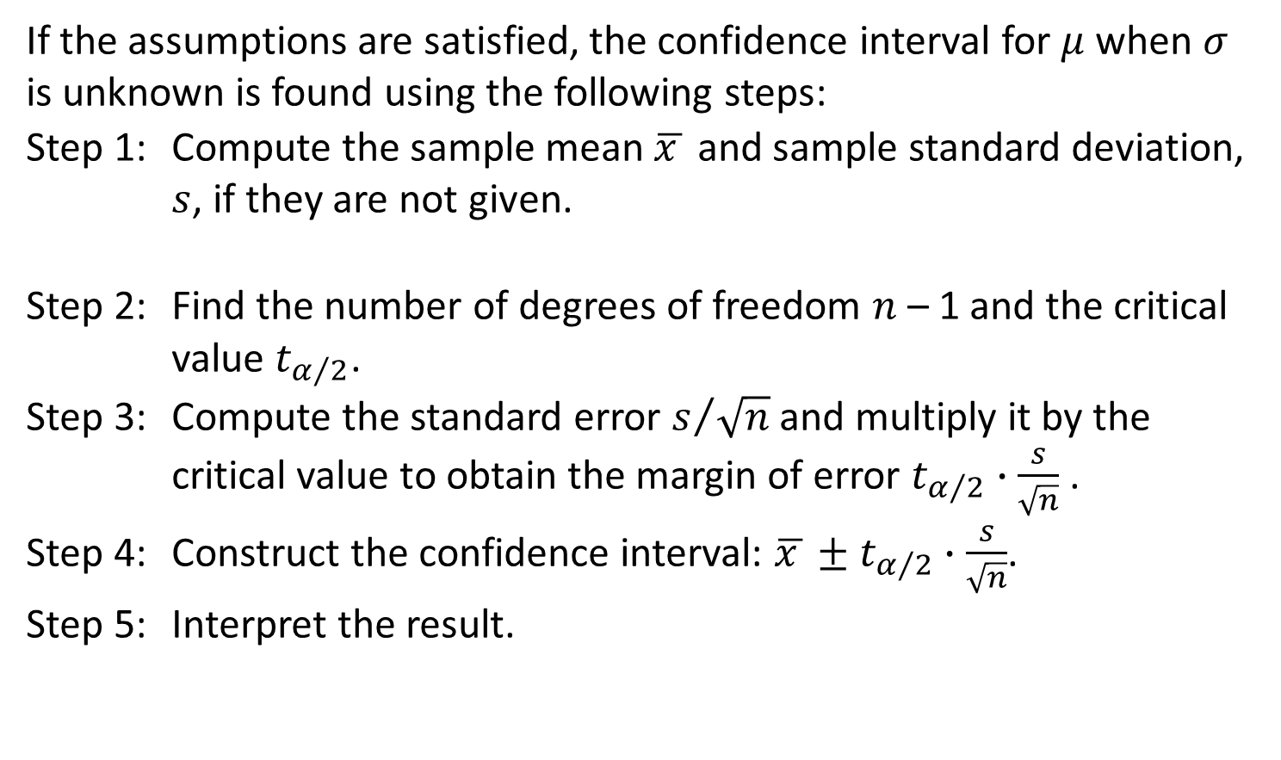
Confidence Interval When $σ$ is Unknown
If the assumptions are satisfied, the confidence interval for $μ$ when $σ$ is unknown is found using the following steps:
Step 1: Compute the sample mean $\overline{x }$ and sample standard deviation, $s$, if they are not given.
Step 2: Find the number of degrees of freedom $n$ – 1 and the critical value $t_{α/2}$.
Step 3: Compute the standard error $s/{\sqrt{n}}$ and multiply it by the critical value to obtain the margin of error $t_{α/2}∙\frac{s}{\sqrt{n}}$ .
Step 4: Construct the confidence interval: $\overline{x }±t_{α/2}∙\frac{s}{\sqrt{n}}$.
Step 5: Interpret the result.

Slide 44

Example 1: Confidence Interval
A food chemist analyzed the calorie content for a popular type of chocolate cookie. Following are the numbers of calories in a sample of eight cookies.
113, 114, 111, 116, 115, 120, 118, 116
Find a 98% confidence interval for the mean number of calories in this type of cookie.
Solution:
We check the assumptions. We have a simple random sample. Because the sample size is small, the population must be approximately normal. A dotplot indicates that there is no evidence of strong skewness and no outliers, therefore we may proceed.
Now, we find the sample mean and sample standard deviation. We have $\overline{x}=115.375$ and $s=2.8253$.

Slide 45
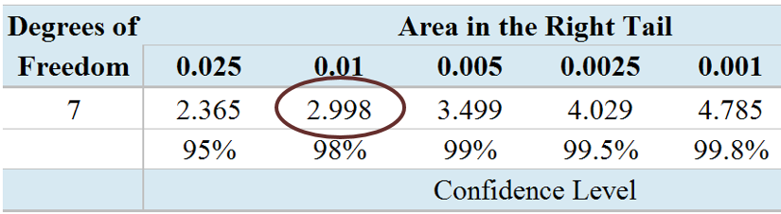
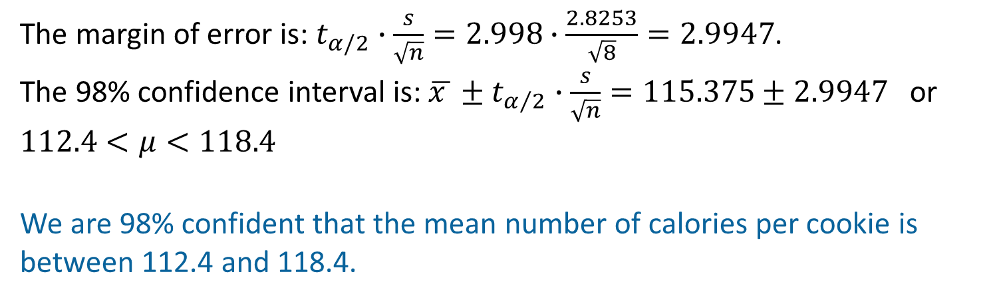
Example 1: Confidence Interval (Continued)
The number of degrees of freedom is $n−1=8−1$
$=7$. Using Table A.3, we find that the critical value corresponding to a level of 98% is $t_{α/2}=$2.998.
Remember:
$\overline{x}=115.375$
$s=2.8253$
$n=8$
The margin of error is:$t_{α/2}∙\frac{s}{\sqrt{n}}=2.998∙\frac{2.8253}{\sqrt{8}}=2.9947$.
The 98% confidence interval is: $\overline{x }±t_{α/2}∙\frac{s}{\sqrt{n}}=115.375±2.9947$ or $112.4<μ<118.4$
We are 98% confident that the mean number of calories per cookie is between 112.4 and 118.4.

Slide 46
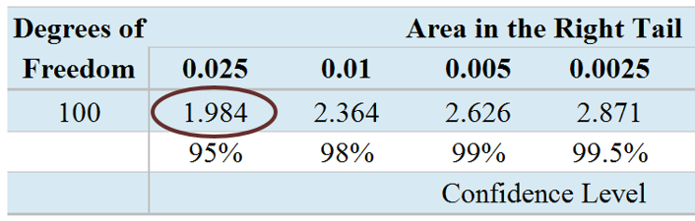
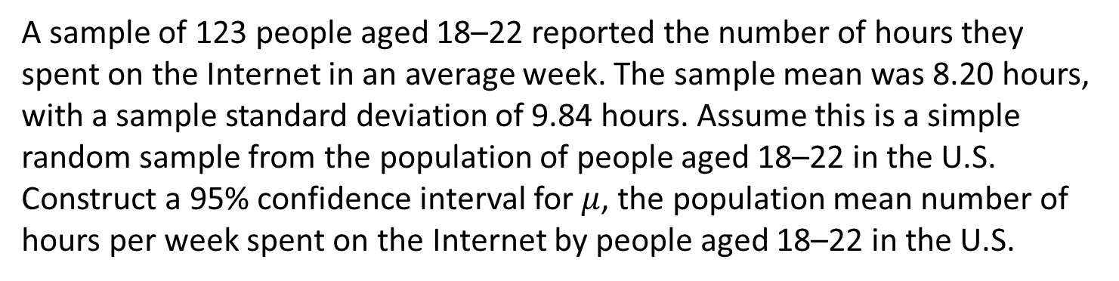
Example 2: Confidence Interval
A sample of 123 people aged 18–22 reported the number of hours they spent on the Internet in an average week. The sample mean was 8.20 hours, with a sample standard deviation of 9.84 hours. Assume this is a simple random sample from the population of people aged 18–22 in the U.S. Construct a 95% confidence interval for $μ$, the population mean number of hours per week spent on the Internet by people aged 18–22 in the U.S.
Solution:
We have a simple random sample and the sample size is large. We may proceed. Note that $\overline{x}=8.20$ and $s=9.84$. The number of degrees of freedom is $n−1=123−1=122$. Since this value does not appear in the table, we will use the next smaller
value in the table which is 100.
The critical value corresponding
to a level of 95% is $t_{α/2}$ = 1.984.

Slide 47
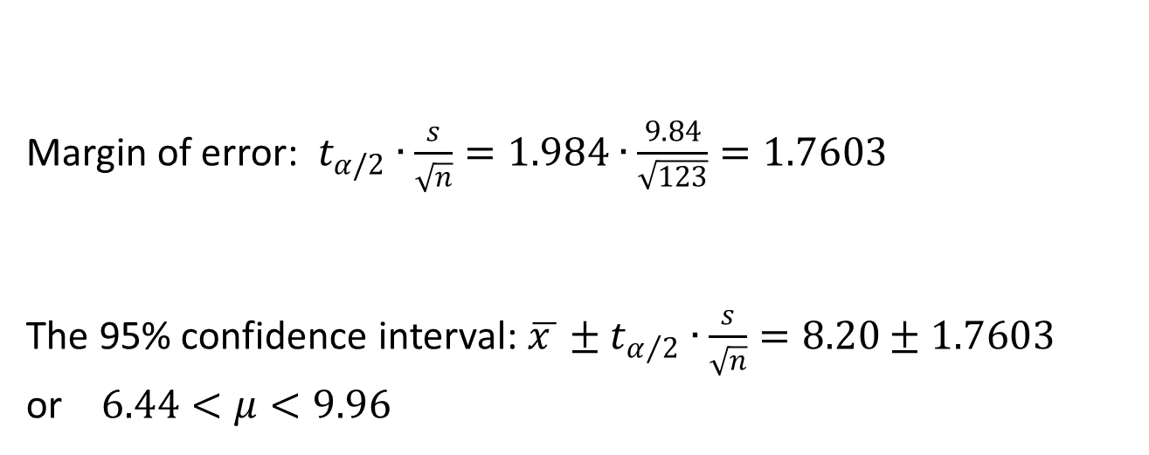
Example 2: Confidence Interval (Continued)
Margin of error: $t_{α/2}∙\frac{s}{\sqrt{n}}=1.984∙\frac{9.84}{\sqrt{123}}=1.7603$
The 95% confidence interval: $\overline{x }±t_{α/2}∙\frac{s}{\sqrt{n}}=8.20±1.7603$
or $6.44<μ<9.96$
Remember:
$\overline{x}=8.20$
$s=9.84$
$n=123$
$t_{α/2}=1.984$
We are 95% confident that the mean number of hours per week spent on the Internet by people 18 – 22 years old is between 6.44 and 9.96.

Slide 48
Objective 2**
Construct confidence intervals for a population mean when the population standard deviation is unknown **(TI-84 PLUS)

Slide 49
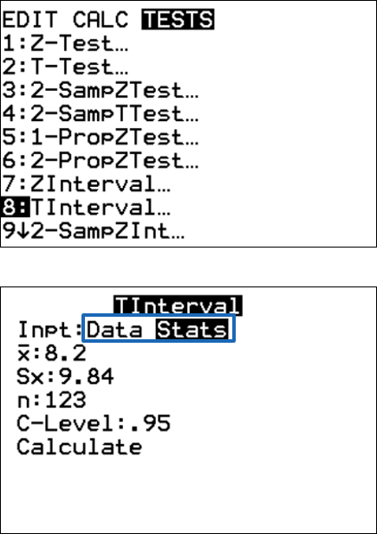
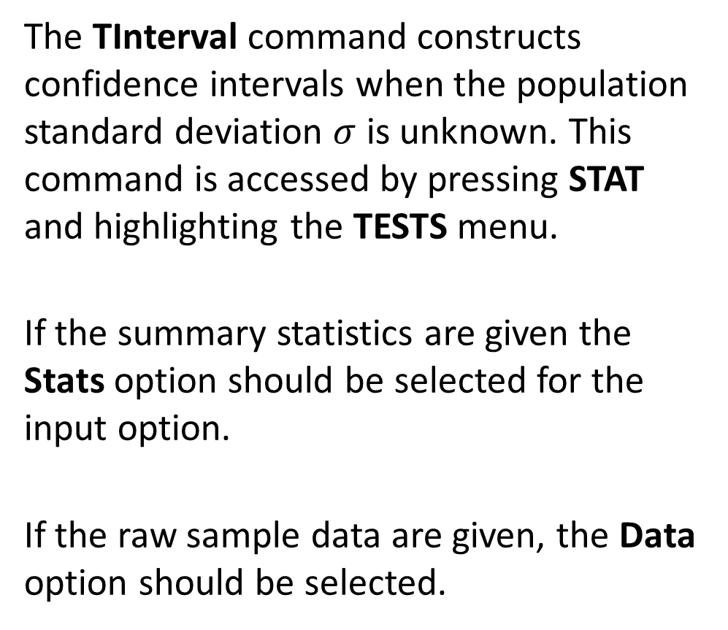
Confidence Intervals on the TI-84 PLUS
The TInterval command constructs confidence intervals when the population standard deviation $σ$ is unknown. This command is accessed by pressing STAT and highlighting the TESTS menu.
If the summary statistics are given the Stats option should be selected for the input option.
If the raw sample data are given, the Data option should be selected.

Slide 50
Example 1: Confidence Interval (TI-84 PLUS)
A food chemist analyzed the calorie content for a popular type of chocolate cookie. Following are the numbers of calories in a sample of eight cookies.
113, 114, 111, 116, 115, 120, 118, 116
Find a 98% confidence interval for the mean number of calories in this type of cookie.
Solution:
We check the assumptions. We have a simple random sample. Because the sample size is small, the population must be approximately normal. A dotplot indicates that there is no evidence of strong skewness and no outliers, therefore we may proceed.

Slide 51
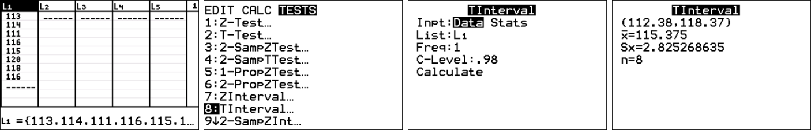
Example 1: Confidence Interval (TI-84 PLUS Continued)
We enter the data into list L1 in the data editor. Then we press
STAT and highlight the TESTS menu and select TInterval. Select Data as the input method and enter L1 in the List field, 1 in the Freq field, and 0.98 for the C-Level field. Select Calculate.
The confidence interval is (112.4, 118.4). We are 98% confident that the mean number of calories per cookie is between 112.4 and 118.4.

Slide 52
Example 2: Confidence Interval (TI-84 PLUS)
A sample of 123 people aged 18–22 reported the number of hours they spent on the Internet in an average week. The sample mean was 8.20 hours, with a sample standard deviation of 9.84 hours. Assume this is a simple random sample from the population of people aged 18–22 in the U.S. Construct a 95% confidence interval for $μ$, the population mean number of hours per week spent on the Internet by people aged 18–22 in the U.S.
Solution:
We begin by checking the assumptions. We have a simple random sample and the sample size is large (greater than 30). The assumptions are satisfied.

Slide 53


Example 2: Confidence Interval (TI-84 PLUS Continued)
We press STAT and highlight the TESTS menu and select Tinterval.
Select Stats as the input method and enter 8.2 for the $\overline{x}$ field, 9.84 for the $s$ field, 123 for the $n$ field, and 0.95 for the C-Level field. Now, select Calculate.
The confidence interval is (6.4436, 9.9564). We are 95% confident that the mean number of hours per week spent on the Internet by people 18 – 22 years old is between 6.44 and 9.96.
Remember:
$\overline{x}=8.20$
$s=9.84$
$n=123$

Slide 54

You Should Know . . .
The properties of the Student’s $t$ distribution
Why we must determine whether the sample comes from a population that is approximately normal when the sample size is small ($n≤30$)
How to construct and interpret confidence intervals for a population mean when the population standard deviation is unknown

Slide 55
Elementary Statistics 3E
William Navidi and Barry Monk

Slide 56
Confidence Intervals for a Population Proportion
Section 8.3

Slide 57
Objectives
Construct a confidence interval for a population proportion
Find the sample size necessary to obtain a confidence interval of a given width
Describe a method for constructing confidence intervals with small samples

Slide 58
Objective 1*
Construct a confidence interval for a population proportion
*(Tables)

Slide 59
Confidence Interval for a Proportion*
The National Association of Music Merchants surveyed 800 parents of children 5-18, and 632 of them said that music education has a positive effect on academic performance.
Assuming these parents to be a random sample, we would like to construct a confidence interval for the proportion of parents who believe that music education has a positive effect on academic performance.

Slide 60
Notation*
We use the following notation:
$p$ is the population proportion of individuals who are in a specified category.
$x$ is the number of individuals in the sample who are in the specified category.
$n$ is the sample size.
$\hat{p}$ is the sample proportion of individuals who are in the specified category. $\hat{p}$ is defined as $\hat{p}=\frac{x}{n}.$

Slide 61
Confidence Interval*
To construct a confidence interval, we need a point estimate. The point estimate for the population proportion $p$ is:
Point estimate: $\hat{p}=\frac{x}{n}$
We also need the standard error of $\hat{p}$. By the Central Limit Theorem for Proportions, we have:
Standard error of $\hat{p}$ =$\sqrt{\frac{\hat{p}(1−\hat{p})}{n}}$
To compute the margin of error, we multiply the standard error by the critical value:
Margin of error = $z_{α/2}∙\sqrt{\frac{\hat{p}(1−\hat{p})}{n}}$
The confidence interval is:
Point estimate $±$ Margin of error
$\hat{p}$ $±$ $z_{α/2}∙\sqrt{\frac{\hat{p}(1−\hat{p})}{n}}$

Slide 62
Assumptions*
The method for constructing a confidence interval for a population proportion requires that the sampling distribution be approximately normal. The following assumptions ensure this.
We have a simple random sample.
The population is at least 20 times as large as the sample.
The items in the population are divided into two categories.
The sample must contain at least 10 individuals in each category.

Slide 63
Example: Confidence Interval (Tables)
In a survey of 800 parents, 632 said that music education has a positive effect on academic performance. Construct a 95% confidence interval for the proportion of parents who believe that music education has a positive effect.
Solution:
We begin by checking the assumptions. We have a simple random sample. The population of parents in the United States is at least 20 times as large as the sample. The items in the population can be divided into two categories. There are 632 parents who believe that music education has a positive effect, and 800 − 632 = 168 who do not, so there are 10 or more items in each category. The assumptions are met.
Note that $n$ = 800 and $x$ = 632, so $\hat{p}=\frac{x}{n}=\frac{632}{800}=0.79$.

Slide 64
Example: Confidence Interval (Tables, Continued 1)
According to Table A.3, the critical value corresponding to a level of 95% is $z_{α/2}=1.96$.
Remember:
$\hat{p}=0.79$
$n=800$
Margin of Error: $z_{α/2}∙\sqrt{\frac{\hat{p}\left(1−\hat{p}\right)}{n}}=1.96∙\sqrt{\frac{0.79\left(1−0.79\right)}{800}}=0.028225$.
95% Confidence Interval:
$\hat{p}$ $±$ $z_{α/2}∙\sqrt{\frac{\hat{p}\left(1−\hat{p}\right)}{n}}=0.79±0.028225$ or $0.762<p<0.818$
We are 95% confident that the proportion of parents who believe that music education has a positive effect is between 0.762 and 0.818.

Slide 65
Example: Confidence Interval (Tables, Continued 2)
A 95% confidence interval for the proportion of parents who believe that music education has a positive effect is 0.762 < $p$ < 0.818. One music teacher claims that 80% of parents believe that music education has a positive effect. Does the confidence interval contradict this claim?
Since the value 0.80 is within the confidence interval, the confidence interval does not contradict the claim.

Slide 66
Objective 1**
Construct a confidence interval for a population proportion
**(TI-84 PLUS)

Slide 67
Confidence Interval for a Proportion**
The National Association of Music Merchants surveyed 800 parents of children 5-18, and 632 of them said that music education has a positive effect on academic performance.
Assuming these parents to be a random sample, we would like to construct a confidence interval for the proportion of parents who believe that music education has a positive effect on academic performance.

Slide 68
Notation**
We use the following notation:
$p$ is the population proportion of individuals who are in a specified category.
$x$ is the number of individuals in the sample who are in the specified category.
$n$ is the sample size.
$\hat{p}$ is the sample proportion of individuals who are in the specified category. $\hat{p}$ is defined as $\hat{p}=\frac{x}{n}.$

Slide 69
Confidence Interval**
To construct a confidence interval, we need a point estimate. The point estimate for the population proportion $p$ is:
Point estimate: $\hat{p}=\frac{x}{n}$
We also need the standard error of $\hat{p}$. By the Central Limit Theorem for Proportions, we have:
Standard error of $\hat{p}$ =$\sqrt{\frac{\hat{p}(1−\hat{p})}{n}}$
To compute the margin of error, we multiply the standard error by the critical value:
Margin of error = $z_{α/2}∙\sqrt{\frac{\hat{p}(1−\hat{p})}{n}}$
The confidence interval is:
Point estimate $±$ Margin of error
$\hat{p}$ $±$ $z_{α/2}∙\sqrt{\frac{\hat{p}(1−\hat{p})}{n}}$

Slide 70
Assumptions**
The method for constructing a confidence interval for a population proportion requires that the sampling distribution be approximately normal. The following assumptions ensure this.
We have a simple random sample.
The population is at least 20 times as large as the sample.
The items in the population are divided into two categories.
The sample must contain at least 10 individuals in each category.

Slide 71

Confidence Intervals on the TI-84 PLUS
The 1-PropZInt command constructs confidence intervals for the population proportion. This command is accessed by pressing STAT and highlighting the TESTS menu.
Enter the values of $x$, $n$, and the confidence level.

Slide 72
Example: Confidence Interval (TI-84 PLUS)
In a survey of 800 parents, 632 said that music education has a positive effect on academic performance. Construct a 95% confidence interval for the proportion of parents who believe that music education has a positive effect.
Solution:
We begin by checking the assumptions. We have a simple random sample. The population of parents in the United States is at least 20 times as large as the sample. The items in the population can be divided into two categories. There are 632 parents who believe that music education has a positive effect, and 800 − 632 = 168 who do not, so there are 10 or more items in each category. The assumptions are met.
Note that $n$ = 800 and $x$ = 632.

Slide 73

Example: Confidence Interval (TI-84 PLUS, Continued)
We press STAT and highlight the TESTS menu and select 1-PropZInt.
Remember:
$x=632$ $n=800$
Enter 632 in the $x$ field, 800 in the $n$ field, and 0.95 in the C-level field. Select Calculate.
The confidence interval is (0.762, 0.818).
We are 95% confident that the proportion of parents who believe that music education has a positive effect is between 0.762 and 0.818.

Slide 74
Example: Confidence Interval (TI-84 PLUS, Continued 2)
A 95% confidence interval for the proportion of parents who believe that music education has a positive effect is 0.762 < $p$ < 0.818. One music teacher claims that 80% of parents believe that music education has a positive effect. Does the confidence interval contradict this claim?
Since the value 0.80 is within the confidence interval, the confidence interval does not contradict the claim.

Slide 75
Objective 2
Find the sample size necessary to obtain a confidence interval of a given width

Slide 76
Reducing the Margin of Error
If we wish to make the margin of error of a confidence interval smaller while keeping the confidence level the same, we can do this by making the sample size larger.
Let $m$ represent the margin of error: $m$ = $z_{α/2}∙\sqrt{\frac{\hat{p}(1−\hat{p})}{n}}$. We rewrite this formula as follows by solving for $n$.
$n=\hat{p}(1−\hat{p}){\left(\frac{z_{α/2}}{m}\right)}^{2}$
This is the minimum sample size needed to attain a margin of error of size $m$. If the value of $n$ is not a whole number, round up to the nearest whole number.

Slide 77
Reducing the Margin of Error (Continued)
In order to use the formula $n=\hat{p}(1−\hat{p}){\left(\frac{z_{α/2}}{m}\right)}^{2}$, we need a value for $m$ and $\hat{p}$. We can set the value of $m$, but we don’t know ahead of time what $\hat{p}$ is going to be.
There are two ways to determine a value for $\hat{p}$.
  Use a value that is available from a previously drawn sample.
  To assume that $\hat{p}$ = 0.5, which makes the margin of error as large as possible for any sample size. In this case, the formula simplifies to $n=0.25{\left(\frac{z_{α/2}}{m}\right)}^{2}$.

Slide 78

Example 1: Finding the Sample Size
In a survey of 800 music teachers, 632 said that music education has a positive effect on academic performance. Estimate the sample size needed so that a 95% confidence interval will have a margin of error of 0.025.
Solution:
From the bottom row of Table A.3, or by technology, we see that the critical value for a 95% confidence interval is 1.96.
We compute$\hat{p}= \frac{x}{n}=\frac{632}{800}=0.79$. The desired margin of error is $m$= 0.025. The necessary sample size is
$n=\hat{p}(1−\hat{p}){\left(\frac{z_{α/2}}{m}\right)}^{2}$
= ${(0.79)(1−0.79)\left(\frac{1.96}{0.025}\right)}^{2}=1019.71$
We round up to 1020.

Slide 79

Example 2: Finding the Sample Size
We plan to sample parents in order to construct a 95% confidence interval for the proportion who believe that physical education has a positive effect on academic performance. We have no value of $\hat{p}$ available. Estimate the sample size needed so that a 95% confidence interval will have a margin of error of 0.025.
Solution:
From the bottom row of Table A.3, or by
technology, we see that the critical value
for a 95% confidence interval is 1.96.
Since we have no estimate of $\hat{p}$, use the formula $n=0.25{\left(\frac{z_{α/2}}{m}\right)}^{2}$. The desired margin of error is $m$= 0.025. The necessary sample size is
$n=0.25{\left(\frac{z_{α/2}}{m}\right)}^{2}={0.25\left(\frac{1.96}{0.025}\right)}^{2}=1536.64$
We round up to 1537.

Slide 80
Objective 3
Describe a method for constructing confidence intervals with small samples

Slide 81
Adjusted Sample Proportion $\tilde{p}$
The method presented for constructing a confidence interval for a proportion requires that we have at least 10 individuals in each category. When this condition is not met, we can still construct a confidence interval by adjusting the sample proportion a bit.
We increase the number of individuals in each category by 2, so that the sample size increases by 4. Thus, instead of using the sample proportion $\hat{p}=\frac{x}{n}$, we use the adjusted sample proportion, $\tilde{p}$.
Adjusted sample proportion
$$\tilde{p}=\frac{x+2}{n+4}$$

Slide 82
Standard Error and Critical Values
When using the small sample method, the standard error and critical value are calculated in the same way as in the traditional method, except that we use the adjusted sample proportion $\tilde{p}$in place of $\hat{p}$, and $n + 4$ in place of $n$.
The standard error becomes $\sqrt{\frac{\tilde{p}(1−\tilde{p})}{n+4}}$ .

Slide 83
Example: Small Sample Confidence Interval
In a random sample of 10 businesses in a certain city, 6 of them had more than 15 employees. Use the small-sample method to construct a 95% confidence interval for the proportion of businesses in this city that have more than 15 employees.
Solution:
The adjusted sample proportion is $\tilde{p}=\frac{x+2}{n+4}$ = $\frac{6+2}{10+4}=0.5714$. The critical value is $z_{α/2}$= 1.96.
The confidence interval is given by $\tilde{p}±z_{α/2}\sqrt{\frac{\tilde{p}(1−\tilde{p})}{n+4}}$.
We have $0.5714±1.96\sqrt{\frac{0.5714 (1−0.5714)}{10+ 4}}$ so that $0.312<p<0.831$.

Slide 84
Small-Sample Method: TI-84 PLUS
Because the only difference between the small-sample method and the traditional method is the use of $\tilde{p}$ rather than $\hat{p}$, a software package or calculator such as TI-84 PLUS can be made to produce a confidence interval using the small-sample method. Simply input $x + 2$ for the number of individuals in the category of interest, and $n + 4$ for the sample size.

Slide 85

Example: Small Sample Confidence Interval (TI-84 PLUS)
In a random sample of 10 businesses in a certain city, 6 of them had more than 15 employees. Use the small-sample method to construct a 95% confidence interval for the proportion of businesses in this city that have more than 15 employees.
Solution:
We press STAT and highlight the TESTS menu and select 1-PropZInt.
Enter 8 (which is 6+2) in the $x$ field, 14 (which is 10+4) in the $n$ field, and 0.95 in the C-level field. Select Calculate.
The confidence interval is (0.312, 0.831).

Slide 86
Advantages of the Small-Sample Method
The small-sample method can be used for any sample size, and recent research has shown that it has two advantages over the traditional method;
  The margin of error is smaller, because we divide by $n+4$ rather than $n$.
  The actual probability that the small-sample confidence interval covers the true proportion is almost always at least as great as, or greater than, that of the traditional method.

Slide 87
You Should Know . . .
How to construct and interpret confidence intervals for a population proportion
How to find the sample size necessary to obtain a given confidence interval for a population proportion of a given width where:
  An estimate of $\hat{p}$ exists
  No estimate of $\hat{p}$ exists
How to construct confidence intervals for a population proportion with small samples

